Slide 1
The Influence of Nursing Labor Support on the Reduction of Cesarean Sections
Cheryl Larry-Osman, MS, RN, CNM, CNS-C
University of Detroit Mercy
November 12, 2020

Slide 2
Project Committee
Committee Chair
Dr. Lori Glenn, DNP, CNM, RN
University of Detroit Mercy
McAuley School of Nursing
Associate Professor
Organizational Committee Member
Elikem Amable, CNM
Henry Ford Hospital
Detroit, Michigan

Slide 3
Introduction
In the United States, childbirth is the leading reason for hospitalization, with approximately 4 million women giving birth annually the majority of whom will receive care and support from a nurse.
Cesarean sections: Most common surgical procedure in US.
~33% of births in 2013
1 in every 3 women
Organizational and Regulatory Targets for C/S:
10% (Healthy People 2020)
15% per the World Health Organization (WHO)
26.2 % (California Maternal Quality Care Collaborative).
Lyndon, Simpson, Spetz, 2017; Bell, Joy, Gullo, Higgins, and Stevenson, 2017
Notes:
No “ideal” cesarean section rate, yet there are Organizational and Regulatory Targets

Slide 4
Introduction
One of the approaches to reduce cesarean birth rates is to increase the woman’s access to nonmedical interventions during labor, such as continuous labor and delivery support.
Labor support has a patient-centered focus of treating the laboring women with:
Kindness
Respect
Dignity
Cultural sensitivity
Obstetric Care Concensus No. 1, 2014; Sauls, 2004; Lawrence, et. al. (2012
Notes:
This speaks to the interventions used in nursing practice and the unique role of nurses in supporting women in labor.

Slide 5
Benefits of Normal Physiologic Birth
Short-term:
Emerging from childbirth feeling physically and emotionally healthy and powerful as mothers.
Long-term:
Beneficial side effects for the woman’s physical and mental health and capacity to mother her child/children.
Enhanced infant growth and development
Potentially diminished incidence of chronic disease.
Combined (short/long term):
Beneficial to the family and society through enhanced family functioning and cost-effective care.
Consensus, 2013

Slide 6
What is Labor Support?
The intentional human interaction between a perinatal nurse and the laboring woman that assists with positive coping during the process of labor & birth.
Recorded events in nearly all societies throughout the ages, display laboring women being helped & comforted, in a manner often referred to as “mothering the mother”.
Adams and Sauls, 2014; Sauls, 2004

Slide 7
Dimensions of Labor Support
Emotional Support | The ability to subjectively participate and share in the laboring client’s feelings (reassurance, encouragement, and guidance).
Tangible/Physical Support | The performance of tasks to meet the physical needs of the laboring client (coping techniques, use of touch, massage, heat and cold, hydrotherapy, positioning and movement).
Informational Support | A process of exchanging information to meet the learning and knowledge needs of the laboring client (childbirth educator, explanation of procedures, and shared decision making).
Advocacy | The process of interpreting the woman’s wishes during the intrapartum period and acting on her behalf to ensure the centrality of her role in decisions about her care (advocates for the mothers’ rights for health and safety through informed decision-making, self-determination, self-advocacy, anticipatory guidance, advice, and support).
Sauls, 2004; Simpkin, 2004; Butts and Rich, 2020; AWHONN, 2019

Slide 8
Benefits of Continuous Labor Support
Less likely to:
have an epidural or other “regional” analgesia.
use any type of pain medication (including narcotics).
give birth by cesarean section.
give birth by vacuum extraction or forceps.
be dissatisfied with or give a negative rating to their childbirth experience.
Benefits of:
slight reduction in the length of labor.
improved maternal satisfaction (coping during labor & level of personal control during childbirth).
medical benefits for both mom and baby.
AWHONN, 2018; CMQCC, 2016); Obstetric Care Concensus No. 1, 2014

Slide 9
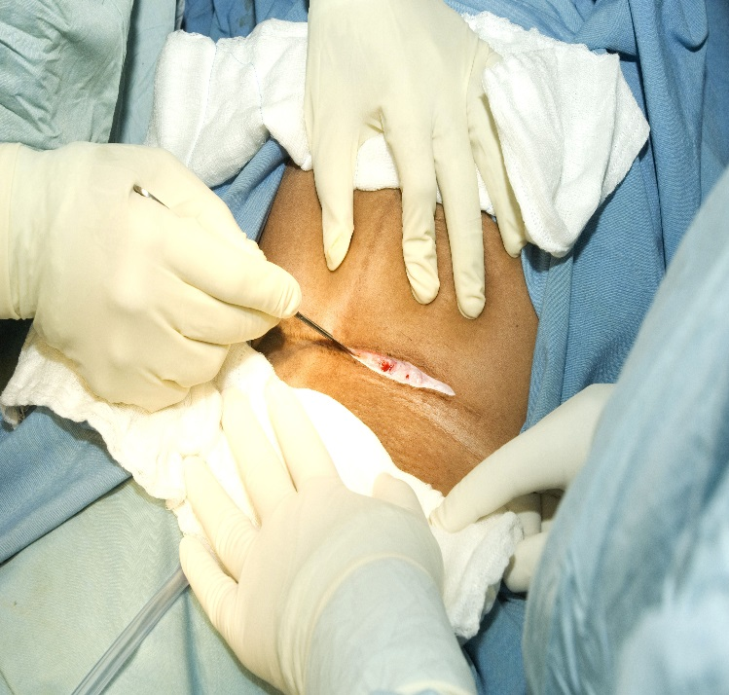
Background & Significance
Cesarean Section
Major abdominal surgery.
Risks and benefits:
Safest route of delivery for certain complex conditions (ie.,placenta previa & uterine rupture).
Potential consequences:
Surgical complications
Surgical site infections
Newborn admission to neonatal intensive care
Higher costs compared to vaginal birth.
Longer length of stay
Associated elements from the route of birth (i.e., daily room charges, medications, supplies, clinical staff, etc
More cost by the nature of the clinical procedure; thus, cost savings occur with vaginal births
CDC, National Vital Statistics Reports, 63, Number 1, 1/23/2014
Notes:
In the hospital setting, the average length of stay is 24-48 hours for a vaginal birth, and 36-96 hours for a cesarean birth.
The cost associated with each is not only reflected in the length of stay, yet also in the associated elements from the route of birth (i.e., daily room charges, medications, supplies, clinical staff, etc.).
Many insurance companies utilize a global billing system that pays the hospital one set amount to cover birth expenses (vaginal or cesarean).
Cost savings occur when appropriate care is provided, and the total amount of individually allocated patient global billing funds were not all utilized.
More cost is associated with cesarean birth by the nature of the clinical procedure; thus, cost savings occur with vaginal births.

Slide 10
Why?
The opportunity for the labor nurse to impact birth outcomes have both patient (mom/baby dyad) and financial implications.
In 2018, there were 2617 babies born at Henry Ford Hospital
Total Cesarean Section Rate: 27.5%
Nulliparous, Term, Singleton, Vertex (NTSV) Cesarean Birth Rate: 24%
Implementation of a project to increase the skill set and use of labor support techniques by the labor and delivery nurses presents an opportunity to:
reduce the NTSV cesarean birth rate & cesarean section rate
reduce costs
assess the influence birth beliefs related to birth
impact medical benefits for the maternal-newborn dyad
improve the maternal birth experience & overall outcomes

Slide 11
Clinical Questions
Population
Intervention
Comparison
Outcome
In labor nurses (P), how would increasing the knowledge of labor support skills (I) compared to traditional skills (C) influence the Nulliparous, Term, Singleton, Vertex (NTSV) & Total Cesarean Section Rate (O)?
In labor nurses (P), how would increasing the knowledge of labor support skills (I) compared to traditional skills (C) influence birth beliefs related to birth practice (O)?

Slide 12
Literature Review
Quantitative and qualitative studies, labor and delivery units in hospital settings, labor nurses included in the discussion, and women having a cesarean birth.
The literature revealed that labor nurses not only believe they can influence birth outcomes, also suggests that the use of labor support techniques can influence vaginal and cesarean birth.
Aschenbrenner, et. al. (2016), Simpson and Lyndon, (2017); Edmonds and Jones, (2013)

Slide 13
Project Purpose
Primary Objective:
Incorporate a Hands-On Labor Support Class for Labor & Delivery nurses to:
Enhance skills and knowledge of labor support techniques utilized during the first and second stage of labor.
Reduce NTSV cesarean birth rate.
Reduce Total cesarean section rate
Secondary Objective:
To compare birth beliefs of L&D nurses related to birth practice before and after attending the hands-on Labor Support Class.

Slide 14
Anticipated Benefits
Patient | Enhanced birth experience using labor support techniques and having a vaginal birth in the presence of non- clinical factors.
Nurse | Increased knowledge of labor support techniques, improved communication with patients, providers, and peers.
Hospital | Cost savings related to billing for a vaginal birth versus cesarean birth.
Overall | To enhance the maternal, newborn, family, and clinician birth experience and outcomes.
Consensus, 2016; Bell, Joy, Gullo, Higgins, and Stevenson, 2017; Aschenbrenner, et al., 2013; Bell, Joy, Gullo, Higgins, and Stevenson, 2017; CMQCC, 2016; Concensus, 2016

Slide 15
Theoretical Framework
The Theory of Planned Behavior (TPB) was selected to explore the links between beliefs of labor nurses and their birth practice behavior
TPB is a social behavior theory developed by Icek Ajzen in 1985.

Slide 16
Theoretical Framework
Improved on the Theory of Reasoned Action (TRA) Ajzen co-developed with Martin Fishbein in 1980.
TRA predicts an individual’s intention to engage in a behavior based on the concepts of attitude and subjective norms.
TPB adds a 3rd influencing factor called the perceived behavioral control, which improved the predictability of the model.

Slide 17
Theory of Planned Behavior (TPB)
The cornerstone of TPB is on the relationship between behavior and beliefs, attitudes, subjective norms, and intentions.
Beliefs about any given behavior are the prevailing determinants about of a person’s intentions and actions.
Links an individual’s personal beliefs as predictors of their behavior, and answers the question:
“Why do we do what we do and act the way we act?”
Ajzen, 1991
Notes:
The Labor and Delivery nurse incorporates decision making into birth experiences with every mother.
Guiding each decision is a set of beliefs related to birth practice, which if identified, may lead to improvement in subsequent birth practice and improved maternal/fetal outcomes. (Adams and Sauls, 2014)

Slide 18
Theory of Planned Behavior
Ajzen, 1991

Slide 19
TPB Concepts
Behavioral Beliefs
Identifies an individual’s Attitude as reflected in beliefs regarding the degree to which a positive or negative value is placed on the behavior.
Normative Beliefs
Influence Subjective Norms and refers to a person’s belief that peers or significant others will approve or disapprove the behavior.
Control Beliefs
Refers to a person’s belief of their ability (ease/difficulty) to perform a given behavior (Perceived Behavioral Control).
“What do I think about the behavior?”
Conceptually related to the concepts of self-efficacy or self-confidence.
“What do others think about the behavior?”
“Can I do it?”
Notes:
Behavioral Beliefs: For example, a Labor and Delivery nurse may choose to incorporate upright positioning during labor because of the belief regarding the physiologic benefits of gravity to aid in fetal decent
Normative Beliefs: For example, when incorporating upright positioning to enhance the physiologic benefits of gravity, the labor and delivery nurse may suggest ambulation. However, past negative experiences with colleagues not approving out-of-bed positions may cause doubt in one's personal beliefs.
Control Beliefs: For example, the Labor and Delivery nurse must have a strong sense of self-confidence when incorporating ambulation as an upright position during labor.

Slide 20
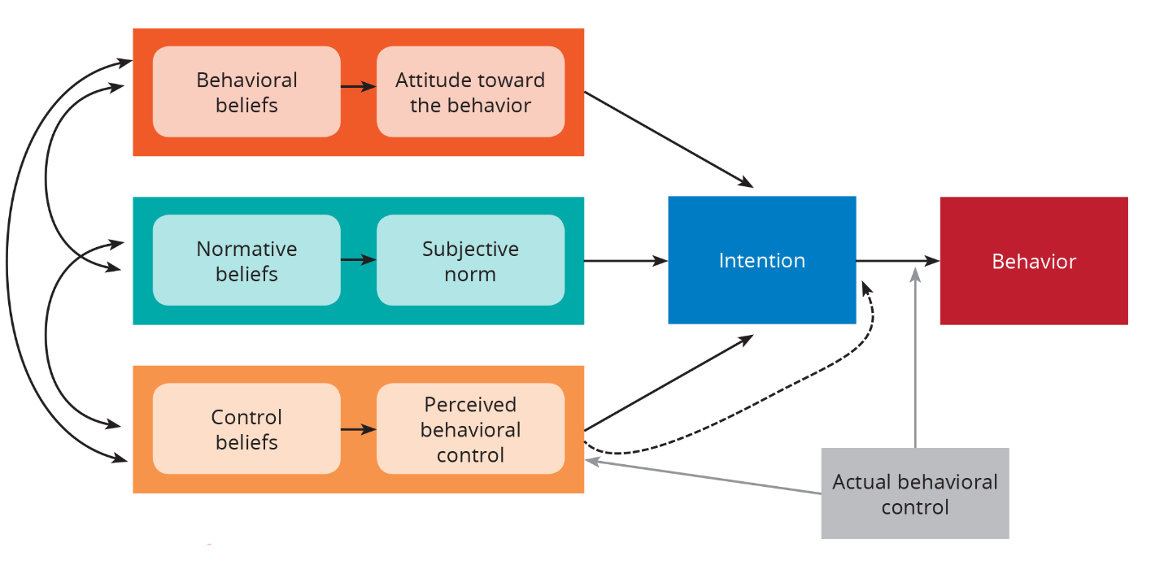
TPB Concepts
Actual Behavioral Control
Refers to the extent to which a person has the skills and resources necessary to perform the behavior in question and elicits the self-confidence that:
“I can do it”

Slide 21
Organizational Assessment
Patient Volume: Approximately 9900+ pregnant patients present annually to Henry Ford Hospital Labor and Delivery: 1/3 are admitted for birth (~2600/yr) after being evaluated in Triage, and the remaining 2/3 are discharged.
Unit Design: 12 Labor, Delivery, Recovery beds (LDR), 5-bed triage, 2 operating rooms, 2-bed recovery room.
Patients: Normal/low-risk pregnancies, as well as with complex/high-risk maternal and fetal conditions.
Patient population: drawn largely from the surrounding urban geographical location and consists of African American, Hispanic, Caucasian, Middle Eastern (primarily Arab and Bengali).
Language access services available.

Slide 23
Project Description
The method will be an interactive hands-on labor support class aimed at merging:
Contextual (mind) learning focusing on “why” & “when”.
Kinesthetic (hand/body) learning focusing on “what” & “how”.
The overall all process improvement strategies will enhance/clarify current knowledge, develop new techniques, provide latest information, and increase confidence in the care of laboring women thus influencing birth outcomes and impacting:
Nulliparous, Term, Singleton, Vertex (NTSV) Cesarean Birth Rate
Total Cesarean Section Rate

Slide 24
Project Design
The project will be of a descriptive mixed-method design.
Quantitative outcomes will include the following pre- and post-information:
Data x 2-months of the total cesarean section rates.
Date x 2-months of the nulliparous, term, singleton, vertex (NTSV) cesarean birth rate.
28 items from the survey tool titled “Intrapartum Nurse’s Beliefs Related to Birth Practice” (IPNBBP).
Qualitative measures from the IPNBBP tool include 2-open ended questions about the individual nurses’ beliefs related birth practice.
Anova repeated measures for C/S and NTSV Rates
Notes:
Formula: Number of cesarean sections divided by total number of births
Formula: Number of NTSV cesarean sections divided by the total number NTSVs

Slide 25
Outcome Measures
After the labor support class intervention evaluate:
NTSV C/S rate.
Total C/S rate.
Nurse beliefs related to normal birth in comparison to medicalized birth.

Slide 26
Survey Tool: Intrapartum Nurse’s Beliefs Related to Birth Practice
Author Ellise D. Adams, PhD, CNM (Permission granted 6/3/2019) Compares medicalized birth and normal birth beliefs. (~15 mins to complete)
Section 1 | Includes non-identifiable demographics, nursing education and certification, intrapartum nurse experience, & current work environment.
Section 2 | Includes 28 quantitative items with two Sub-Scales which identify birth beliefs R/T: Medicalized Birth: 11 items measuring the concept. (Score range 11-33) Normal Birth: 17 items measuring the concept. (Score range 68-102)
Section 3 | Includes 2 qualitative items consisting of open-ended questions to allow the labor nurse to express their beliefs related to birth practice in a narrative manner. According to my birth beliefs related to birth practice, the birth process is... According to my birth beliefs related to birth practice, my role as an intrapartum nurse in the birth process is…

Slide 27
Data Collection & Tools/Instrument
Survey Tool:
Intrapartum Nurse’s Beliefs Related to Birth Practice (IPNBBP)
Author, Ellise D. Adams, PhD, CNM
Compares:
Medicalized birth beliefs: labor & birth must occur in a clinical setting, continuous fetal/uterine monitoring, birth is a pathological process where complication can be catastrophic & interventions needed to prevent them.
Normal birth beliefs: birth is a physiologic life event & unique to each laboring woman, process not bound by time & parameters, variety of setting (birth center/home), can be spontaneous, variety of birth attendants, supportive environment, trust birth process, promote normal birth, technology not always necessary, use liberal labor support techniques.
Funding Source:
2018-2019: Henry Ford Hospital Nurses’ Research Grant Award, $900
Supplies: Birth balls, peanut balls, robozo, labor support training
Incentive to Participate
Labor nurses were offered the option to enter a drawing for a $25 Visa gift card.
A total of eight $25 gift cards were awarded during the study period.

Slide 28
IPNBBP Survey Tool
Setting:
Pre-survey: Henry Ford Health System Simulation Center, Detroit, Michigan (prior to labor support class)
Post-survey: Henry Ford Hospital, Labor and Delivery Unit and the High-Risk Pregnancy Unit, Detroit, Michigan (during shift)
Sample:
Convenience sample of 75 Labor & Delivery RNs at Henry Ford
Hospital who attended a labor support class during the study period.
Sample Period:
Pre-intervention: 6/25/2019, 7/2/2019, 7/9/2019, 7/23/2019, 8/20/2019, 12/10/2019 (6-classes)
Post-intervention: March 1, 2020 – March 31, 2020

Slide 29
IPNBBP Survey Tool
Inclusion Criteria:
HFH L&D RNs who attended a Labor Support Class.
Exclusion Criteria:
HFH L&D RNs who did not attend a Labor Support Class.
Participation:
Voluntary participation by completion of the survey.
Completion of the survey is considered agreement to participate.
Opt-Out:
Participants could opt-out at any time without repercussions nor impact on employment status.

Slide 30
Additional Maternal Child Health Labor Support Presentations
OBGYN Senior Staff Meeting, Henry Ford Hospital (20 minutes)
OBGYN Resident Education, HFH, 8/28/2019 (30 minutes)
Obstetric Technician Education, 11/26/2019, 30-minutes.
Women’s Health Services Grand Rounds, Henry Ford Hospital, One Ford Place: MD/DO/CNM/RN, 12/4/2019 (15 minutes)

Slide 31
Intervention: Interactive Hands-on Labor Support Class
Primary Facilitator:
PI-primary content developer/instructor/facilitator (Author: Cheryl Larry-Osman, MS, RN, CNM, CNS)
Co-facilitators:
Wendy Mackenzie, MScN, RNC, Unit Educator, Labor & Delivery Unit
Mesha Farrington, BSN, RNC-MNN, Unit Educator, Mother Baby Unit
Katherine Balten, MSN, RN, AGCNS-BC, HN-BC, Clinical Nurse Specialist, Mother Baby Unit
Class Format:
Bridge kinesthetic and contextual learning.

Slide 32
Intervention: Interactive Hands-on Labor Support Class
RN Goal:
To enhance the knowledge & confidence of labor and delivery nurses performing labor support
To increase nursing satisfaction in the care of laboring women.
To strengthen labor nurses as the primary “staff-person” influencers incorporating labor support techniques into care during childbirth.
To enhance labor support techniques that impact nurse-patient communication, nurse-provider communication, and nurse-nurse communication.
Patient Goal:
To increase the woman’s access to nonmedical interventions during labor, as provided by continuous labor and delivery support
To reduce the risk of a cesarean birth.
To increase patient satisfaction in the birth experience.

Slide 33
Labor Support Class Content
8-hour paid workday for RN attendance at labor support class.
Hospital financial investment
Staff survey: Intrapartum Nurse’s Beliefs Related to Birth Practice
Labor Support and Management Lecture
Define labor management & communication
Discuss approaches to supporting women in labor
Discuss alternative/complementary therapies for pregnancy and childbirth.
Video: Hill Rom Birth Bed Positioning
HFH Comfort Menu Lecture
Aromatherapy, music therapy, coloring, books, playing cards, essential oils, spiritual care, pet therapy, ear plugs/eye masks, heat/cold, personal care items
Coping Scale Lecture
Handouts
AWHONN Continuous Labor Support
Positions for laboring out of bed
Birth positions
Respectful maternity care
Labor Support articles

Slide 34
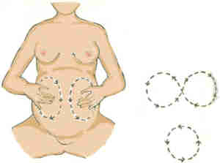
Hands-on Techniques
Maternal positioning in and out of birthing bed
Breathing techniques
Peanut balls
Birthing balls
Aromatherapy (4-essential oils)
Music therapy
Massage
Ambulation
Hydrotherapy (shower/tub)
Robozo
Delayed pushing in the second stage of labor
Use of the coping scale in assessing discomfort in labor
Birth Affirmations
What is YOUR WHY?
KINESTHETIC LEARNING
Notes:
Highlight Kinesthetic Learning

Slide 35
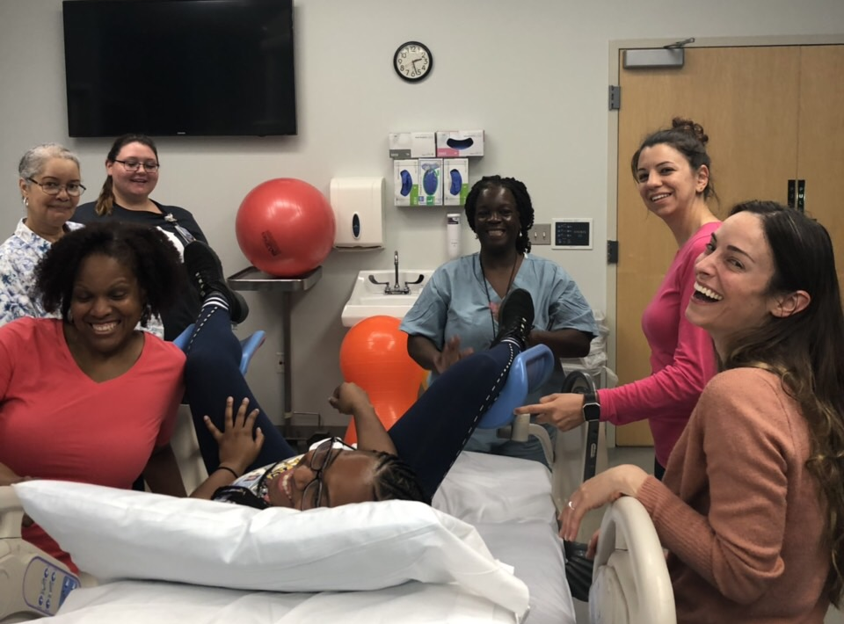
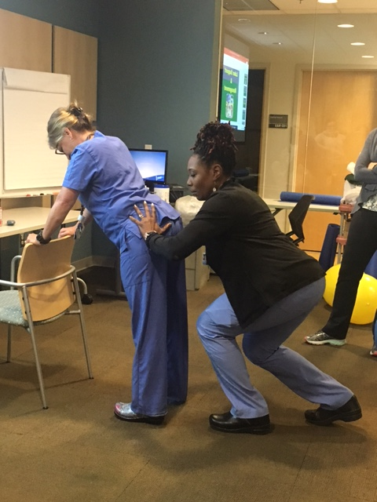
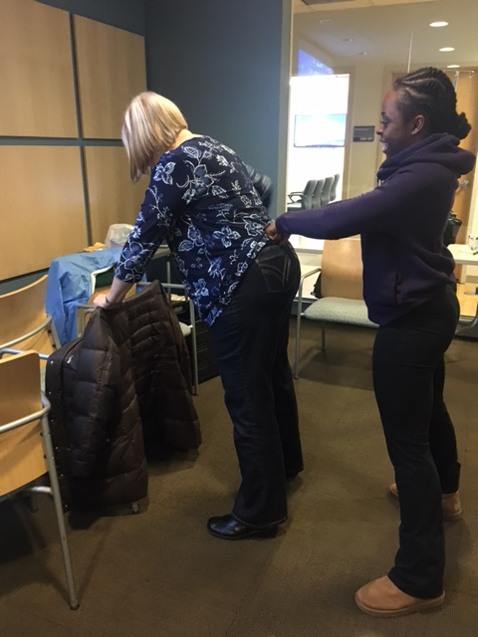
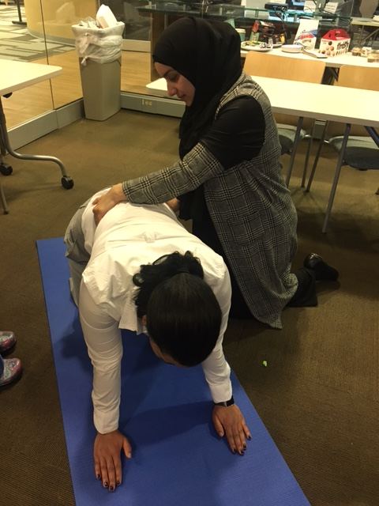

Slide 36
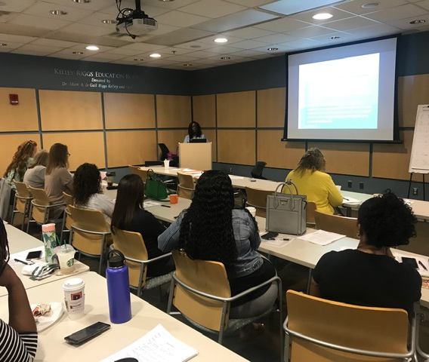
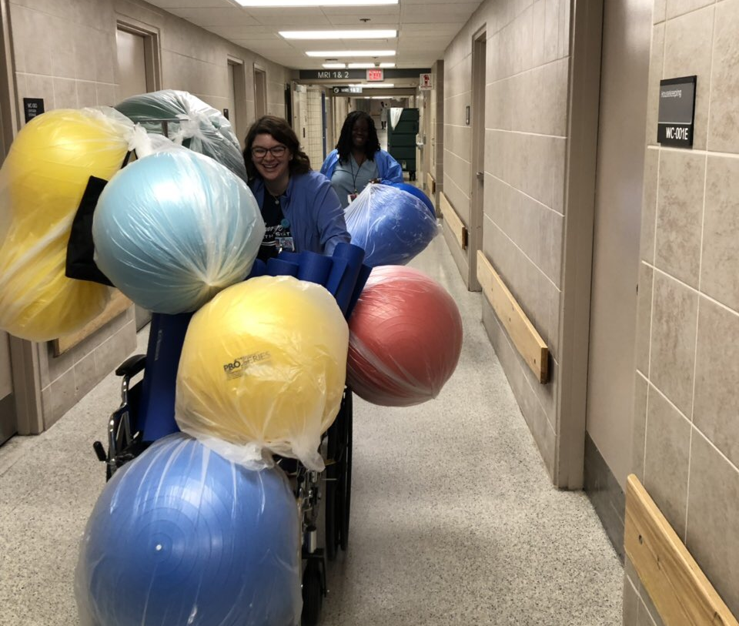
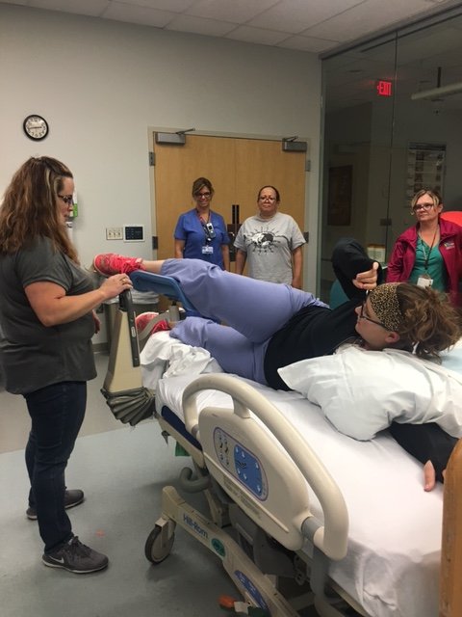

Slide 37
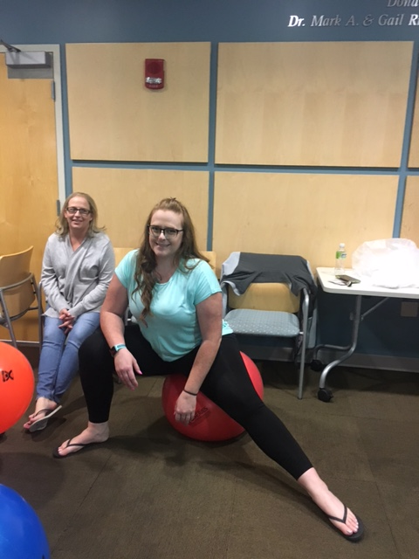
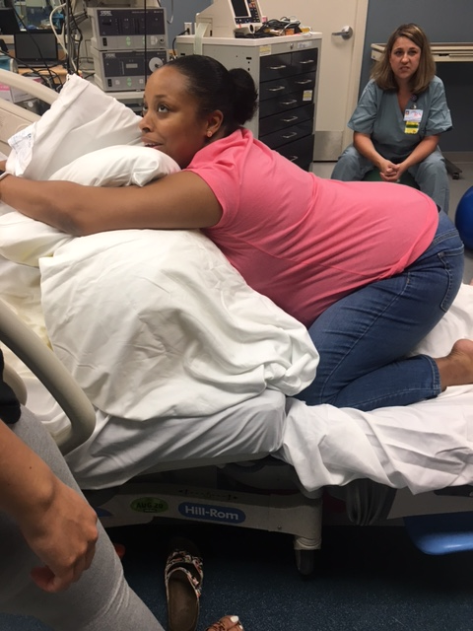
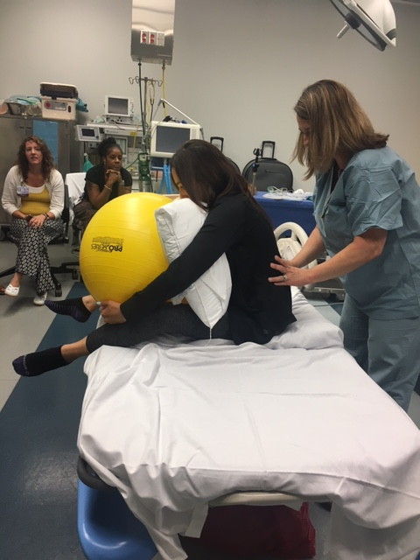
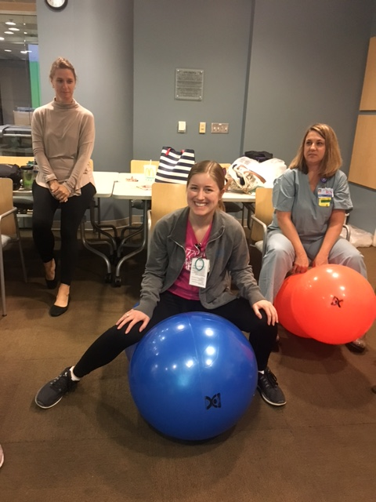

Slide 38
Results: Section 1 IPNBBP Survey Quantitative Data

Slide 39
Demographics
Variable |  | Pre (N=69) | Post (N=34)
Age | (20-69 years) | 37.93 | 37.15
Race | White | 44 (63.77%) | 23 (67.65%)
 | Black | 15 (21.74%) | 7 (20.59%)
 | Hispanic | 0 | 0
 | American Indian | 1 (1.45%) | 0
 | Pacific | 1 (1.45%) | 0
 | Two or More | 3 (4.35%) | 2 (5.88%)
 | Other | 4 (5.80%) | 5 (5.88%)
Method of Birth | Vaginal | 34 (49.28%) | 17 (50%)
 | Cesarean Section | 9 (13.04%) | 6 (17.65%)
 | Forceps | 2 (2.90%) | 1 (2.94%)
 | Vacuum | 2 (2.90%) | 0
 | N/A | 27 (39.13%) | 14 (41.18%)

Slide 40
Demographics
Variable |  | Pre (N=69) | Post (N=34)
Location of Birth | Home | 2 (2.9%) | 0
 | Hospital | 39 (56.52%) | 20 (58.82%)
 | Birth Center | 2 (2.90%) | 0
 | N/A | 26 (37.68%) | 14 (41.18%)
 | Other | 0 | 0
Opinion of Birth Experience | Positive | 35 (50.72%) | 15 (44.12%)
 | Negative | 13 (18.84%) | 6 (17.65%)
 | No Opinion | 1 (1.45%) | 0
 | N/A | 26 (37.68%) | 15 (44.12%)
 | Other | 1 (1.45%) | 0
Years as Labor Nurse | ( 1month-45 years) | 7.53 | 8.52

Slide 41
Demographics
Variable |  | Pre (N=69) | Post (N=34)
Education | PhD/DNP/Doc Prac | 0 | 0
 | MSN | 3 (4.35%) | 3 (3.82%)
 | Masters | 1 (1.45%) | 1 (2.94%)
 | BSN | 45 (65.22%) | 26 (76.47%)
 | Associates | 22 (31.88%) | 8 (23.53%)
 | Diploma | 4 (5.80%) | 0
 | Other | 2 (2.90%) | 0
Certifications | EFM | 32 (46.38%) | 20 (58.82%)
 | Intrapartum | 15 (21.74%) | 6 (17.65%)
 | Birth Education | 8 (11.60%) | 1 (2.94%)
 | Midwifery | 1 (1.45%) | 1 (2.94%)
 | CNS/CNP | 0 | 0
 | Doula | 1 (1.45%) | 0
 | Certified NA | 14 (20.29%) | 0
 | Certification Other | 2 (2.90%) | 0

Slide 42
Intrapartum Nurse Experience (30 elements)
Elective inductions of labor
Augmented labors
Cesarean birth
Elective cesarean birth
Epidural anesthesia
Unmedicated vaginal birth
Forceps delivery
Vacuum extraction
Episiotomy
Ambulation for labor
Continuous fetal monitoring
Intermittent fetal monitoring
Laboring down
Birth plans
Use of closed glottis pushing
Use of open glottis pushing
Doulas
Use of breathing & relaxation techniques
Hydrotherapy
Water birth
Encouraging upright positioning during labor & birth
Certified nurse midwives
Certified midwives
Certified professional midwives
Lay midwives
Obstetricians
Family physicians
OB medical students & residents
Freestanding birth centers
Home birth

Slide 43
Intrapartum Nurse Experience
% Increase
2.9%
2.86%
4.35%
=
5.8%
3.5%
2.73%
 | Labor Support Class Items | Pre (N-69) | Post (N-34)
1. | Unmedicated Vaginal Birth | 67 (97.10%) | 34 (100%)
2. | Ambulation for Labor | 65 (94.2%) | 33 (97.06%)
3. | Intermittent fetal monitoring | 66 (95.65%) | 34 (100%)
4. | Laboring Down | 69 (100%) | 34 (100%)
5. | Use of breathing & relaxation techniques | 65 (94.2%) | 34 (100%)
6. | Hydrotherapy | 26 (37.68% | 14 (41.18%)
7. | Encouraging upright positioning during labor & birth | 59 (85.51%) | 30 (88.24%)

Slide 44
Results: Section 2 IPNBBP Survey Quantitative Data

Slide 45
Quantitative IPNBBP Survey
Variable | P-value
Total Score | 0.3209
Medicalized Birth Scores | 0.0510 | No significant statistical difference (marginal significance noted)
Normal Birth Scores | 0.5439 | No significant statistical difference

Slide 46
Score Distribution: Medicalized Birth Beliefs
 | Variable | N Obs | Mean | Minimum | Maximum
Pre-Intervention | Medicalized | 69 | 50.59 | 33.00 | 66.00
Post-Intervention | Medicalized | 34 | 47.62 | 30.00 | 65.00
Medicalized Birth Beliefs score range for IPNBBP tool (11-33)
Pre-intervention average score for medicalized birth beliefs is 50.59, with a range of 33-66.
Based on the labor support tool, this range does not indicate that the IP nurse’s beliefs are more closely associated with the elements of medicalized birth.
Post intervention, the average score goes down slightly for medicalized birth beliefs, with a range of 30-65.
The difference between the pre- and post-intervention is marginally significant.

Slide 47
Score Distribution: Normal Birth Beliefs
 | Variable | N | Mean | Minimum | Maximum
Pre-Intervention | Normal | 69 | 84.13 | 29.00 | 102.00
Post-Intervention | Normal | 34 | 86.06 | 73.00 | 100.00
Normal Birth Belief score range for IPNBBP tool 68-102.
The average score goes slightly up from pre (84.13) to post (86.06).
A big change in the range from pre (29-102) to post (73-100).

Slide 48
Data Analysis Results Quantitative Score Distribution
Tool Range
Normal Birth
68-102
Tool Range
Medicalized Birth
11-33
Participant
Range
Participant
Mean score
Notes:
Tool Range: For scoring, items indicating medicalized birth beliefs must be reversed. The range of possible scores is 28-168.
Medicalized birth beliefs
Tool Range: For the sub- scale of birth beliefs related to medicalized birth, a score ranging from 11-66 is possible.
Pre: 50.59, with a participant range of 33-66. This is above tool range for medicalized birth beliefs.
Post: 47.62, with a range of 30-65. This is mostly above tool range for medicalized birth beliefs.
Post intervention, the average score goes down slightly for medicalized birth beliefs to.
The difference between the pre- and post-intervention is marginally significant.
Normal Birth
Tool Range: 68-102
The average score goes slightly up from pre (84.13) to post (86.06).
A big change in the range from pre (29-102) to post (73-100).

Slide 49
Results: Section 3 IPNBBP Survey Qualitative Data
According to my birth beliefs r/t birth practice, the birth process is:
According to my birth beliefs r/t birth practice, my role as an intrapartum nurse in the birth process is:

Slide 50
Results Section 3 IPNBBP PRE-Survey Data Qualitative Data Responses Questions
Top 5 Themes:
Support
Safety
Normal/Natural Birth/Teach/Educate
Families
Advocacy
Notes:
Qualitative Questions
According to my birth beliefs related to birth practice, the birth process is:
According to my birth beliefs related to birth practice, my role as an intrapartum nurse in the birth process is:

Slide 51
Results Section 3 IPNBBP POST-Survey Data Qualitative Data Responses Questions
Top 5 Themes:
Safety
Support
Helping
Normal/Natural Birth
Teach/Educate

Slide 52
Top 5 Pre/Post Themes
Support (89)
Safety (73)
Natural/normal (48)
Teach/educate (47)
Helping (35)

Slide 53
Staff Responses About Birth
“Coach, encourage, educate, support and advocate for the safety and well being of both mom and baby”.
“Be flexible, understanding, and supportive since each birth process is unique, you must be able to adopt with patient’s needs/preferences while keeping both the mother and baby’s safety your first priority”.
“They should be treated with the same kindness and compassion that a loved one would be treated with and creativity must be used to facilitate interventions that will aid the birthing process”.
“To support, care, educate, counsel, help, do anything I can to make this (labor, birth, recovery) process as easy, understandable”.

Slide 54
Results: Quantitative Total Cesarean Section Rate NTSV Cesarean Section Rate

Slide 55
Results-Quantitative Total C/S & NTSV C/S Rate
% Difference Pre-Post
Total C/S 3.9% higher NTSV C/S 1% Lower
 | Pre-Intervention |  | Post-Intervention
 | April 2019 | May 2019 | Jan 2020 | February 2020
Total Deliveries | 197 | 250 | 218 | 201
Total C/S Rate | 27.9%(n=55) | 29.2% (n=73) | 26.1% (57) | 32.8% (66)
Average C/S Rate | 28.55% |  | 32.45%
NTSV C/S Rate | 24% | 19% | 29% | 12%
Average NTSV Rate | 21.5% |  | 20.5%

Slide 56
Clinical Implication Barriers Sustainability Conclusion

Slide 57
Clinical Implications: Survey
Medicalized Birth:
The difference between the pre- and post- intervention is marginally significant for medicalized birth.
The range DOES NOT indicate that the intrapartum (L&D) nurse’s beliefs are more closely associated with the elements of a medicalized birth.
Normal Birth:
Overall, the nurses beliefs (pre & post) are more closely associated with elements of a normal birth.
The post survey results significantly changed to fall more narrowly within the range of normal birth.
Notes:
The difference between the pre- and post- intervention is marginally significant for medicalized birth.
The range DOES NOT indicate that the intrapartum (L&D) nurse’s beliefs are more closely associated with the elements of a medicalized birth.
In comparison to pre-survey responses, the scores for normal birth significantly changed to focus as all scores were within the range for close association with normal birth.

Slide 58
Data Analysis Results Quantitative Score Distribution
102
100
Tool Range
Normal Birth
68-102
Tool Range
Medicalized Birth
11-33
73
Participant
Range
Participant
Mean score
29
Notes:
Tool Range: For scoring, items indicating medicalized birth beliefs must be reversed. The range of possible scores is 28-168.
Medicalized birth beliefs
Tool Range: For the sub- scale of birth beliefs related to medicalized birth, a score ranging from 11-66 is possible.
Pre: 50.59, with a participant range of 33-66. This is above tool range for medicalized birth beliefs.
Post: 47.62, with a range of 30-65. This is mostly above tool range for medicalized birth beliefs.
Post intervention, the average score goes down slightly for medicalized birth beliefs to.
The difference between the pre- and post-intervention is marginally significant.
Normal Birth
Tool Range: 68-102
The average score goes slightly up from pre (84.13) to post (86.06).
A big change in the range from pre (29-102) to post (73-100).

Slide 59
Clinical Implications: Intrapartum Nurse Experience Results
Items included in the INPBBP Tool & Labor Support Class
Unmedicated vaginal birth
Ambulation in labor
Intermittent fetal monitoring
Laboring down
Use of breathing & relaxation techniques
Hydrotherapy
Encouraging upright positioning during labor & birth.
Experience with all items, except for laboring down, increased 2.73%-5.8% comparing pre- and post-intervention.
Notes:
Variables relate to the experiences of the IP nurse more closely aligned with labor support techniques show an increase in of approximately 4% (range: 2.73%-5.8%) in comparison of pre- and post-intervention.
Unmedicated vaginal birth, ambulation in labor, intermittent fetal monitoring, laboring down (same), use of breathing & relaxation techniques, hydrotherapy, encouraging upright positioning during labor & birth.
Answer PICO questions more formally?

Slide 60
Clinical Implications: NTSV Cesarean Birth & Total Cesarean Section Rate
NTSV cesarean rate decreased by 1%
Total C/S rate increased by 3.9%
It takes time & continued evaluation to see changes.
Ongoing education of entire clinical team.

Slide 61
Barriers/Limitations
COVID-19 Impact
Post intervention survey
C/S data collection
NTSV cesarean birth data collection
Data analysis pause due to biostats critical focus on COVID-19 research
Length of time to complete survey
Inability to provide an electronic survey (IT barriers)
Pre & post participation as aggregate data (Limitations)
Notes:
Aggregate data collection
Tool can be used either way

Slide 62
Sustainability
Continuing to track total C/S and NTSV cesarean birth rates
Annual RN Staff Education: The plan is to use the content of the labor support course for future annual nursing skills fairs
New Hire Orientation: Include the updated information from the project in new hire RN orientation classes for Henry Ford Health System labor nurses.
Childbirth Education (CBE) Class Instructors: The instructors for the HFHS Childbirth Education Classes are some of the labor nurses included in the project. The labor support techniques taught in the class can be utilized to enhance the education provided to parents in the CBE Class.
Labor Support Grant: Modeled after the authors project, HFHS received a $5000 grant from the Obstetrics Initiative (OBI) to provide labor support education/training for the health system.
Conference presentations
Journal Publication

Slide 63
Impact
Obstetrics Initiative (OBI) is a Collaborative Quality Initiative (CQI) funded by Blue Cross Blue Shield of Michigan/Blue Care Network. It is comprised of 75 Michigan maternity hospitals.
The first initiative is supporting physiologic vaginal birth and safely lowering the cesarean delivery rate among low-risk (for cesarean delivery) patients.
The author’s project is being used as the foundation to develop Labor Support Toolkit for the 75-participating birthing in the state of Michigan.
Planning/Development: Q3/Q4 2020
Go-live, Q1 2021
Train the trainer (CNS’s, Educators, Childbirth Instructors, Experienced RNs, etc.)
Exploring use of data collection tool, such as INPBBP Survey (undecided)
Phase 1: Pre-learning: What is Labor Support/RN Role? (self directed learning)
Phase 2: Facilitated virtual class: What/Why Labor Support?
Phase 3: Facilitated Hands-on Labor Support Techniques at individual sites: How?

Slide 64
Conclusion
A personal set of beliefs related to birth practice establishes accountability to peers, patients, and society at large while also providing meaning to the work of the perinatal nurse within the context of the birth environment.
Labor support education and training can:
increase nurse beliefs related to normal birth in comparison to medicalized birth.
enhance the maternal, newborn, family, and clinician birth experience and outcomes.

Slide 65
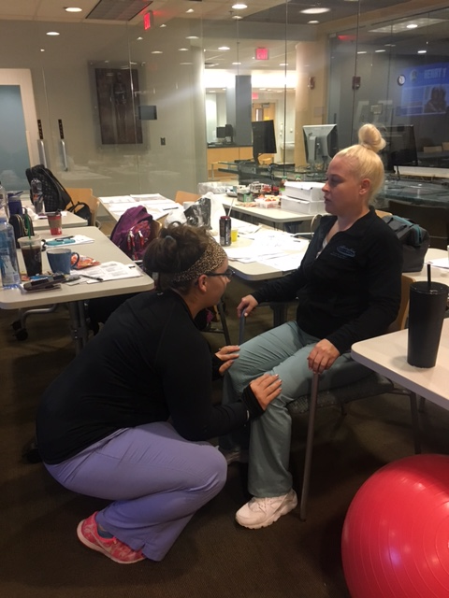
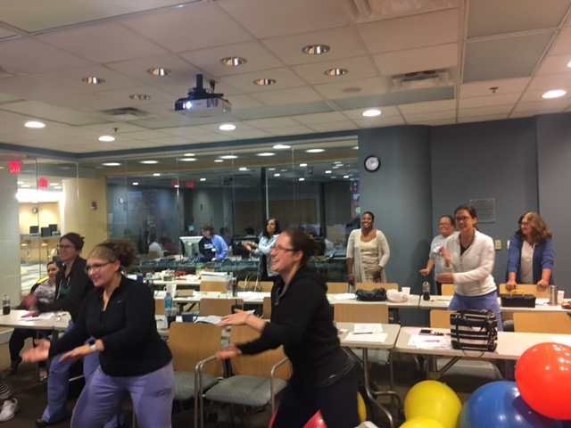
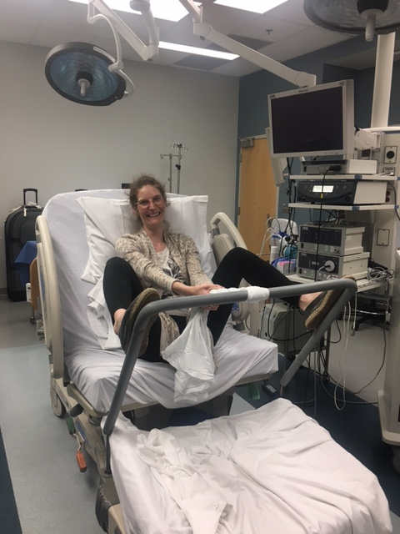
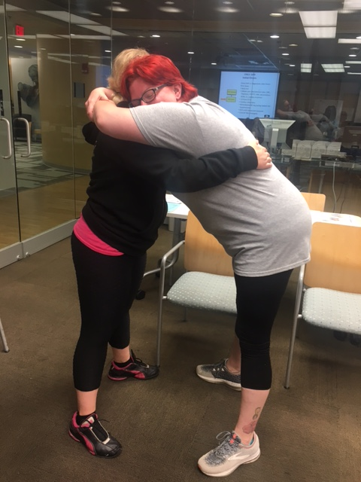
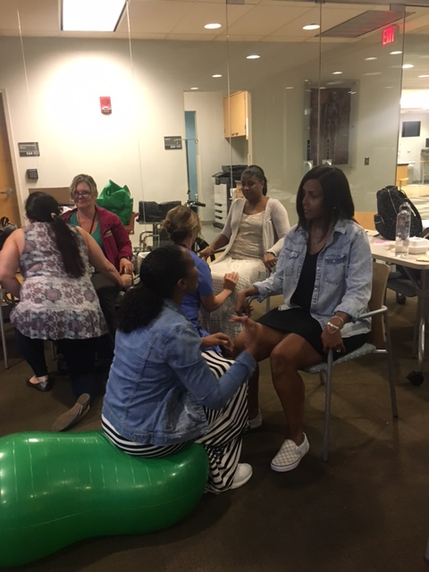
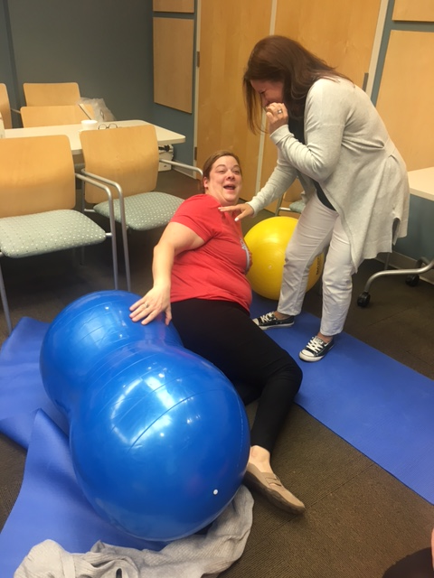

Slide 66
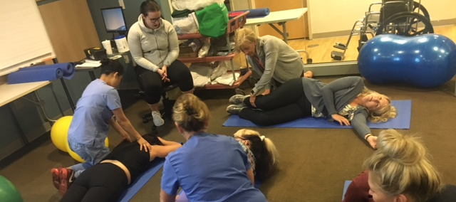
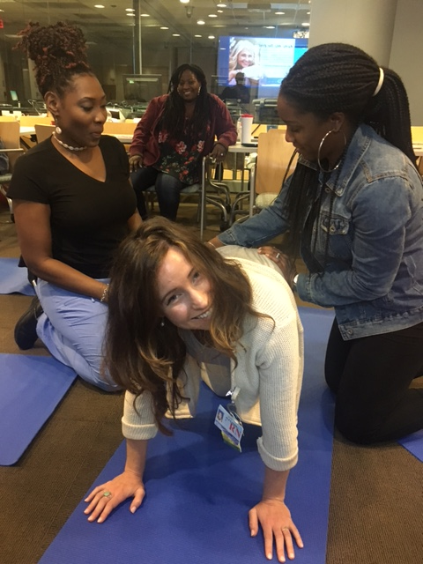
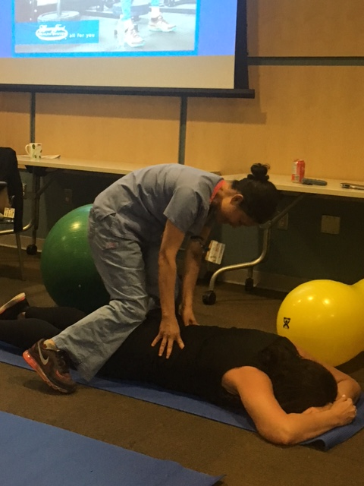
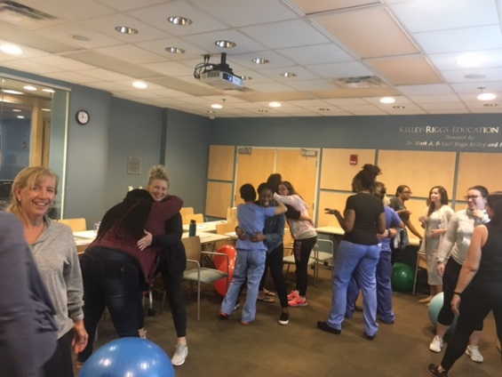

Slide 67
References
Adams, E. (2017). Workplace challenges: the impact of personal beliefs and the birth environment. JPNN, 31 (1), 20-31.
Adams, E., and Sauls, D. (2014). Reliability and validity of an instrument to measure the beliefs of intrapartum nurses. JPNN, 28(2), 127-134.
Adams, E., and Sauls, D. (2014). Development of the intrapartum nurses’ beliefs related to birth practice scale. J Nurs Meas., 22, 1-10.
Ajzen, I. (1991). The theory of planned behavior. Organizational behavior and human decision processes, 50, 179-211.
Aschenbrenner, A.P., Hanson, L, Johnson, T. S., Kelber, S.T. (2016). Nurses’ own birth experiences influence labor support attitudes and behaviors. JOGNN, 45, 491-501.
Association of Women’s Health, Obstetric and Neonatal Nurses. (2018). Position statement: continuous labor support for every woman. JOGNN, 47, 73-74.
Association of Women’s Health, Obstetric and Neonatal Nurses. (2019). Standards for professional nursing practice in the care of women and newborns (8th ed.). Washington, DC: Author.
Bell, D. B., Joy, S., Gullo, S., Higgins, R., and Stevenson, E. (2017). Implementing a Systematic Approach to Reduce Cesarean Birth Rated in Nulliparous Women. Obstetrics and Gynecology, 130 (5), 1082-1089.
Butts, J., and Rich, K. (2020). Nursing ethics: across the curriculum and into practice. (5th Ed). Jones and Bartlett.
California Maternal Quality Care Collaborative (CMQCC): Toolkit to support vaginal birth and Reduce Primary Cesarean. (2016).
Center for Disease Control and Prevention (CDC), National Vital Statistics Reports, Volume 63, Number 1, Primary Cesarean Delivery Rates, by State: Results from Revised Birth Certificate, 2006-20012. 1/23/2014.
DiGiovanni, L. (2010). Ethical issues in obstetrics. Obstet Gynecol Clin N Am, 37, 345-357.
Edmonds, J.K., and Jones, E.J. (2013). Intrapartum nurses’ perceived influence on delivery mode decisions and outcomes. JOGNN, 42, 3-11.
Gams, B., Neerland, C., Kennedy, S. (2018). Reducing primary cesareans: an innovative multipronged approach to supporting physiologic labor and vaginal birth. JPNN, 33 (1), 52-60.
Glenn, L., Stocker-Schnieder, J., McCune, R., McClelland, M., and King, D. (2014). Caring nurse practice in the intrapartum setting: nurse’s perspectives on complexity, relationships and safety. JAN, 70 (9), 2019-2030.
Lawrence. H., Copel, J., O’Keeffe, D., Bradford, W., Scarrow, P., Kennedy, H., Grobman, W., Johnson, C., Simpson, K., Lyndon, A., Wade, K., Peddicord, K., Bingham, D., and Olden, C. (2012). Patient Safety Series. Quality patient care in labor and delivery: a call to action. AJOG.
Lyndon, A., Simpson, K., Spetz, J. (2017). The analysis of US stakeholder views on the influence of labour nurses’ care on birth outcomes. BMJ Qual Saf. 26, 824-831.
Northhouse, P.G. (2016) Leadership: Theory and Practice (7th ed). Thousand Oaks, CA: Sage Publications.
Peters, R., and, Templin, T. (2010). Theory of planned behavior, self-care motivation, and blood pressure self-care. Res Theory Nurs Pract., 24(3), 172-186.
Safe Prevention of the primary cesarean delivery. (2014). Obstetric Care Concensus No1. American College of Obstetrician and Gynecologists. Obstetrics and Gynecology, 123, 693-711.
Sauls, D. The labor support questionnaire: development and psychometric analysis. (2004). J Nurs Meas., 12 (2), 123-132.
Simpson, K. R., and Lyndon A. Labor nurses’ views of their influence on cesarean birth. (2017). MCN, pg. 81-87.
Simkin, P. (2014). Preventing Primary Cesareans: Implications for Laboring Women, Their Partners, Nurses, Educators, and Doulas. BIRTH, 41(3), 220-222.
Simpkin, P., and Bolding, A. (2004). Update on nonpharmacologic approaches to relieve labor pain and prevent suffering. J Midwifery Womens Health, 49, 489-504.
Wilson-Leedy, J.G., DiSilvestro, A. J., Repke, J.T., and Pauli, J.M. (2016). Reduction in the Cesarean Delivery Rate After Obstetric Care Concensus Guideline Information. Obstetrics and Gynecology, 128 (1), 145-152.
The Joint Commission: Cesarean Sections. www.jointcommission.org
World Health Organization (WHO). Cesarean Section Rates. www.who.com

Slide 68
Acknowledgements
Dr. Glenn/Elikem Amable, CNM
HFH Labor & Delivery Nurses
HFH & HFHS Nursing Leadership & Providers
Co-facilitators (Wendy, Mesha, Kate)
HFH Biostatistics (Ed Peterson & Kylie Springer)
UDM-DNP Faculty (Dr. Burson, Dr. Rouen, & all instructors)
HFHS DNP Cohort (#WGT): Dr. Edith Combs, Dr. Mary Echols, Dr. Cathy Draus, Dr. Jeanette Tanafranca, Dr. Noel Koller-Ditto, Dr. Taylor Brazelton, Gina Aquino
Nursing Colleagues
Mom (Cherrye Larry, RN)
Dad (Luckett Larry)
Rodney
Ali & Sarene, Katia, Khari
Siblings
Nieces/Nephews
Family/Friends

Slide 69
DNP Studies on the Road

Slide 70
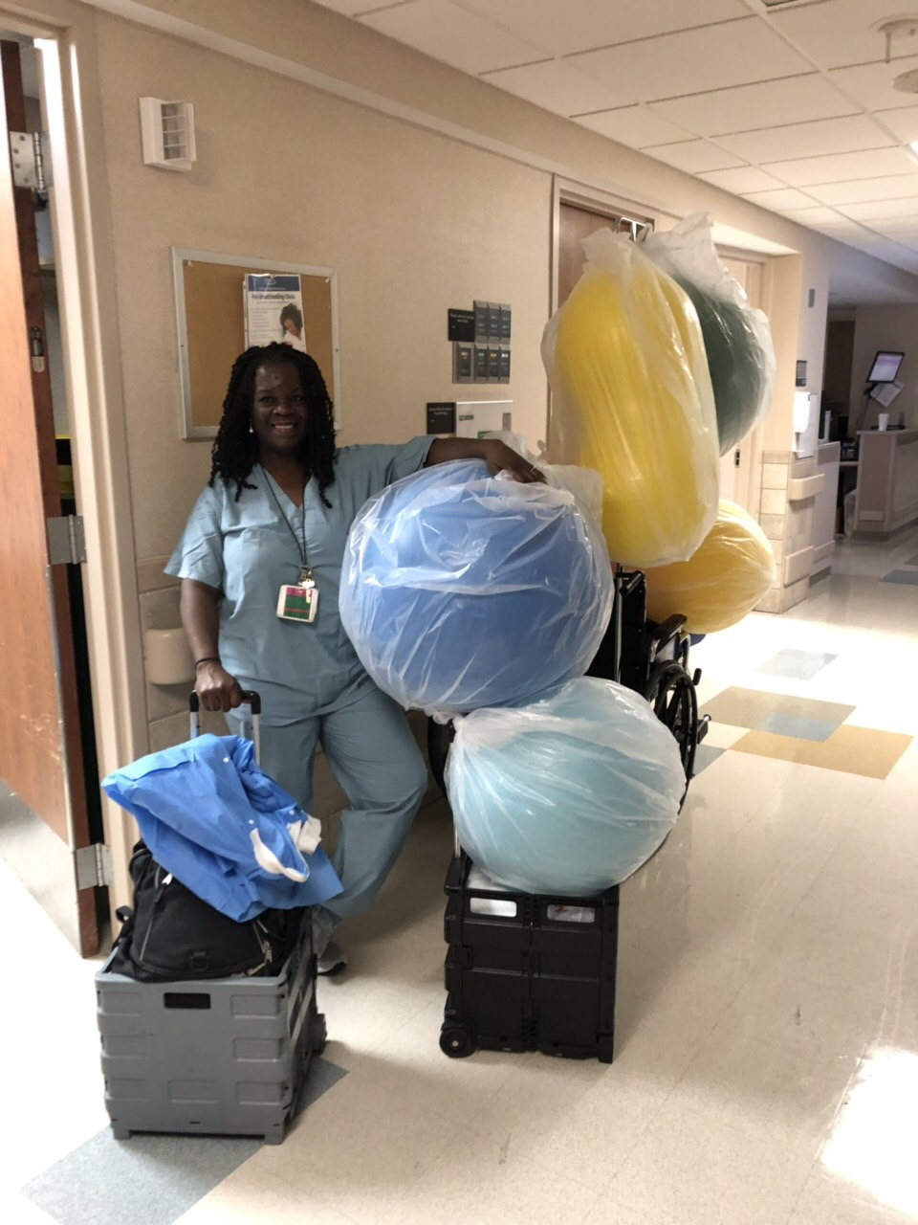
Thank You!
Questions?

