Slide 1
Quality Improvement Project In The Emergency Department Based On The Colorado Alternative To Opioids Project
Presented by: Bianca Skowronski MSN,FNP-BC

Slide 2
Introduction
According to the Centers for Disease Control and Prevention (CDC), (2018) “in 2017, 70,000 drug overdose deaths occurred in the United States of which 68% of those deaths were from prescription opioids” (p.1).
Pain
Opioid
Physicians, dentists, and advanced practice providers
Emergency departments (ED)
Notes:
But it has been found that prescribing higher doses for longer periods can ultimately lead to addiction (Centers for Disease Control and Prevention, 2018). Excluding cancer patients, palliative care, and end of life care, the CDC confirms that a patient prescribed an opioid longer than seven days doubles their chances of becoming addicted (Centers for Disease Control and Prevention, 2018).

Slide 3
Background & Significance
“Fifth vital sign”
Pharmaceutical companies
Prescribing high dose opioids
ED overdose visits
Strict protocols & policies in place
Stealing family members money
Alternatives for pain control and prescribe opioids as the last resort.
Notes:
Shortly afterwards, the Veterans Affairs health system along with the Joint Commission (TJC) embraced the “fifth vital sign” which led to an increase of opioid prescribing. Introducing the fifth vital sign required healthcare providers to address and take action when patients reported pain (Scalpel, 2016).
Over time health care providers realized that they were contributing to America’s opioid epidemic and started to refrain from prescribing larger quantities. Without getting their monthly prescription of opioids, patients were forced to seek elsewhere which led to street access of prescription opioids and eventually turned to heroin (Kolodny, et al., 2015).

Slide 4
What is the Colorado ALTO Project?
2017 the Colorado Hospital Association (CHA) and its partners developed the Colorado Opioid Safety Pilot
10 participating sites achieved an average of 36 percent reduction
31.4 percent increase in the administration of alternative to opioids
Broken down by chief complaint: renal colic, musculoskeletal pain, chronic abdominal pain, gastroparesis, cyclic vomiting, headache, acute or chronic radicular LBP, and acute fractures.
Notes:
In 2017 the Colorado Hospital Association (CHA) and its partners developed the Colorado Opioid Safety Pilot, a study that was conducted in 10 hospital emergency departments over a six month span with a goal of reducing the administration of opioids in those emergency departments by 15 percent.
The cohort of 10 participating sites achieved and average of 36 percent reduction in the administration of opioids during those six months as well as a 31.4 percent increase in the administration of alternative to opioids (Colorado ALTO program, 2019).
The Colorado ALTO project (Colorado ALTO project, 2019) is broken down by chief complaint: renal colic, musculoskeletal pain, chronic abdominal pain, gastroparesis, cyclic vomiting, headache, acute or chronic radicular LBP, and acute fractures.

Slide 5
Template of Colorado ALTO project

Slide 6
Clinical Question
Will providing an educational intervention tool based on the quality improvement Colorado ALTO project, to the emergency department staff at Detroit Receiving Hospital (DRH) increase their knowledge and show an interest in implementing the Colorado ALTO project for the management of acute pain in the DRH ED?

Slide 7
Literature Review
DATABASE: PubMed, CINAHL, Cochrane, Medline through University of Detroit Mercy Library Database
LITERATURE REVIEW RESULTS: Over 500 articles, eight articles utilized in literature review
INCLUSION/EXCLUSION: English, full text, dated within 5 years included in literature review. Articles that were non-English, not available for full text (without payment or membership) or dated over 10 years old excluded
COMMON THEMES: Alternative treatment options, acute pain, emergency department treatment options, personal prescribing practices, decrease opioid epidemic, ALTO programs
KEY WORDS USED: Opioids, emergency department, prescribing, acute pain, ALTO, opioid epidemic, ED health care providers

Slide 8
Project Purpose
It has been proven that implementing an ALTO program in the emergency department has shown a reduction in the administration of opioids and an increase in the administration of alternatives to opioids (Colorado ALTO Project, 2019). The purpose is to complete the educational phase of the Colorado ALTO project at DRH’s ED by leading providers through an evidence-based educational intervention promoting non-opioid acute pain management strategies and to decrease opioid prescribing and gain buy-in for future implementation.
Notes:
Stakeholders including lead nursing staff, pharmacists, chief residents, physician attendings, and advanced practice providers

Slide 9
Theoretical Framework
Model for Improvement utilizing the Plan-Do-Study-Act cycle
Notes:
In this case by providing an educational intervention to the staff at DRH based on the Colorado ALTO project, we are trying to accomplish increasing knowledge, showing interest, and gaining buy-in to implement the Colorado ALTO project for the management of acute pain in the ED. How will we know that a change is an improvement will be based on the pre and post assessment surveys. Lastly, the change that we will make resulting in this improvement will be increasing the providers knowledge on using alternative treatment options for the management of acute pain with the hope of decreasing the amount of opioids used or prescribed? in the ED for the management of acute pain. This essentially will improve America’s opioid epidemic.

Slide 10
SWOT Analysis
STRENGTHS Internal team and expertise (Research committee at DRH’s Emergency Department) Resources (personal, UDM, DMC) Geographic advantage Chronic Pain Policy Sickle Cell Policy Thirty-minute Analgesic Administration | WEAKNESS No “formal” acute pain protocol / policy for the management of acute pain in the Emergency Departments Extensive monitoring (moving patients) Cost Education / preference on prescribing Patient’s Medical History Legal/liability implications Readmission
OPPORTUNITIES Partnerships with other hospitals (Detroit Receiving, Harper / Sinai Grace / Children’s / Huron Valley Hospital) Need for product in hospitals, particularly ER Support from Emergency Attending’s, Residents, Physician Assistants, Nurse Practitioners and Pharmacists. Increasing patient satisfaction scores Reducing the exposure to opioids Safer/more effective patient care Funding: Grant/Investment | THREATS Health system competitors implementing new protocols Not being up to date on the latest research Recognition
Notes:
Detroit Receiving Hospital (DRH) is a level one trauma center located in Midtown, Detroit, Michigan. Detroit Receiving Hospital offers many specialty services ranging from trauma, orthopedics, neurosciences, nephrology, pulmonology, endocrine, geriatrics, urology and emergency.

Slide 11
Methods
DRH prescribing practices (February of 2020)
Personal prescribing practices pre survey (Survey Monkey)
Educational intervention (February 19th 2021 @ 8:00am)
DRH prescribing practices post educational intervention (February 20th 2021– March 20th 2021)
Personal prescribing practices post survey (Survey Monkey)

Slide 12
DRH Prescribing Practices from February of 2020
Specific ICD 10 codes based on diagnosis and chief complaint: N20.0 (Renal colic) & R10.9 (Flank pain), 10.9, Unspecified abdominal pain, K 31.84 (Gastroparesis), R11.15 (Cyclic vomiting), R11.2 (Nausea and vomiting), R51 (Headache), G43.909 (Migraine), M54.5 (Low back pain), M79.1 (Muscle pain), M54.16 (Acute or chronic radicular LBP), M79.601 / M79. 602 (Arm pain), M79.606 (Leg pain), M25.559 (Hip pain), M79.64 (Finger pain), M79.64 (Hand pain), M25.539 (Wrist pain), M25.529 (Elbow pain), M25.519 (Shoulder pain), M25.569 (Knee pain), M25.579, M25.579 (Ankle pain), M79.673 (Foot pain), M79.676 (Toe pain)
Age(s): 18-65
Medications used based on chief complaint and diagnosis: Only opioid specific medications used in the ED: Codeine, Fentanyl (Actiq, Duragesic, Fentora, Abstral, Onsolis), Hydrocodone & Acetminophen (Lorcet, Norco, Vicodin), Hydromorphone (Dilaudid), Demerol, Methadone, Morphine, Oxycodone (OxyContin), Oxycodone & Acetaminophen (Percocet) & Tramadol

Slide 13
DRH Prescribing Practices from February of 2020
Notes:
1 of 18 pages of data based on the specific ICD codes with opioids used in the emergency department at DRH from February of 2020

Slide 14
Personal Prescribing Practices Pre Survey
Circle the percentage group that applies to your OPIATE prescribing practices in the ED based on the chief complaints listed below:
Renal Colic: 0-25% / 26%-50% / 51%-75% / 76%-100%
Headache: 0-25% / 26%-50% / 51%-75% / 76%-100%
Musculoskeletal pain: 0-25% / 26%-50% / 51%-75% / 76%-100%
Acute and Chronic Radicular Lower Back Pain: 0-25% / 26%-50% / 51%-75% / 76%-100%
Chronic abdominal pain gastroparesis, cyclic vomiting: 0-25% / 26%-50% / 51%-75% / 76%-100%

Slide 15
DRH Personal Prescribing Practices
DRH emergency department has seventy-eight healthcare providers, specifically seventy-five attending physicians, two physician assistants and one nurse practitioner.
Of the seventy- eight healthcare providers that are employed thirty-four health care providers completed the pre survey. Based on the questions asked, most health care providers at DRH prescribe between 0 to 50% opioids for the management of renal colic, headache, musculoskeletal pain, acute and chronic radicular lower back pain, chronic abdominal pain, gastroporesis, and cyclic vomiting.

Slide 16
DRH Personal Prescribing Practices

Slide 17
Educational intervention (February 19th 2021 @ 8:00am)

Slide 18
DRH Prescribing Practices from February 20th 2021 – March 20th 2021

Slide 19
Personal Prescribing Practices Post Survey
After listening to the presentation based on the Colorado ALTO project did the presentation increase knowledge on the topics discussed?: Please select YES or NO
Yes or No
After listening to the presentation based on the Colorado ALTO project what is the likeliness to implement the ALTO project into practice: Please circle either NOT LIKELY, SOMEWHAT LIKELY, or VERY LIKELY
Not Likely / Somewhat Likely / Very Likely

Slide 20
Personal Prescribing Practices Post Survey
Fourteen health care providers responded of which majority of the health care providers said the educational intervention increased their knowledge on the topics discussed (85.71%).

Slide 21
Personal Prescribing Practices Post Survey
Fourteen health care providers responded showed that 100% of respondents were either in favor of “somewhat likely” or “very likely” to implement the Colorado ALTO project into practice. No respondents responded “not likely”.

Slide 22
Limitations
Covid-19 Pandemic
Patient’s waiting in the lobby for long periods of time
Focused on the early initial phase of implementation
The Colorado ALTO project was not fully implemented

Slide 23
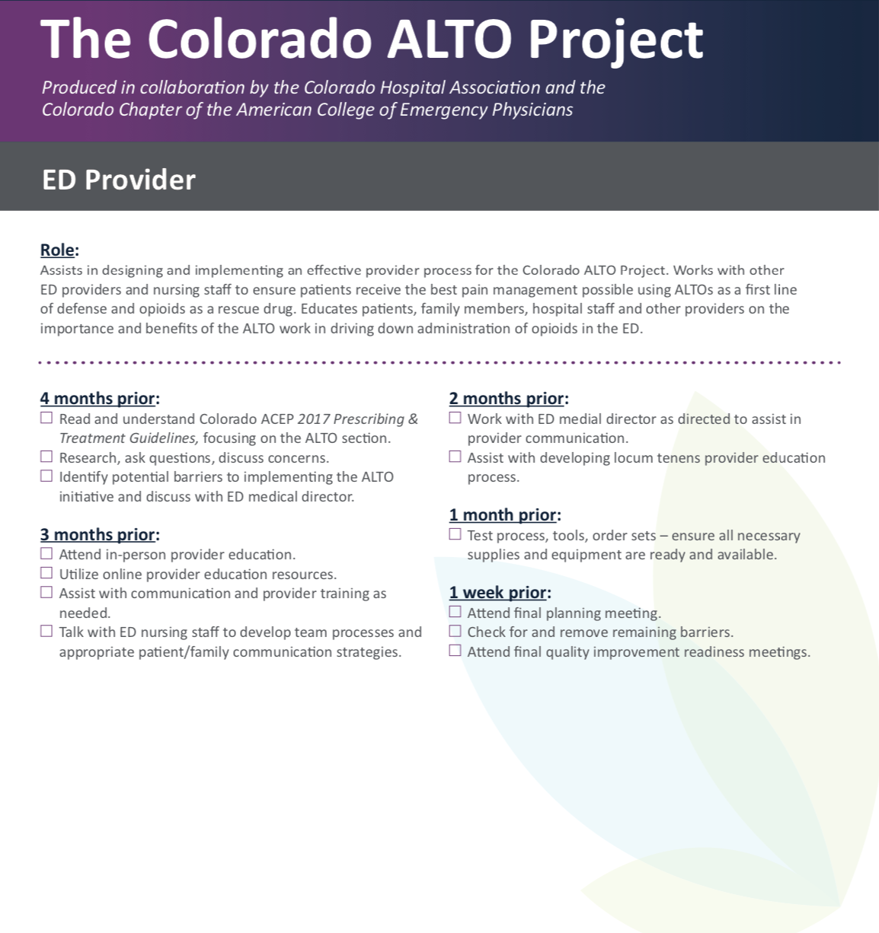
ED Provider Role

Slide 24
Clinical Question Answered
Providing an educational presentation based on the quality improvement Colorado ALTO project, did increase the knowledge for the staff at DRH. The educational tool showed interest from the staff with the intent of implementing the Colorado ALTO project for the management of acute pain in the ED.

Slide 25
Recommendation & Dissemination
Fully implement the Colorado ALTO project into practice
Educating the seventy- eight ED healthcare providers at DRH but will also educate the other ED health care providers at the various other DMC ED’s including, Huron Valley, Harper Hospital, Sinai Grace and Children’s Hospital of Michigan.
Following the completion of the fully implemented Colorado ALTO project into practice, the results will be disseminated through a peer-reviewed nursing journals in order to educate and broaden healthcare providers prescribing practices for the management of acute pain.

Slide 26
Impact and Sustainability
Personal impact in my own practice
The Colorado ALTO project will be the FIRST ALTO project to be implemented at the DMC in Detroit, MI.
Advertisement to future patients
Up to date on the current knowledge

Slide 27
Acknowledgements
Special Thanks to...
Jennifer Ruel DNP, APRN, FNP-BC, ENP-BC, project chair from University of Detroit Mercy. Thank you SO much for your guidance and commitment to this project. I am very fortunate to have had the opportunity to have you has a professor and role model through my academic career over the last 4 years.
James Paxton MD,MBA, FACEP FAHA, organizational chair and director of clinical research at DRH. Thank you for giving me the opportunity to perform this project and make a difference and play an impact to the ED healthcare providers at DRH.
Thank you to all the staff and DNP faculty at University of Detroit Mercy. It has been a privilege and amazing experience to work with all of you.
Lastly, I would like to extend my sincere thanks to my loving parents Dr. Raymond and Mary Ann Skowronski, siblings Deanna and Raymond Skowronski, and boyfriend Nicholas Goza for all their love and support. Without their tremendous understanding, encouragement, and love over the past few years it would have been impossible for me to complete this doctoral project.

Slide 28
References
Brooks, D. (2016). Innovative program targets five common pain syndromes with non-opioid
alternatives. ED Management , 28(6), 61–72. Retrieved from
http://web.b.ebscohost.com.ezproxy.libraries.udmercy.edu/ehost/pdfviewer/pdfviewer?vi
d=1&sid=0766aa75-e107-41a9-baad-781027675211@pdc-v-sessmgr06
Center for Disease Control and Prevention. (2019): Opioid overdose: Retrieved from
http://www.cdc.gov/drugoverdose/data/index.html
Chang, A. K., Bijur, P. E., Esses, D., Barnaby, D. P., & Baer, J. (2017, November 7). Effect of a
single dose of oral opioid and nonopioid analgesics on acute extremity pain in the
emergency department: A Randomized Clinical Trial. Retrieved from
http://www.ncbi.nlm.nih.gov/pubmed/29114833
Cleveland Clinic. (2017). Acute pain vs. chronic pain: What it is & differences. Retrieved from
https://my.clevelandclinic.org/health/articles/12051-acute-vs-chronic-pain
Colorado ALTO Project. (2019.). Retrieved from https://cha.com/opioid-safety/colorado-alto-
project/
Gratton, M. (2017). The ER doctor's role in combating the opioid epidemic. Retrieved from
https://www.ncbi.nlm.nih.gov/pmc/articles/PMC6140208/

Slide 29
References
Hoppe, J. A., Kim, H., & Heard, K. (2015, May). Association of emergency department opioid
initiation with recurrent opioid use. Retrieved from https://www.ncbi.nlm.nih.gov/pubmed/25534654.
IHI (2021) :Science of improvement: How to improve: Retrieved March 01, 2021, from
http://www.ihi.org/resources/Pages/HowtoImprove/ScienceofImprovementHowtoImprove.
aspx
Karlow, N., Schlaepfer, C. H., Stoll, C. R., Doering, M., Carpenter, C. R., Colditz, G. A., . . .
Schwarz, E. S. (2018, October). A systematic review and meta-analysis of ketamine as
an alternative to opioids for acute pain in the emergency department. Retrieved from
https://www.ncbi.nlm.nih.gov/pubmed/30019434
Kumar, K, and P Elavarasi. “Definition of pain and classification of pain disorders.” Journal of
Advanced Clinical & Research Insights3 (2016.): 87–90.
http://jcri.net/eJournals/_ejournals/112_Review Article.pdf.
LaPietra, A., Motov, & Rosenberg. (2016). Alternatives to opioids for acute pain management
in the emergency department: Part I. ProQuest, 37(19). Retrieved from https://search-
proquestcom.ezproxy.libraries.udmercy.edu/docview/1993224917/fulltext/BF8C7B84A7
DD4248PQ/1?accountid=28018

Slide 30
References
NIH. 2019. The drug overdose epidemic affects all U.S. communities. Retrieved from
https://nimhd.nih.gov/news-events/features/community-health/overdose-epidemic.html
Scalpel, S. (2016). The Joint Commission deserves some blame for the opioid crisis. Retrieved
from https://www.ncbi.nlm.nih.gov/pmc/articles/PMC6139759/
Todd, K. H. (2017, December). A review of current and emerging approaches to pain
management in the emergency department. Retrieved from
https://www.ncbi.nlm.nih.gov/pmc/articles/PMC5693816/.

