Slide 1
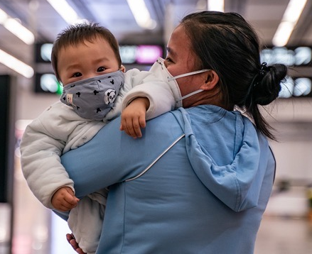
Program Evaluation: School-based Clinic’s Response during the Pandemic to Enhance Immunization Uptake & Assist with Social Determinants
Maureen Murphy, RN, MSN, FNP-BC
This Photo by Unknown Author is licensed under CC BY-NC

Slide 2

Description: COVID-19 Pandemic
Footprint as a Four Wave Process
  First, immediate mortality and morbidity
  Second, impact of resource restrictions on urgent non-pandemic conditions
  Third, interruption of care for chronic conditions and prevention care such as immunizations
  The fourth wave considers the Post traumatic stress, psychosocial burnout and economic impact
  (Steward, 2020)
This Photo by Unknown Author is licensed under CC BY-SA

Slide 3
The Introduction to the Problem…..
COVID-19 Pandemic - An interruption of care…. especially immunizations
Michigan reported an overall 44.5% decrease & 65.5% decrease in adolescents compared to the previous two years (Roelofs, & French, 2020)
A decline in vaccinations put children at risk
Parents afraid to visit their providers
Michigan guidance from LARA indicates that primary care practices should consider drive-thru service (LARA, 2020)
This Photo by Unknown Author is licensed under CC BY-SA

Slide 4

Problem Statement
If vaccines are not received, patients, families, and entire communities are at risk of getting these diseases.
This would further stress communities that have been so profoundly affected by the Coronavirus
This Photo by Unknown Author is licensed under CC BY-SA

Slide 5
Background/Significance
Immunizations saves lives, prevent illness & reduce health care cost ("Healthy people 2020," 2020)
Immunization increase life expectancy (Gessner et al., 2017)
  Globally (2015) 6 million children died under the age of 5 & over ½ were preventable! (Smith, et al., 2017)
Before the Pandemic already significant gap of vaccine rate correlated to race and poverty (Gati, et al., 2020; Reagan-Steiner, et al., 2016)
A lack of access is a health disparity
  Most of Metro Detroit
    is a medically underserved area (Data Detroit, 2019)
    have many health disparities/inequities (City data, 2020; "CHA, Detroit Health Department," 2019)
    Quality of life ranks lowest in the state ("2020 County Health Rankings Report," 2020)

Slide 6
Social Vulnerability Index

Slide 7

Available Knowledge – Lit Review
Four Themes reviewed:
  Preventing the spread of Coronavirus
  Reasons for decreased immunization uptake
  Cost analysis
  Vulnerable populations/health disparity and inequities
This was a catapult to provide evidence if the program elements were of importance
This Photo by Unknown Author is licensed under CC BY-NC-ND

Slide 8
Modified Social-ecological Model
Policy: New recommendations from state to provide curb-side immunizations
Community: A healthy community with a lower SVI could handle disasters better and improve overall health of community
Organization: Beaumont’s system is founded on a culture of caring partnerships providing compassionate, extraordinary care every day.
Providers are trusted- well trained and culturally competent
Person & Family: People will engage in service if medical care has easy access, is affordable, culturally caring, compassionate and trustworthy
Policy
Organization
Provider
Person and family
Community
(National Quality Forum, 2017)

Slide 9

Organizational Assessment
Beaumont Health’s mission
  compassionate, extraordinary care every day
(CNO) charged nurse leaders
  to aspire in innovative ways to create new models of care
  Call to action ….fueled and supported environment of excellence and teamwork
  Value of nurse-led initiatives
Impact patient outcomes
This Photo by Unknown Author is licensed under CC BY-SA

Slide 10
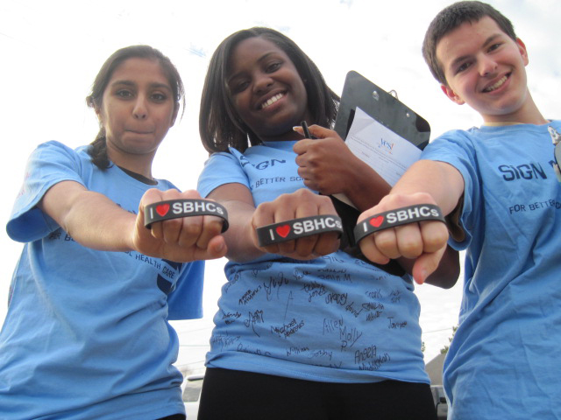
Description of the Innovation:
SETTING: School-based Curbside Immunization Event………A perfect fit!
Designated medically underserved areas (River Rouge & Taylor)
Strategically located in vulnerable populations where health equity and health disparity exist
      Clinics – limited staffing – an event allowed shared staffing and better outreach
Culturally competent and trusted resource in community
        Knowledgeable in the immunization process
        Certified training in Vaccination management
        Great teachers!
by Unknown Author is licensed under CC BY-ND

Slide 11
SWOT Analysis
Strengths
Opportunities
Urgent community need
Reduces chance for illness
Trusted community clinic
High staff interest/commitment
Weakness
Promote wellness and prevent illness
Provide easy and safe access
Bridge the gap of health equity
feasibility of curbside service
NP’s are only credentialed at their work site, and affiliated hospital
Need volunteers
Administrative support
Reduces health risk disparity
Threats
Staffing -most MA's had been furloughed
Potential health department issues
IT support & unpredictable weather
Insufficient time/resources for marketing to public
Assist with social determinants of health

Slide 12

Defining the Project
  A Program Evaluation using the LOGIC Model
  Purpose/clinical considerations/questions:
    Overall program success
    Parental Perception
    Evaluate the process activities
    Was it sustainable, – economically feasible, and replicable?
This Photo by Unknown Author is licensed under CC BY-NC-ND

Slide 13
LOGIC Model: Curbside Immunization
Improving immunization rates within the Metro-Detroit county while assessing social determinants and providing resources
Inputs (resources)
Dedicated staff
Lap tops
Stock VFC and Private Immunizations
Temp control mechanisms
Tent stations
Volunteers
Accessory budget
Constraints
Outside environment
I.T. support
Need more staff
Marketing with limited budget
NPs with different Medical Director & hospital affiliations
Insufficient supply of vaccinations
Activities
Assurance that events were scheduled approximately one week apart
Each participants will:
Go through centralized pre-registration before arrival and will have
Reminder text or phone calls 1-2 days prior to event
Before event begins:
“pop up” vaccination administration area consistent with best evidenced based practice.
Physical design and stationing to provide social distancing and heightened attention to infection control
Huddle with staff prior to start of event
When arriving will drive up to Three stations COVID-19 screening, Vaccine administration, & post immunization area.
The vaccine stations can see up to three cars every 20 minutes
The vaccine are will include:
Check in
NP Review
Teaching and immunizations given
Then car will proceed to
Post immunization
Complete a Satisfaction survey with review of social determinants
Visit time will be tracked in vaccine station
Linkage to resources and Medicaid sign up
Provide a box of food to each family
Staff debrief focus group before clean up at each event
Outputs
Number of children Immunized
Number of immunizations given
Review immunization registry (MICR) and compare does administered reports from past
How many fully “Up to date” via MICR after immunization event
Measure Typical timed visit in vaccine station
Measure which location was most effective
Measure satisfaction surveys
Measure how many uninsured with resource to signup with Medicaid
Measure how many resources linked to social determinants
Effects
Increase health equity by providing more access to immunizations
Improved immunization numbers during COVID -19 pandemic
High satisfaction rates
Improved linkage to needs for social determinants
Improved linkage for Medicaid service

Slide 14

Methods: A Program Evaluation
Use LOGIC model to review all resources/constraints
Use LOGIC model to review all process and event activities
Use LOGIC model to review and analyze outputs
Analyze if effects/goals of the program were met
This Photo by Unknown Author is licensed under CC BY-NC

Slide 15
LOGIC Model -- Resources/Constraints
Resources
Constraints
Outside environment
I.T. support
Need more staff
Marketing with limited budget
NP’s with different Medical Director & hospital affiliations
Insufficient supply of vaccinations
Inputs
Dedicated staff
Lap tops
Stock VFC and Private Immunizations
Temp control mechanisms
Tent stations
Volunteers
Accessory budget

Slide 16
LOGIC Model -- Process Activities
Assurance that events were scheduled approximately one week apart Each participants will:
  Go through centralized pre-registration before arrival and will have
  Reminder text or phone calls 1-2 days prior to event
Before event begins:
  “Pop up” vaccination administration area
    Best evidenced based practice
  Physical design and stationing
    social distancing
    heightened attention to infection control
  Huddle with staff prior to start of event
***After Event Staff debrief focus group before clean up at each event***

Slide 17
LOGIC Model -- Event Activities
When arriving will drive up to Three stations:
COVID-19 screening, Vaccine administration, & Post-immunization area
The vaccine stations can see up to three cars every 20 minutes
  The vaccine station will include:
    Check in
    NP Review
    Teaching & immunizations administration
Car moves to the Post Immunization area:
  Complete a Satisfaction survey with review of social determinants
  Visit time will be tracked in vaccine station
  Linkage to resources and Medicaid sign up
  Provide a box of food to each family

Slide 18
Activity:
Process flow of curbside immunization event
Vaccinations done here
Post-immunization waiting
done here
1st lane
2nd lane
3rd lane
Post-immunization waiting
Assessment for social determinants of health
Resources provided
Food distribution
Pre-registration
COVID-19 Screening before entrance
Each car follows the arrows to complete full immunizations and social determinant assessment and assistance

Slide 19
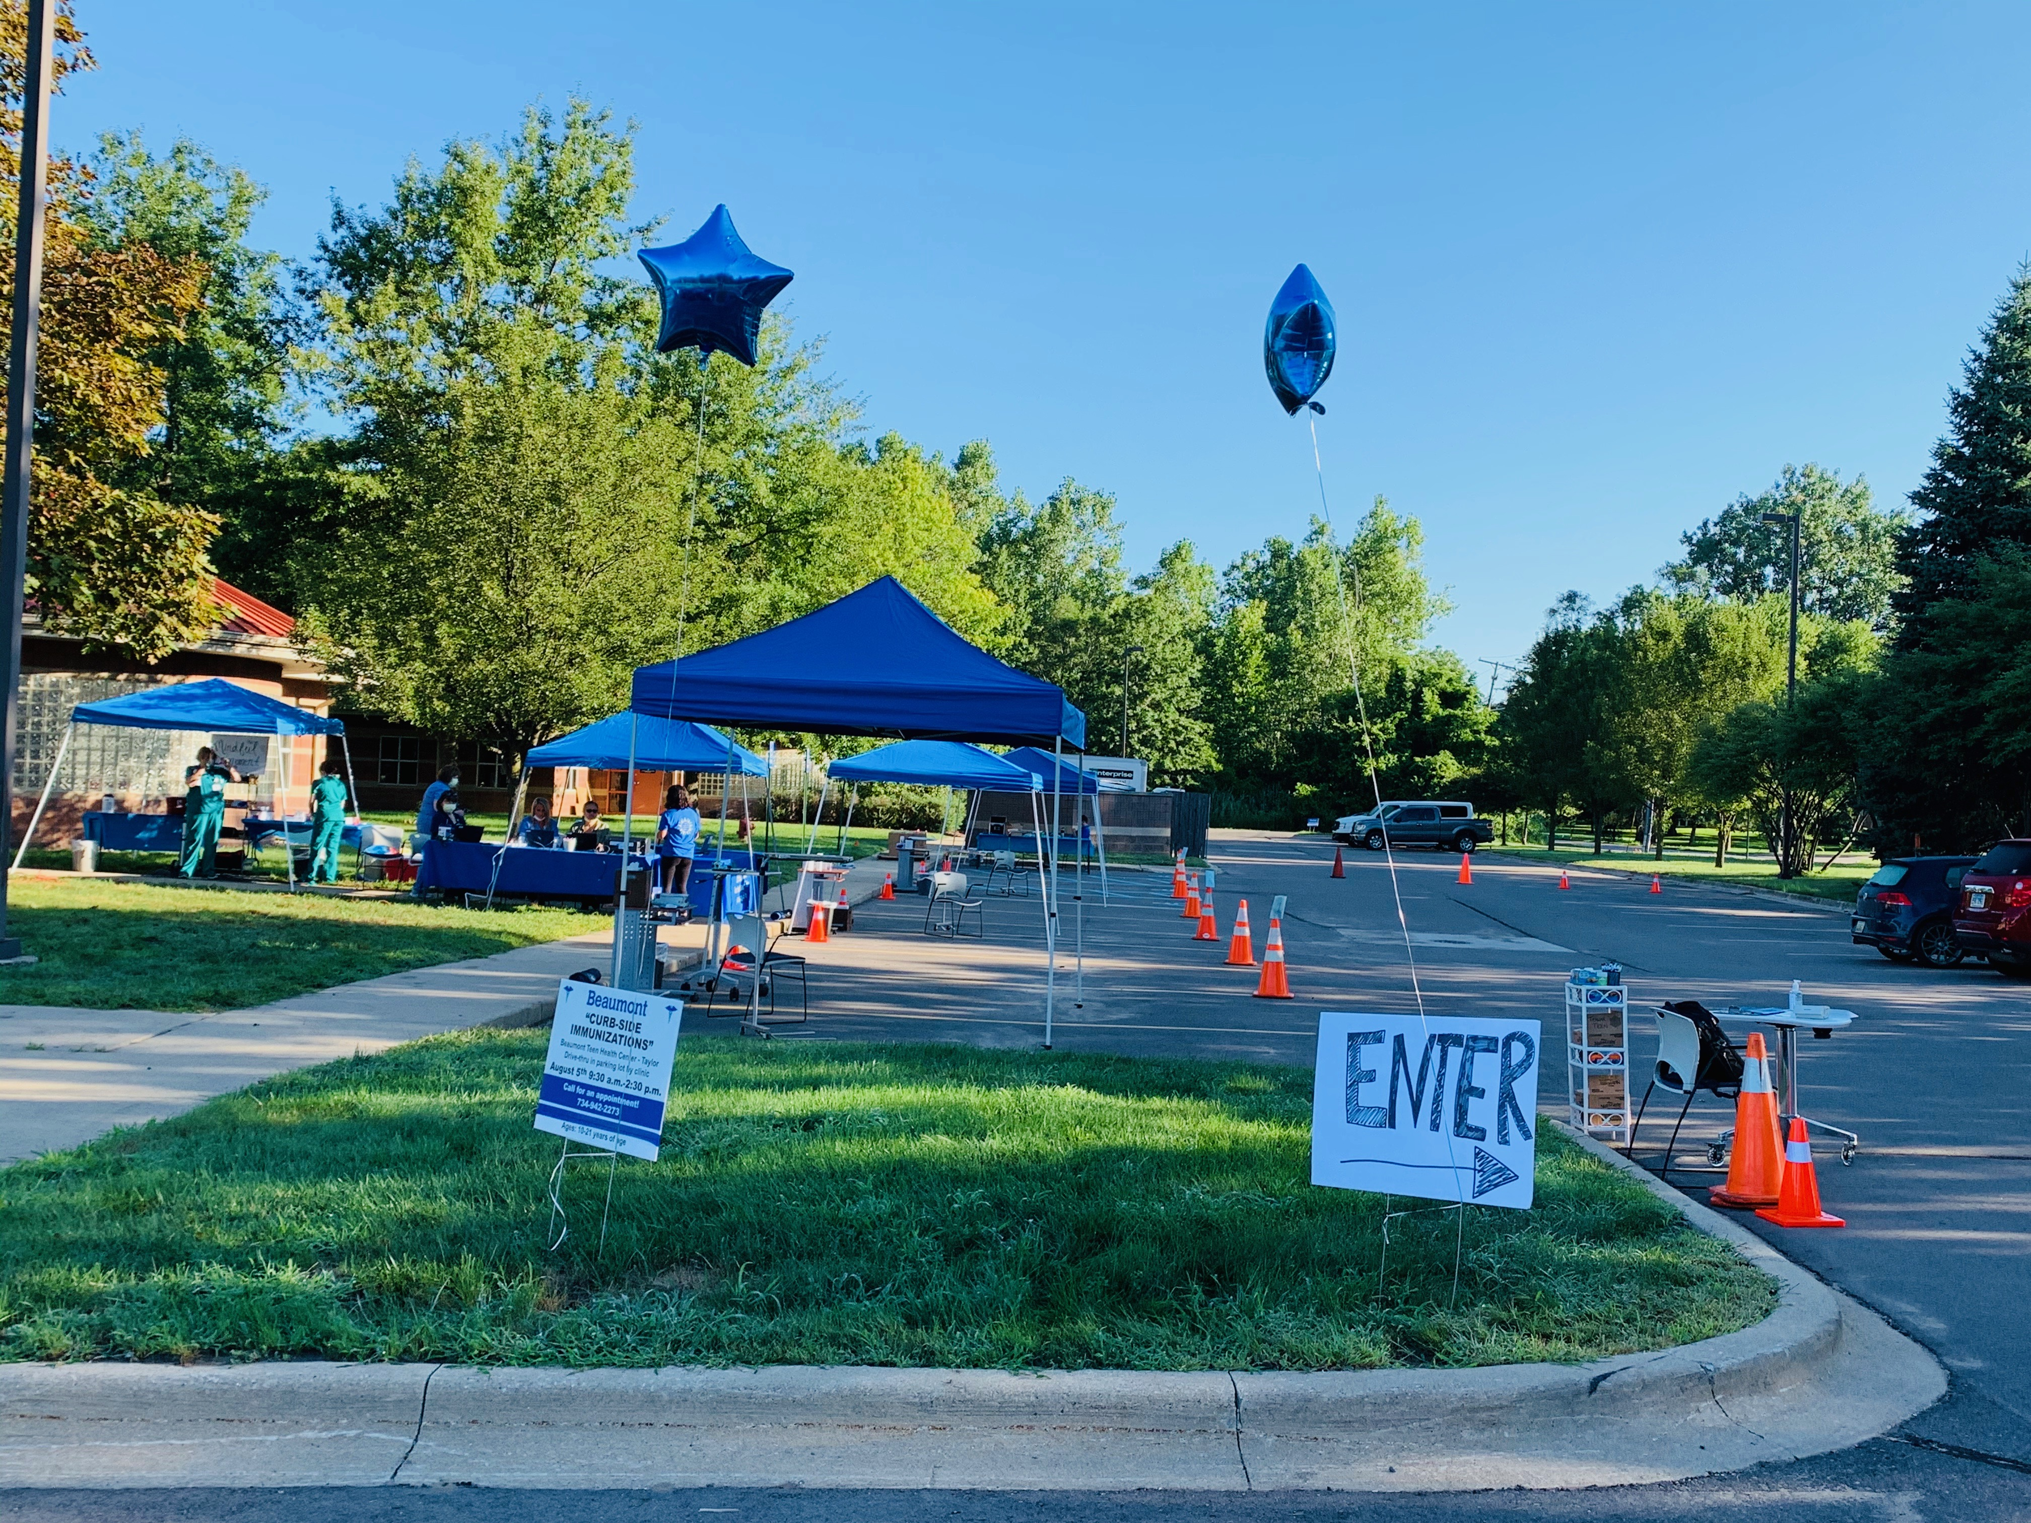

Slide 20
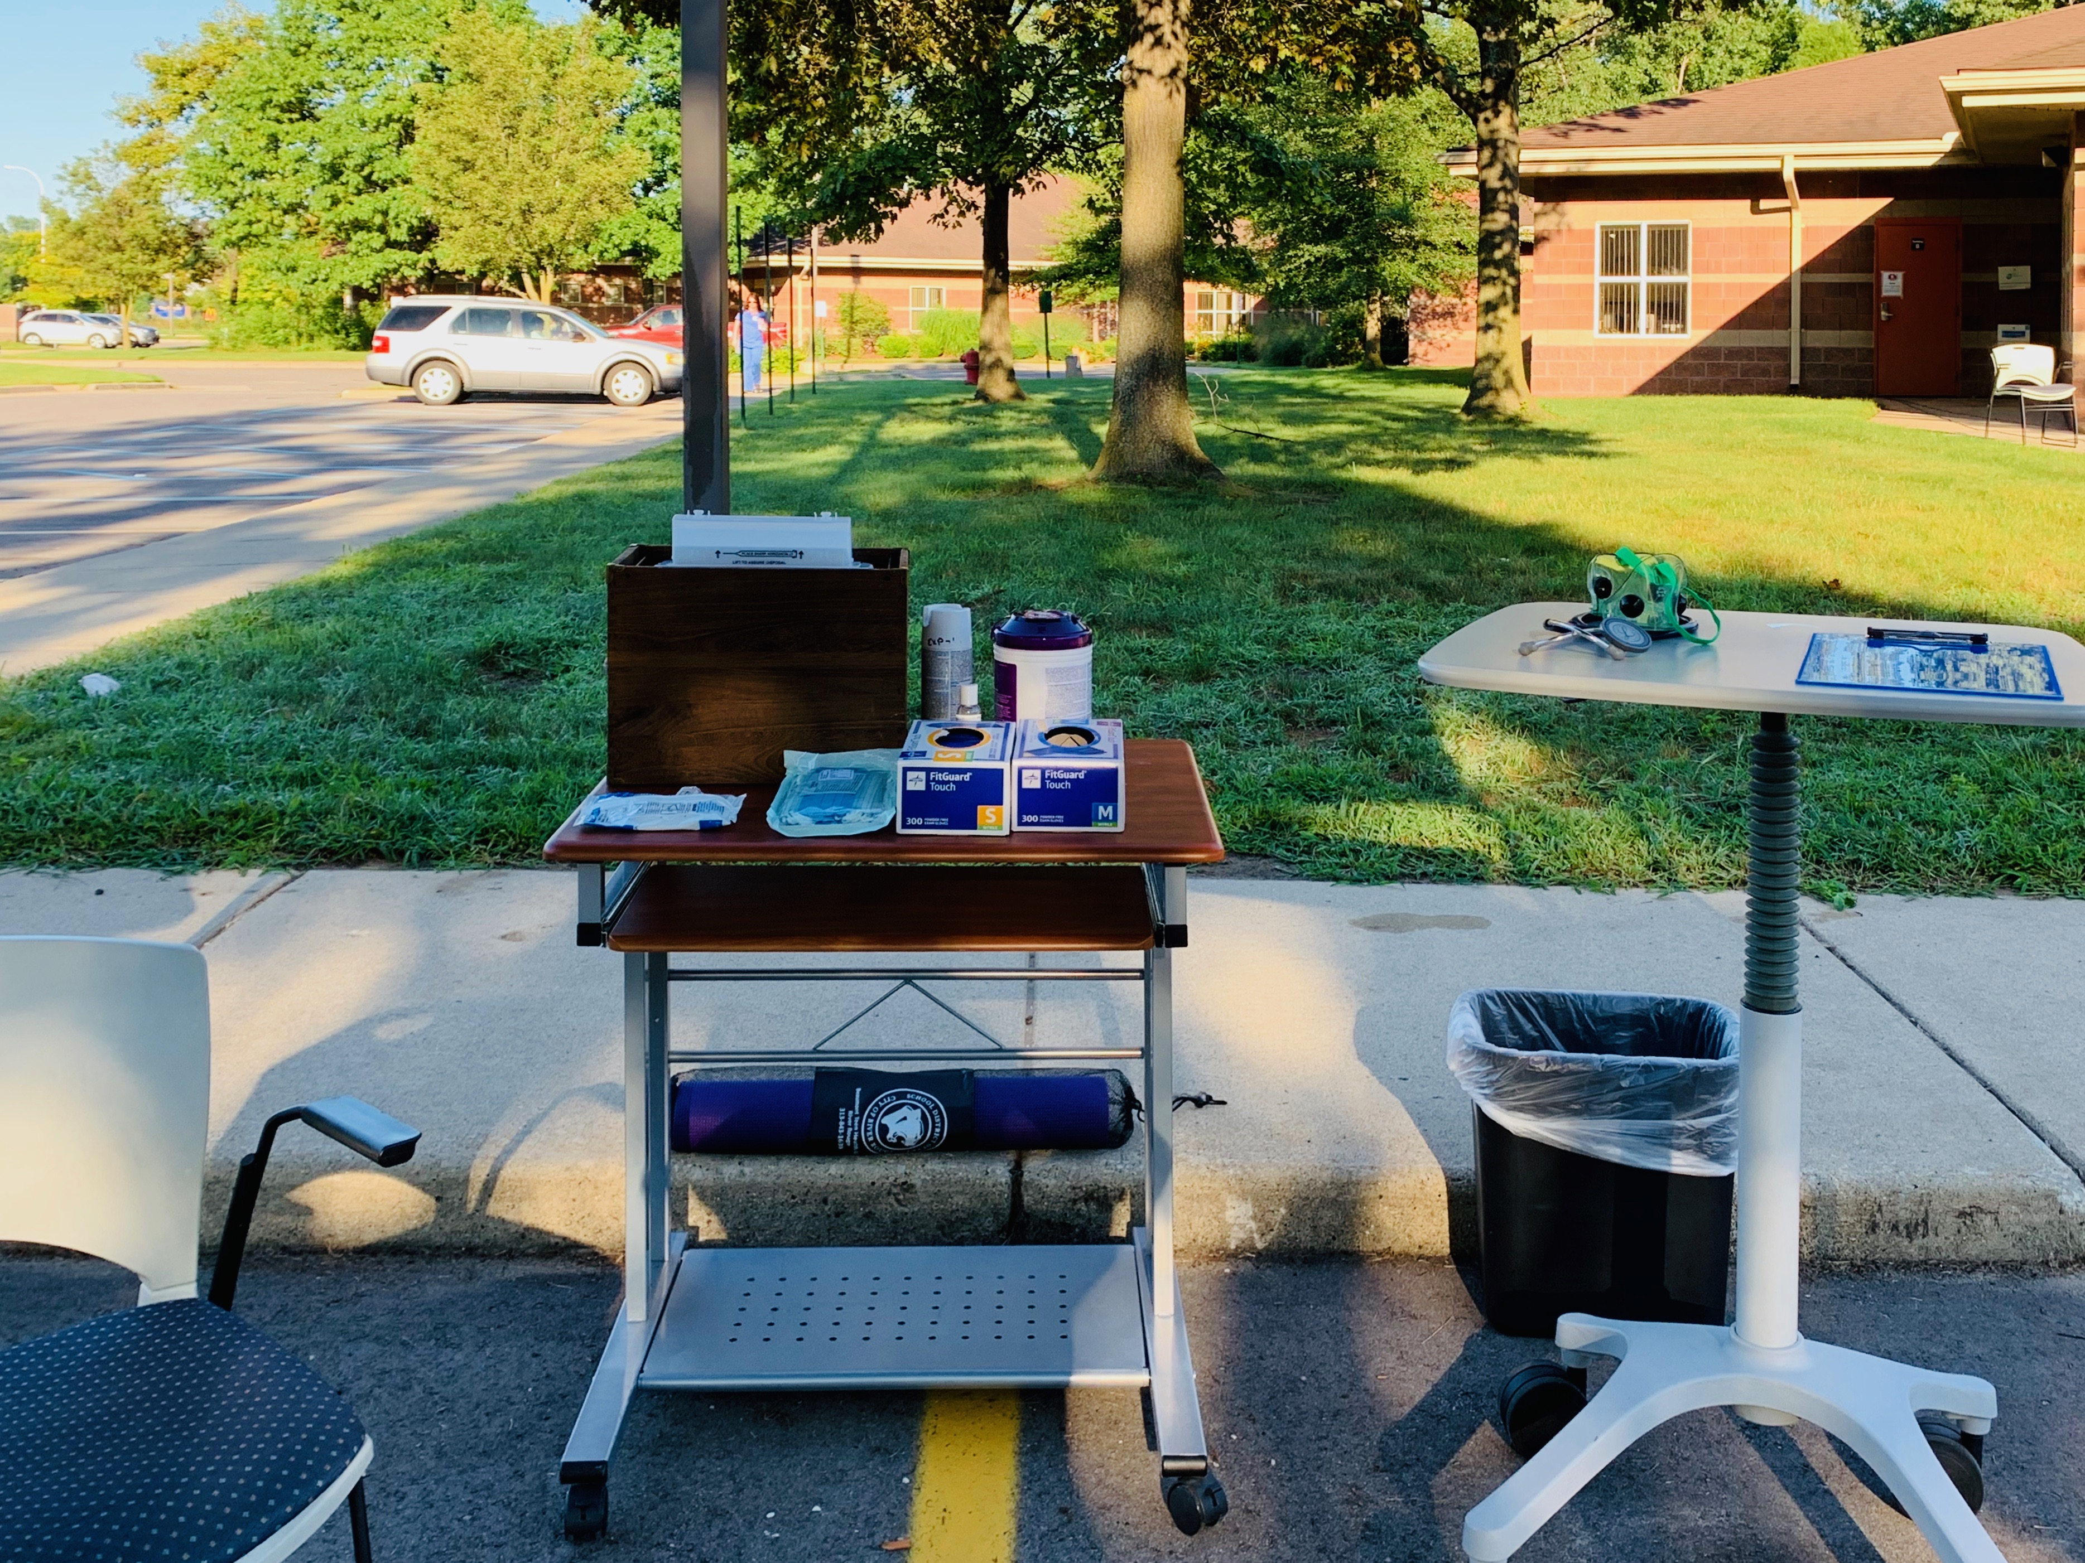
The Tent experience!
Chair with small table
Computer
Other table
  with tape, gloves sharp container, ice pack, yoga mat, tape gauze, PDI wipes, trash can

Slide 21
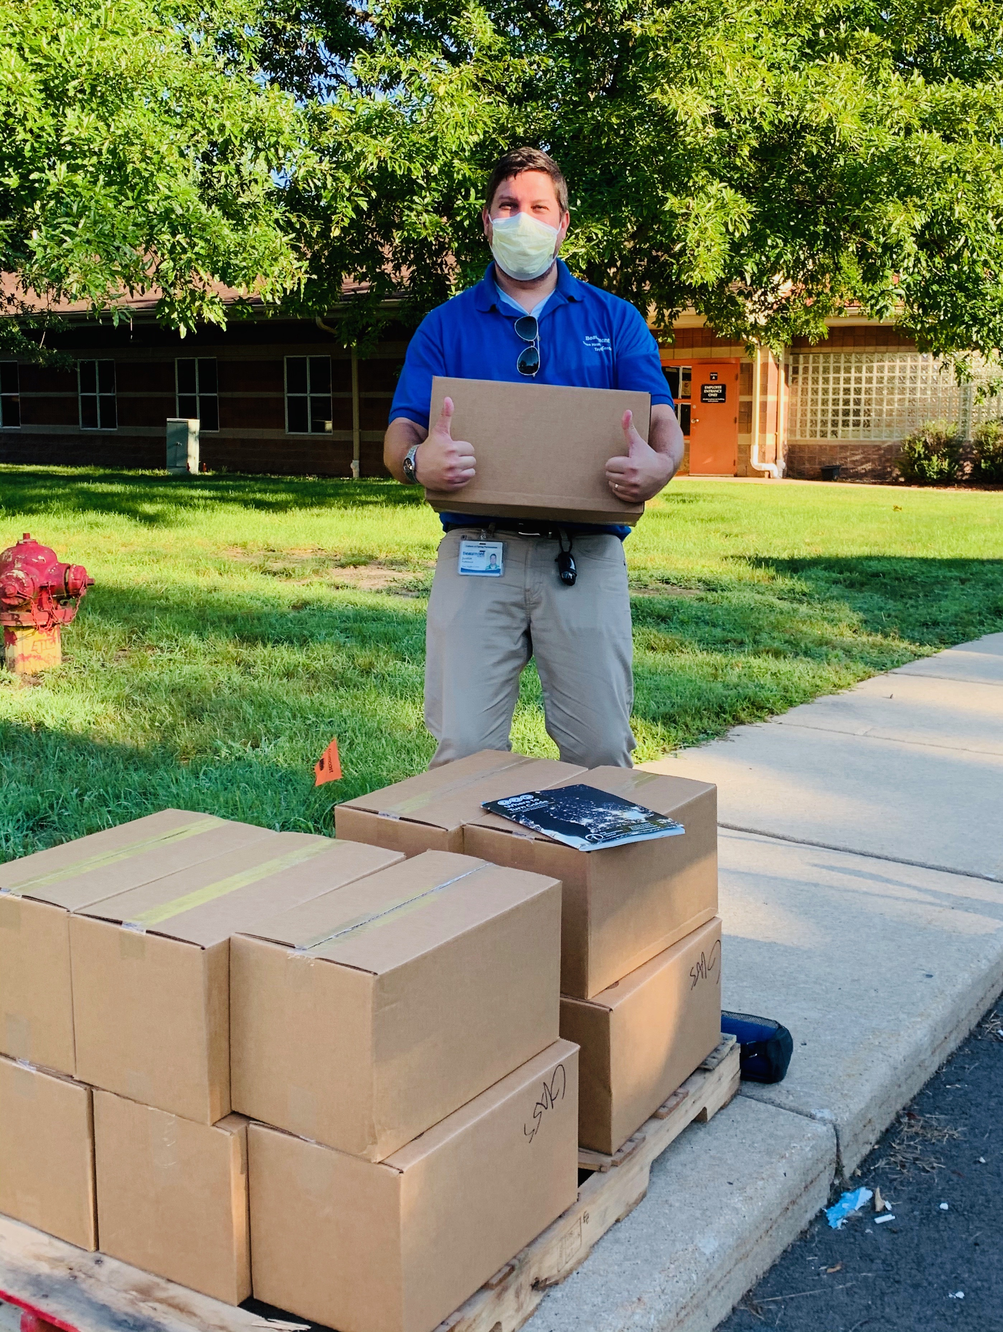
Post-immunization A great opportunity
Social Workers
  Medical care close – available
Survey on process/social determinants of health
Social determinant Resources
Medicaid resource
Food

Slide 22

LOGIC Model -- Outputs
Number of children immunized
Number of immunizations given
Review immunization registry (MICR) and compare doses administered reports from past
How many fully “Up to date” via MICR after immunization event
Typical timed visit in vaccine station
Which location was most effective
Satisfaction surveys
How many uninsured with resource to signup with Medicaid
How many resources linked to social determinants
This Photo by Unknown Author is licensed under CC BY-SA-NC

Slide 23

LOGIC Model Goals / Effects
Improving immunization rates within Detroit and Wayne County area
Assisting with social determinant concerns of a community needing to heal post-pandemic
Access to medical care that is safe and efficient in a cost-effective manner
High Satisfaction rates
This Photo by Unknown Author is licensed under CC BY-SA-NC
Notes:
Goals

Slide 24

Method/Design
Mixed method
  Descriptive demographic statistics and time measures were completed; means were compared
  Fisher’s Exact test to compare differences between clinic locations
  Data management - SPSS 27 software system
Data security
  De-identified via MRN linking key
    IRB “exempt” status approval from both Beaumont Health and University of Detroit Mercy
This Photo by Unknown Author is licensed under CC BY-NC-ND

Slide 25

Results -- Demographics
The mean age that participated was 14 (range 10-20 years)
The mean number of shots given was 2.21 (range 1-5 shots given)
Prior to the events
  79.3% were greater than 6 months behind
  69% were greater than 1 year behind
    Validated through MCIR
This Photo by Unknown Author is licensed under CC BY-SA

Slide 26
Results continued
Outputs
Results
Number of children Immunized
Number of immunizations given
Review MCIR and compare doses administered reports from past
How many fully UTD via MCIR
Measure Typical timed visit
Measure which location served most effective
29 children Immunized
64 immunizations given
Improved distribution of immunizations given from regular clinic day of service comparative to 1 year prior
28 participants – all but 1 --97%
Average time spent registration through vaccination 21 min
River Rouge had higher number of participants

Slide 27
Survey Response
Survey response results
100% of patients and families felt the precautions that the center took helped them feel more comfortable and that the process was easy & safe!
93.1% indicated they would recommend this service to others
100% indicated the staff answered all of their questions
51.7% felt concerned about going into the providers office
55.1% would have delayed service if this event was not possible

Slide 28
Social Determinant Survey Response…..
Social Determinants
Results
Transportation issues
Gas issues for house
Water bill issues for house
DTE (electrical) issues for house
Shelter issues
Insurance (medical) issues
Food concerns
  13.8% Have concern
  27.6% Have concern
  11.1% Have concern
  27.6% Have concern
  6.9% Have concern
  13.8% Have concern
  34.5% Have concern

Slide 29
Comparing Locations on SDOH
Significant difference
No significant difference
Gas and electrical needs associated with locations. Higher need in River Rouge, (p = .033 Fisher’s Exact)
Being behind in vaccines associated with location-River Rouge more behind
  > 6 months (p=.005 Fisher’s Exact)
  > 12 months (p=.101 Fisher’s Exact)
  Insurance, (p = .280 Fisher’s Exact)
  Shelter, (p=1.00 Fisher’s Exact)
  Transportation, (p =.280 Fishers Exact)
  Water, (p= .529 Fisher’s Exact)
  Food, (p= .107 Fisher’s Exact)

Slide 30
SDOH
Implication showing that both communities have similar struggles with social determinants
River Rouge is adjacent to Detroit, a city with a high social vulnerability index, which may correlate with higher health inequities
Although not a significant difference between locations, the results showed an overall high trend in food security of 34.5%

Slide 31
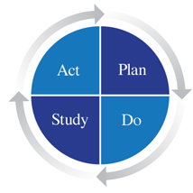
Qualitative Data from Staff
4 themes emerged
      1) Felt possible replication/platform for other events
      2) Enjoyed working together – more cohesive team
      3) Completed PDSA between events
        Distribution of work / IT concerns
      4) Felt patient/parents were pleased with program
This Photo by Unknown Author is licensed under CC BY-SA

Slide 32

Results – The highlights!
Cost neutral!
UPTAKE of Immunization very successful
  97% UTD status post immunization event
    That’s with 69% of the participants before the event greater than 1 year behind in scheduled immunizations
More immunizations given than routine clinic day
48.2 % of this population had concerns about SDOH
34.5% have food insecurity concerns
This Photo by Unknown Author is licensed under CC BY-ND

Slide 33
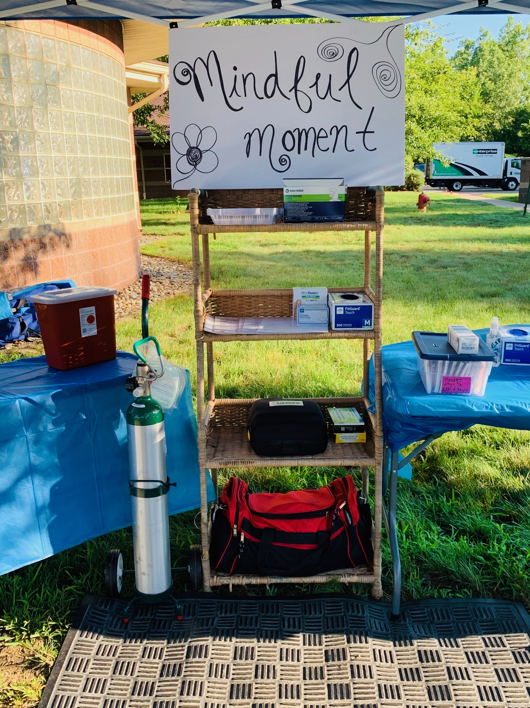
“Pop up” vaccination administration area
Discussion: Implications for quality & safety
  Clean and Dirty area
  Follow Policy
  Job Aides
  Checklist of Best Practice for Vaccinations
  Temperature monitoring
  Emergency Medical equipment and supplies

Slide 34

Discussion: Implications for Health Care Policy
Reflects that patient receives access to care based on how well the family, provider, community and policy support, assist and leverage the care
The pilot program was created based on the state recommendations to rethink curbside approach
Encourages the state policy to look not only to access but in a holistic fashion to assist with social determinants that could impede optimum health
This Photo by Unknown Author is licensed under CC BY

Slide 35
Discussion: Sustainability and Implications for Practice
Limitation of data due to small sample pilot program
A potential for convenience sample bias
Survey created by focus group (not a validated screening tool)

Slide 36
Discussion: Sustainability and Implications for Practice CONT..
Dates of event may impact future outcomes
  Scheduling event closer to the start of the school year may yield higher participant turnout
  Measurement of complete UTD status may be impacted by date…. as Influenza vaccine is not generally available in late summer
For these reasons, and based on our informative results thus far,
there is a strong rationale for future research endeavors and further innovation

Slide 37

DISCUSSION: Opportunity in a time of Crisis
Curbside Immunizations – rethink and redesign
A bridge back to clinic services
Social determinants could/should be assessed
Potential future platform (Flu, Covid-19 immunizations)
      This platform was shared with other school-based centers across the country
      Toolkit developed to assist with replication
      Great opportunity for nurses working on service hours (Magnet status)
      Inter-disciplinary coordination!
This Photo by Unknown Author is licensed under CC BY

Slide 38
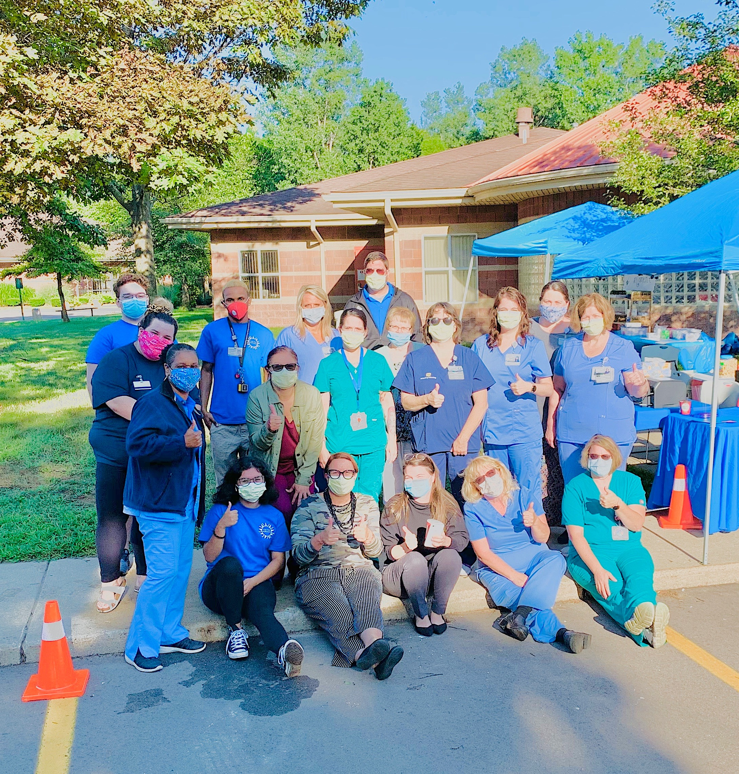
“Life isn’t about waiting for the storm to pass. It’s about learning to dance in the rain.”
Vivian Greene
https://www.clickondetroit.com/health/2020/07/30/beaumont-health-offers-curbside-vaccinations-to-keep-kids-up-to-date/
Notes:
I would like to click on the TV coverage of this event because it shows a parent perspective.
https://www.clickondetroit.com/health/2020/07/30/beaumont-health-offers-curbside-vaccinations-to-keep-kids-up-to-date/

Slide 39

Dissemination
A DNP project
Assist and improve health care
Yield an example of full potential capabilities
Showcase to the world the possibilities of the Doctorate of Nurse Practice In the clinical setting
10
opportunities for dissemination Including…
Article submitted, and accepted to Nursing Administration Quarterly
These Photos by Unknown Author is licensed under CC BY-SA

Slide 40
Dissemination…..
Presentation to Beaumont Health Patient Care Improvement Committee October 2020
Article submitted, and accepted to Nursing Administration Quarterly
Presentation at the 5th Annual Evidenced Based Practice and Research Virtual Conference.
Poster board with zoom recording for the ANA-Michigan 2021 virtual nursing conference
Detroit Free press interview prior to curbside events
Channel 4 News coverage of event
Radio interview WJR
Beaumont Intranet – news clip - to available to all 38,000 employees
Presentation to School-Community Health Alliance of Michigan (SCHA-MI)-(August)
  Power point and tool kit – sent to National School-Community Health Alliance

Slide 41

Thank you!!!!!
Committee for this DNP
Chair: Dr. Mary Serowoky, DNP, APRN-BC, FNP
Mentor: Dr. Susan Grant, DNP, RN, FAAN, EVP & CNO Beaumont Health
Reader: Dr. Elaine Webber, DNP, PPCNP-BC
DNP Interim Project Facilitator: Dr. Lori Glenn, DNP, CNM, RN
DNP project Facilitator: Dr. Rosanne Burson, DNP, APRN,CNS-C, CNE, CDCES, FADCES, FNAP
Dr. Janet M. Baiardi, PhD, FNP-BC Interim Dean & Professor
The Team (coworkers at Beaumont)
My husband, family, and my “Sister Girlfriends”
This Photo by Unknown Author is licensed under CC BY-NC
Notes:
.

Slide 42
References
2018 Detroit community health assessment. (2019). https://detroitmi.gov/sites/detroitmi.localhost/files/2019-04/4pm_April11_DHD_report.pdf
CDC's social vulnerability index 2016 Wayne County, Michigan. (2016). https://svi.cdc.gov/Documents/CountyMaps/2016/Michigan/Michigan2016_Wayne.pdf
CDC’s -Checklist of best practices for vaccination clinics held at satellite, temporary, or off-site locations. (2017). https://www.izsummitpartners.org/content/uploads/2017/02/NAIIS-Vaccination-Clinic-Checklist_v2.pdf
Centers for Disease Control and Prevention. (2020). Pandemic guidance: Vaccination guidance during a pandemic. https://www.cdc.gov/vaccines/pandemic-guidance/index.html
Data Detroit. (2019). Medically Underserved Areas Population [Data file]. https://data.detroitmi.gov/datasets/3f782b4894ec46caa5eb76907529de83_0?geometry=-83.281%2C42.264%2C-82.909%2C42.442
Gati, S., Bloomhardt, H., & McArthur, E. (2020, June 3rd). COVID-19: Widening health disparities among pediatric populations [Editorial]. American Journal of Public Health, 110(9), 1358-1359. http://dx.doi.org/10.2105/AJPH.2020.305815

Slide 43
References
Gessner, B. D., Kaslow, D., Louis, J., Neuzil, K., O'Brien, K. L., Picot, V., ... Nelson, C. B. (2017, October 3). Estimating the full public health value of vaccination. Vaccine, 35, 6255-6263. http://dx.doi.org/10.1016/j.vaccine.2017.09.048 2020
Guidance for outpatient health care facilities - ambulatory care settings. (2020). https://www.michigan.gov/documents/lara/LARA_Safe-Start_Guidance_Outpatient_Health_Care_Facilities_-_Ambulatory_Care_Settings_05-28-2020_692225_7.pdf
Immunization and Infectious Diseases . (2020). https://www.healthypeople.gov/2020/topics-objectives/topic/immunization-and-infectious-diseases
Kelly, Dane & DiGiulio, Kim (2020, 07, 30). Beaumont Health offers curbside vaccinations
keep kids up-to-date [Video]
https://www.clickondetroit.com/health/2020/07/30/beaumont-health-offers-curbside vaccinations-to-keep-kids-up-to-date/
Michigan county health rankings . (2020). https://www.countyhealthrankings.org/sites/default/files/media/document/CHR2020_MI_v2.pdf

Slide 44
References
National Quality Forum. (2017). A roadmap for promoting health equity and eliminating disparities: The four I's for health equity (HHSM-500-T0024). Washington, DC: Government Printing Office.
Reagan-Steiner, S., Yankey, D., Jeyarajah, J., & et al. (2016). National, regional, state, and selected local area vaccination coverage among adolescents aged 13-17 years - United States, 2015. CDC, MMWR, 65(), 850-858. http://dx.doi.org/10.15585/mmwr.mm6533a4external icon.
Roelofs, T., & French, R. (2020, July 8 ). Huge drop in Michigan vaccinations scares experts during coronavirus. Bridge Michigan's nonpartisan, nonprofit news source. https://www.bridgemi.com/michigan-health-watch/huge-drop-michigan-vaccinations-scares-experts-during-coronavirus
Steward, D. (2020). Advanced practice nursing leadership in the era of COVID-19. In [Video podcast]. https://nursing.gwu.edu/public-policy-dialogue
Smith, L. E., Amlot, R., Weinman, J., Yiend, J., & Rubin, G. J. (2017, September 30). A systematic review of factors affecting vaccine uptake in young children. Vaccine, 35(), 6059-6069. http://dx.doi.org/ 10.1016/j.vaccine.2017.09.046

