Slide 1
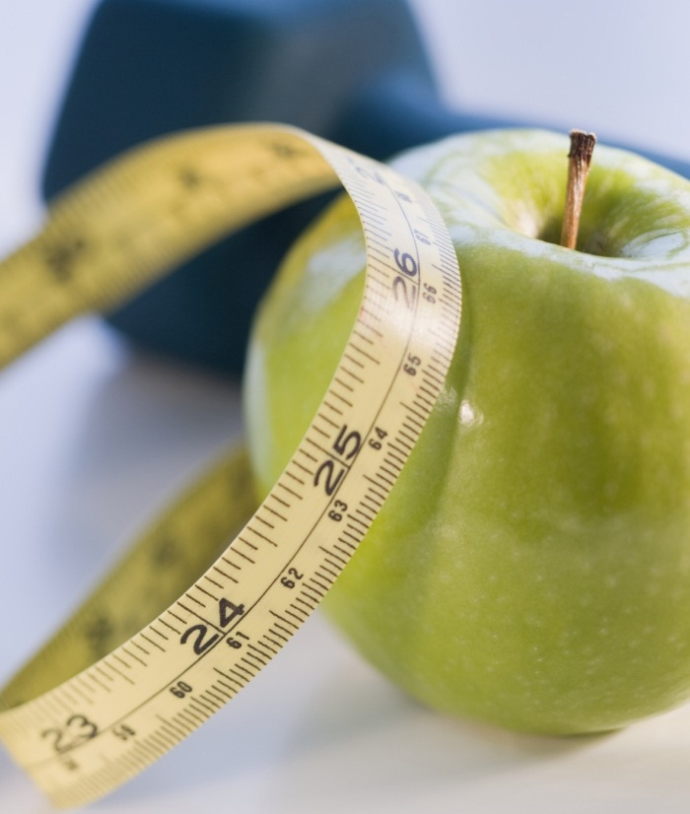
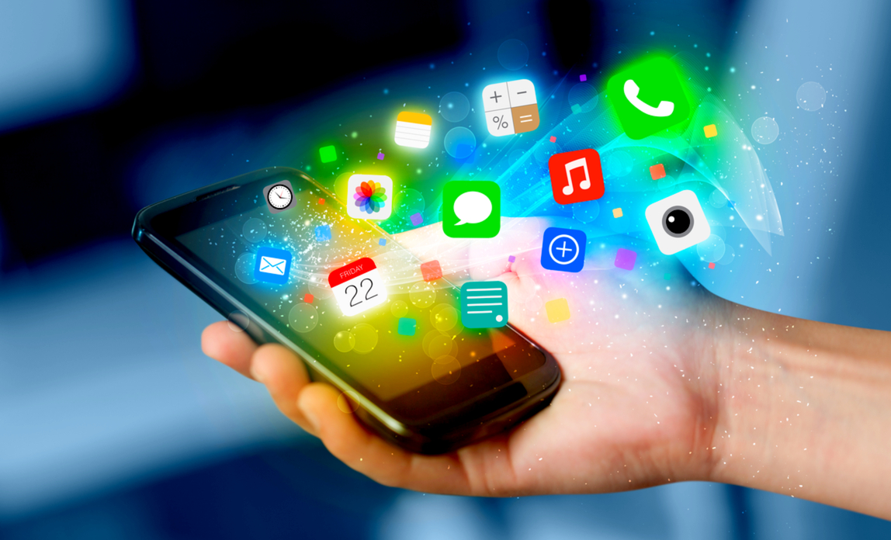
Implementing mobile app technology improving participant engagement and satisfaction
Gina Aquino, MSN, RN, CHSP
University of Detroit Mercy

Slide 2


INTRODUCTION: Project Committee
Topic of Interest
Implementing Mobile App Technology
Chair
Arthur Ko, Ph.D., RN
Reader
Karen Mihelich DNP, ACNS-BC, CDCES
Subject Matter Expert
Ameldia Brown, BSN, MDiv., RN
Notes:
My DNP proposal’s topic of interest relates to implementing mobile app technology. I would like to welcome, my Chair Dr Arthur Ko, my reader Dr Karen Mihelich, and my subject matter expert Ameldia Brown. I am so blessed to have worked with my dynamic trio!!
Time: 18 seconds

Slide 3
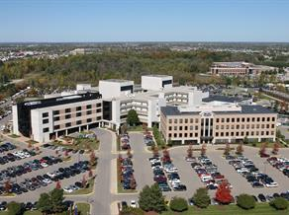
Background
Organization- Henry Ford Health System
Setting: HFMH Faith & Community Nursing Diabetes Prevention Program (DPP) -Virtual class
Mission Statement of the health system (macrosystem):
“To improve people’s lives through excellence in the science and art of health care and healing”.
Vision:
“Transforming lives and communities through health and wellness- one person at a time”
Values:
Each Patient First
Respect for People
High Performance
Learning and Continuous Improvement
A Social Conscience
(HFHS, 2018)
Notes:
The clinical site for my proposal was located at Henry Ford Macomb Hospital Faith & community nursing diabetes prevention program. As many of you know, Henry Ford Macomb is one of five hospitals within Henry Ford Health System. Henry Ford is continually pursing opportunities to bring its medical expertise and innovative tools, technologies and practices to the community. Being an alumna of Henry Ford Innovative Institute allowed me to develop my ideas for mobile app technology and brought my vision for use into action.
When considering my proposal topic, I wanted to ensure that my ideas aligned with our organization’s mission statement, vision, and values
First, HFHS is committed to improving the health and well-being of everyone in our diverse community.
Using innovative approaches during the pandemic, allowed the DPP classes to continue by using a virtual format. In essence, using Mobile app technology has the potential to provide a “link” between the community, lifestyle behavioral coach and the provider.
Time: 63 seconds

Slide 4
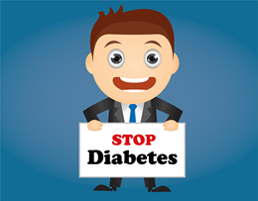
Background/Significance
Prevalence
what does this mean for our providers in clinical practice?
Why is technology important?
Diabetes
> 34.2 million Americans
7.3 million are undiagnosed
Average medical costs is $16,752/year
$9,601 is attributed to diabetes medical expenditures
More likely to develop other co-morbidities
Prediabetes
88 million adults
More than 1 out of 3
24.2 million adults ≥65 years
9 out of 10 adults do not know they have prediabetes
Potentially can be reversed with
  lifestyle interventions
  weight loss of ≥ 5-7 %
67,000 patients have prediabetes
14-30% patients with prediabetes will progress to type 2 diabetes within 5 years
Medicare requires payers to provide DPP services
High demand for DPP services
Recent COVID-19 data demonstrates patients with diabetes and obesity have a higher mortality/morbidity rate
To support the Increased number of DPP referrals
Ensuring participant satisfaction, engagement, and commitment was a challenge.
Barriers identified:
  Manual data entry of food intake and physical activity was time-consuming and tedious
  Time to review paper logs was extensive
  innovative approaches were needed to ensure the success of the DPP and resulting return on investment
Research suggests that technology-assisted DPP weight loss interventions could be both effective and cost-efficient
(ADA, 2018; CDC, 2014; CDC, 2018; Kirley & Williams, 2016)
Notes:
The prevalence of diabetes in Michigan has exceeded the national average almost every year for the past 30 years. While we have seen early signs of plateau in the incidence of diabetes, the number of cases continues to grow at an alarming rate (CDC, 2018). The estimated total costs of diabetes has risen 28% in 5 years, from $245 billion in 2012 to $327 billion in 2017 (ADA, 2018). Considering prediabetes, data from the CDC suggests that 88 million American adults (more than one out of three) have prediabetes and 9 out of 10 patients are not aware that they are at risk (CDC, 2014; CDC, 2016). Recent COVID-19 related data demonstrates patients with diabetes and obesity have a higher mortality/morbidity rate. Good news though-Prediabetes could potentially be reversed by following a lifestyle behavior modification program; such as the DPP. So, what does this data mean for our providers in clinical practice? A recent study that we conducted at a large health system, identified an estimated 67,000 patients were affected by prediabetes. Depending where they are on the prediabetes spectrum, 14-30% with prediabetes will progress on to develop T2DM within 5 years, which often leads to other co-morbidities. The American Medical Association believes that an increase in the number of patients with serious medical conditions can have a significant negative impact on the functioning of primary care practices. (CDC, 2014; CDC, 2018; Kirley & Williams, 2016). Due to the significant findings related to DPP research, Medicare now requires insurance payers to provide DPP services to their beneficiaries resulting in a high demand for classes thus making the use of mobile app technology important. In 2017, HFMH pilot study leveraged technology to develop a prediabetes patient registry to electronically screen, test, and refer patients for diabetes prevention which increased our referral numbers seven-fold allowing for the widespread availability of DPP Interventions. However, even though, our numbers increased, ensuring participant satisfaction, engagement, and commitment to the DPP was a challenge. Two specific barriers that were identified include manual data entry of daily food intake and physical activity was tedious and time-consuming while the time to review paper logs and provide constructive feedback during each class was lengthy. In order to keep up with the demand of DPP classes, innovate approaches needed to be incorporated to ensure the success of the DPP and resulting return on investment.
Time: 2 minutes, 40 seconds

Slide 5
Clinical questions?
Clinical Question 1 (Phase 1):
In adult participants 18 years of age and older enrolled in the Diabetes Prevention Program, how does use of mobile app technology affect participant's engagement and satisfaction with the program compared to manual documentation?
Clinical Question 2 (Phase 2):
In adult participants 18 years of age and older enrolled in the Diabetes Prevention Program, how does the use of mobile app technology affect patient outcomes; i.e., weight loss, physical activity, body mass index (BMI), and blood pressure (BP), as compared to manual documentation?
Notes:
Initially, my proposal plan included two phases. However, due to the pandemic my DNP project, had to be adapted to answer only the first clinical question proposed. In adult participants 18 years of age and older enrolled in the Diabetes Prevention Program, how does use of mobile app technology affect participant's engagement and satisfaction with the program compared to manual documentation? Time: 24 seconds
P: Participants ≥ 18 years of age enrolled in DPP
I: Use of mobile app technology for food and physical activity tracking
C: Use of mobile app technology as compared to manual documentation
O: Effect on participant engagement and satisfaction

Slide 6
Literature review- Technology and DPP
Use of Technology
Approx 90% of adults own a mobile phone; 58% own a smartphone
Mobile app tools are adopted quickly as developed
Barriers to Lifestyle Behavioral changes
Patient Engagement
Benefits
Many apps are available for patients and providers for self-care management and secondary disease prevention
Cost-effective and convenient
Potential for significant amounts of weight loss and improvements in A1C and BP in patients with prediabetes
Potential for significant improvement for all outcome measures, increased participation, and retention
Readiness to change
Language barriers
Cultural and religious beliefs
Barriers to eating healthy: Cost of fresh fruit and vegetables, accessibility to grocery store, time-constraints
Cost of mobile app technology or DPP class
Lack of Transportation to in-person classes
Barriers to physical activity: living in unsafe neighborhoods, costs for gym membership, physical limitations
Provider feedback allows for patient engagement
Engagement needs to be meaningful, trusted, easy, and convenient
Bian et al., 2017; Block et al., 2015; Fukuoka,et al., 2015; Grock et al., 2017; HIMSS, 2014; Kawulich et al., 2016
Notes:
Literature search strategies included searching for both qualitative and quantitative research studies within the past 10 years. Databases searched were the National Center for Biotechnology Information, MEDLINE, pubmed, and sladen library. Data was collected from the various studies and separated into four major themes that were relevant to my project. Data collected on the first theme, use of technology, suggests that approximately 90% of adults own a mobile phone, and 58% own a smart phone. Mobile app tools are adopted as quickly as developed resulting in the availability of many apps for self-care management and secondary disease prevention. Second, there were major benefits for using technology. First, most apps are cost-effective and convenient. App use can help support significant amounts of weight loss which may reduce the risk of diabetes and HTN and may help to enhance participation engagement, satisfaction, and retention. Third, key barriers were identified that prevent positive behavioral changes. Barriers can be caused by the patient not being ready to make a change or being in the precontemplation stage or could be related to other barriers; such as these listed here that prevent healthy eating habits or engaging in physical activity. Finally, the last theme grouped was patient engagement which suggests that by providing constructive provider feedback may help improve patient engagement and satisfaction. Time 1 min, 32 seconds

Slide 7

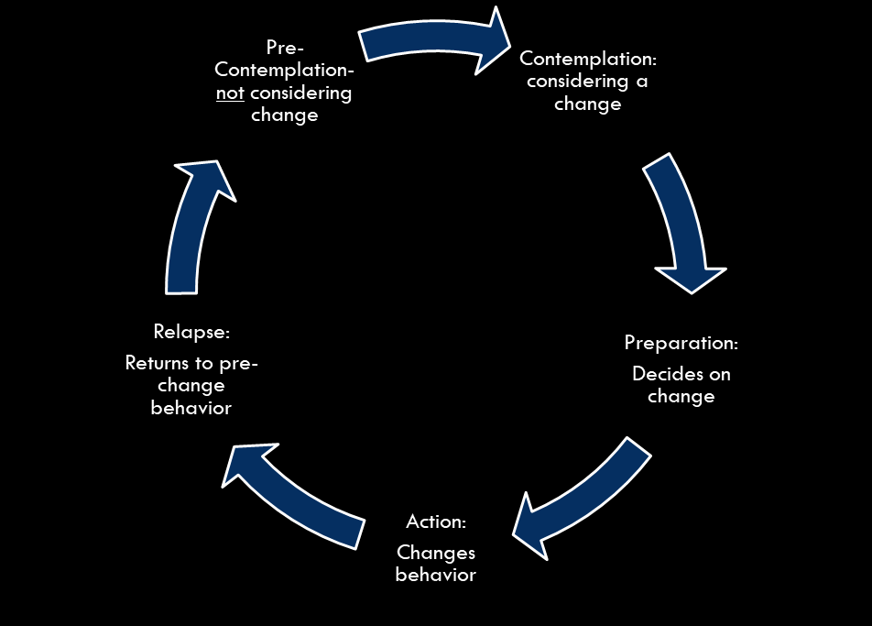
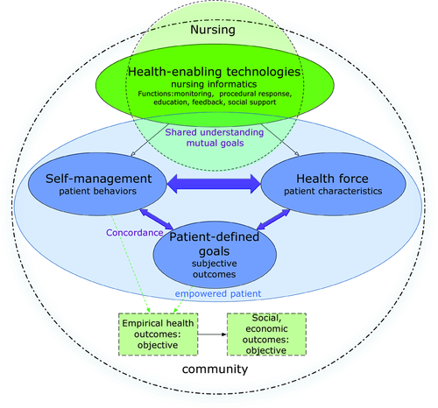

Theoretical framework
The Transtheoretical Model of Stages of Change
  Stages of Change
Empowerment Informatics Framework (EI)
Used to assess the participant’s readiness to change
(Kavulish, Mindrila, & Brandenburg, 2016; Knight & Shea, 2014)
Notes:
My project referenced two theoretical frameworks. First, Pro-chas-ka's, (1977) transtheoretical model of behavioral change which assesses the individual’ readiness to change to healthy behavioral intervention(s) such as the DPP. Secondly, Empowerment Informatics Framework or EI which has two major concepts. The first concept of EI suggests that nurses working with patients living with chronic illnesses can use health-enabling technologies to support the relationships among patients’ behaviors toward self-management, patients’ unique characteristics and context (health force), and the patients’ individual goals. The second concept of EI, health-enabling technologies are information and communication technologies that create conditions for sustainable, patient-empowering health choices. Patient’s direct interaction with Health enabling technologies increases their access to and control over information, removes barriers to empowerment, and assists them to sustain their self-management behaviors after professional intervention has ended- which is the goal of the DPP. By utilizing EI, this helped with designing technological interventions, evaluating the data collected, while supporting the ethical use of technology for self-management support. (TIME 1 min 30).

Slide 8
Purpose Statement
To assess the usability of mobile app technology and its effects on participant engagement and satisfaction within the Diabetes Prevention Program.
To assess whether implementing mobile app technology is effective in supporting the needs and goals of the participants in the Diabetes Prevention Program.
Notes:
This DNP proposal attempts to assess the usability of mobile app technology and its effects on participant engagement and satisfaction within the DPP. In addition, this study will assess whether implementing mobile app technology is effective in supporting the needs and goals of the participants in the DPP. This includes assisting the participants in following available evidence-based interventions; such as, documenting their daily food intake and minutes of physical activity. Finally, the purpose of this study was to gain consumer feedback on the mobile app used which will assist in developing or identifying an app for future use. Time 41 seconds

Slide 9
Methods/Design
Method/Design
Quasi-experimental comparative effectiveness study to measure the user’s interaction with a mobile app technology that utilizes smart-photo food journaling and its associated functions.
Setting and Participant Sample
HFMH Faith & Community DPP
Participants referred from HFMH ambulatory clinic providers and enrolled in the DPP
  Inclusion criteria: 18 years of age and older, newly diagnosed adults with prediabetes or met criteria of being high risk for developing type 2 diabetes
  Exclusion criteria: participants without access to iPhone, android device, tablet, or computer to be able to use mobile app technology.
Ethical Considerations included
Identifying the inclusion/exclusion criteria
IRB approval obtained from HFHS and the University of Detroit Mercy
Obtaining informed consent
Participation was voluntary
Notes:
The original design for this study was a quasi-experimental comparative effectiveness study used to measure the user’s interaction with a mobile app that utilizes photo-food journaling and its associated functions. The participant sample for this project proposal included participants referred from the community and enrolled into a virtual DPP class setting. Inclusion criteria: Adults 18 years and older with newly diagnosed prediabetes or have met the criteria of being high risk for developing type 2 diabetes. Exclusion criteria: participants without access to iPhone, android device, tablet, or computer to be able to use the mobile app technology. Ethical considerations included identifying the inclusion/exclusion criteria prior to collecting data and identifying the specific time-frames for the study to take place. Obtaining IRB approval was a slow process due to the pandemic, but IRB approval was obtained from both HFHS and the University of Detroit Mercy. Time: One minute, 7 seconds

Slide 10
METHODS/DESIGN (cont.)
Outcome Measures (Phase 1):
Quantitative:
  Body Mass Index (BMI), weight loss, A1c level, and Blood Pressure values
  Utilized System Usability Scale (SUS) questionnaire to assess usability of technology, engagement, and satisfaction
Qualitative:
  Readiness to Change was measured by DPP coaches prior to patients enrolling in DPP virtual class
  Utilized SUS questionnaire to assess and compare responses related to usability, engagement, and satisfaction
Descriptive Demographic Data:
  Race/ethnicity, age, gender, insurance payor, geographical area of residence, and health literacy
  Identify barriers in order to promote wellness and disease prevention
Notes:
The quantitative outcome measures included assessing body mass index (BMI), weight loss, A1c levels, Blood Pressure values and usability. The qualitative outcome measures included assessing patient usability of technology, engagement, satisfaction, efficiency, and effectiveness. Readiness to Change was measured by the DPP coaches utilizing a validated Readiness to Change questionnaire. Finally, Demographic data was collected as well.
Time: 19 seconds

Slide 11
IMPLEMENTATION PLAN- Phase 1
Utilize a modified System Usability Survey (SUS) tool
First Objective (Phase 1):
examine the usability of
mobile app technology.
Second Objective (Phase 1):
Assess patient engagement and satisfaction.
Third Objective (Phase 2):
effect on patient outcomes; (weight loss, BMI, A1c, & blood pressure)
Notes:
As stated earlier, this proposal is phase 1 of a larger institutional study around the use of mobile apps in an online DPP. The focus of this DNP project was to answer the first clinical question. The validated tool used for this project was a modified system usability scale (SUS) survey questionnaire used to aggregate and analyze the data. The first objective in phase one was to examine the usability of the mobile app selected to document food intake and physical activity compared to pen and paper documentation. The second objective was to examine whether the use of mobile app technology helped to increase patient engagement and satisfaction. Finally, the third objective is phase 2 which includes conducting further research to compare two or more mobile apps to analyze the affect on patient outcomes pre- and post-
(Time: 48 seconds)

Slide 12
IMPLEMENTATION (Phase 1)
Due to COVID-19 restrictions, in-class sessions were cancelled and converted to a virtual class format
As a result, there were limited participants available to test the usability of the mobile app, provide a comparison of two mobile apps, or address anthropometric outcomes.
Therefore, only the first PICO question was answered through evaluation of the Map4Health mobile app technology for
  Usability
  Participant engagement
  Satisfaction
Education and obtaining informed consent
Analysis consisted of utilizing a modified System Usability Score (SUS) which yielded a single number for each item accessed.
  This score represented a composite measure of the overall usability of the mobile app.
  Additional questions were included to assess user engagement, satisfaction, goals, and demographic information.
  Responses were analyzed by inductive/deductive coding to identify emergent themes
Costs were minimal. Map4Health technology was provided for 6 months free of charge for testing usability. Normal fees are $25 per coach/month and $300 annual fee to the organization.
Descriptive demographic data was collected and correlated with findings: age, gender, race/ethnicity, zip-code of home address, insurance payor, health literacy, language preferred, and preferred method of communicating with DPP lifestyle coach.
Baseline clinical data was collected by the DPP coach for each participant prior to first DPP session and use of technology. Baseline clinical data included: height, weight, BMI, A1c level or fasting blood sugar, and blood pressure reading. Clinical data was current and obtained within the past year.
Notes:
Due to COVID-19 restrictions, in-class sessions were cancelled and converted to a virtual class format. As a result, there were limited participants available to test the usability of the mobile app, provide a comparison of two mobile apps, or address patient outcomes. Prior to testing the mobile app, education was provided to both the DPP coach and patients on use of the mobile app. At this time, patients were also asked to sign an informed consent. The SUS tool was utilized to answer the first clinical question through evaluation of the Map4Health mobile app technology for usability, participant engagement, and satisfaction. SUS Analysis yielded a single number for each item accessed, which represented a composite measure of the overall usability of the mobile app. Time: 48 seconds
Additional questions were included to assess user engagement, satisfaction, goals, and demographic information. Responses were analyzed by inductive/deductive coding to identify emergent themes. Costs for this project were minimal. Healthy interactions, provided the Map4Health technology free of charge for 6 months to allow for testing usability. Descriptive demographic data was collected and correlated with the findings. Finally Baseline clinical data was collected by the DPP coach for each participant prior to first DPP session and use of technology.

Slide 13
Demographic data
De-identified
1:1 female/male
Both respondents completed college/graduate school
Both non-Hispanic and Caucasian
Primary language and preferred language- English
Geographical locations were different- rural and urban
Insurance Payer were different- Medicare and Commercial
Both unemployed/retired
Notes:
Demographic data was collected and de-identified. Time: 2 seconds
and consisted of one female and one male participant whose ethnicity and race were both of non-Hispanic and Caucasian origin. Both preferred English for learning. Both participants education level was considered high, with both completing college or graduate school. Both were either unemployed or retired with insurance coverage. Finally, the geographical locations where they lived was different- one lived in rural area; whereas the other was urban.

Slide 14
Technology- knowledge & skill level
Participant 1-
rated their knowledge and skill level as “high” with software experience
Participant 2-
rated their knowledge and skill level as “limited”
Notes:
When using technology, it was important to assess the knowledge and skill level of the participants and to provide support when needed. For this study, the participants skill level and knowledge differed. The first participant defined their knowledge and skill level as high with software experience; whereas the second participant defined their knowledge and skill level as limited. Time: 13 seconds

Slide 15
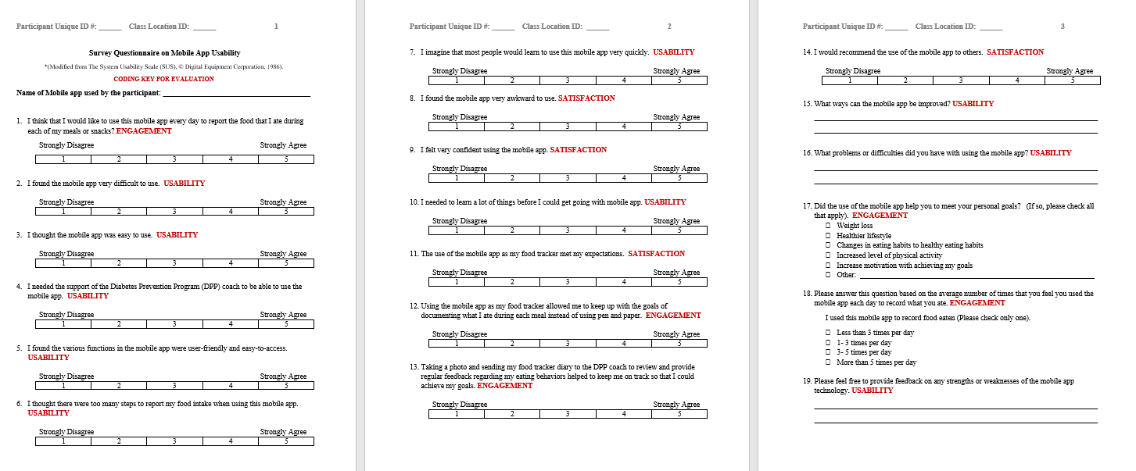
Sample tool
Notes:
This is an example of the modified System Usability Scale survey tool used to assess usability, engagement, and satisfaction. Time: 7 seconds
The sample SUS tool consisted of 10 questions to assess usability, 6 questions on engagement, and 4 questions on satisfaction. Other questions helped to collect demographic information, knowledge and skill level of technology, and health history.
.

Slide 16
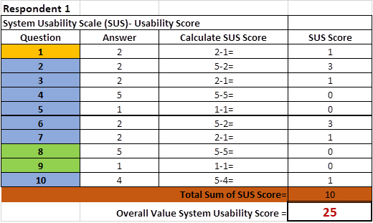
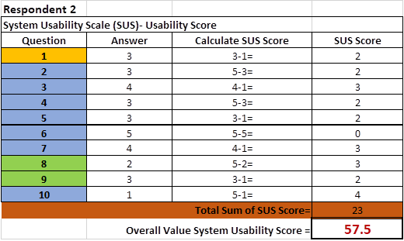
Results
Limitations: in-class sessions cancelled and reduce class participation resulted in limited responses.
Usability
The first participant rated in an overall value system usability score of 25 and the second had 57.5
According to Brooke (1996), "SUS yields a single number representing a composite measure of the overall usability of the system being studied. Note that scores for individual items are not meaningful on their own."
Scoring at the mean score of 68 is considered a C and anything below is an F (placing the usability of the product into the bottom 15%)
To score at the 10% of scores you need to have a mean score above an 80.3 to get an A.
At this point, is where users are more likely to recommend a product (measureu.com)
Notes:
These are the results of this study and how the scores for usability were tallied. Time: 5 seconds
There were several limitations to this study. First, there were limited responses. Next, all in-class sessions were cancelled resulting in switching the DPP class format to virtual. As a result, this reduced virtual class numbers due to many participants preferring in-person classes.
Results in respect to Usability
The first participant rated in an overall value system usability score of 25 and the second had 57.5
According to Brooke (1996), "SUS yields a single number representing a composite measure of the overall usability of the system being studied. Note that scores for individual items are not meaningful on their own."
Scoring at the mean score of 68 is considered a C and anything below is an F (placing the usability of the product into the bottom 15%)
To score at the top 10% of scores you need to have a mean score above an 80.3 to get an A.
At mean score above an 80.3 users are more likely to recommend a product (measureu.com)

Slide 17

GOALS of USING MOBILE APP
Responses include:
Weight loss
Healthier lifestyle
Increased level of physical activity
None of the above
Notes:
When accessing the participants goals for using the mobile app, The Responses from the participants included achieving Weight loss, AND a Healthier lifestyle, and to Increase their level of physical activity. Time: 11 seconds

Slide 18
Usability- challenges with using mobile app
Not user-friendly
“…more useful to DPP Coach”
Lack of image recognition technology
Photo image of plate of food was not helpful
Lack of food catalog or food/restaurant index
Unable to track # of calories, fat, protein (grams) consumed
Need to manually enter nutritional value of meals
Unable to duplicate meals, update, or edit older values
No field to add other biometric values; i.e., Pulse rate, waist circumference
Time-consuming
Limited functions available
Software failure
Limited knowledge of mobile app technology
Notes:
There were several challenges to using the mobile app. The consistent theme from comments included the app was not user friendly, there was a lack of image recognition technology, and the inability to edit or track meals or physical activity caused tracking to be ineffective. Time: 16 seconds

Slide 19
engagement
Meals are made to achieve goals and support diet
Used mobile app “3-5 times per day”
Used mobile app “less than 3 times per day”
“Strongly disagree” and “disagree” that using the mobile app as a food tracker allowed them to keep up with goals of documentation of each meal versus pen and paper
“Neither disagree or agree” and “disagree” uploading a photo and sending food tracker diary to DPP coach for review and feedback helped to achieve goals
Notes:
These are the Results for engagement with using the mobile app. Engagement with usage varied between the participants. Time: 7 seconds

Slide 20
satisfaction
Four questions on the SUS survey tool addressed satisfaction with using the mobile app technology
Both participants suggested that they would not recommend the use of the mobile app to others
Neither participant was satisfied with using the mobile app as their food tracker
Notes:
Four questions on the SUS survey tool were related to satisfaction with using the mobile app technology selected. Both participants stated that they were not satisfied with using the mobile app as their food tracker and therefore would not recommend the use of the mobile app to others. In the free-text box both participants shared their recommendations for selecting a mobile app which I will discuss on the next slide. Time: 25 seconds

Slide 21
Recommended features for selecting a mobile app
User-friendly
Intuitive photo-food journaling
Editing options
Useful dashboard
Self-management support based on diagnosis
Food catalog or index
Blue Tooth Capabilities
Calories Burned Calculator
HIPAA compliant
I.T. Support for Users
User Manual
Notes:
Key features for a mobile app that were recommended by the participants for future testing include being HIPAA compliant, user-friendly with photo recognition software for meal entry and blue-tooth capabilities for physical activity tracking. Time: 14 seconds

Slide 22
Lessons learned
Implementing mobile app technology can be challenging during a pandemic
In-person class sessions cancelled
CDC recommendations resulted in-class format switching to virtual
Number of classes decreased
Class-size reduced
Virtual technology was a safe way to communicate with patients, family, and friends
Need to assess the patient’s readiness to change to different mode of delivery of DPP class and use of technology
Virtual learning is not for everyone
In the beginning, using virtual technology was inconvenient for patients
As more patients became acclimated to using virtual technology and skill level increased, it became more convenient to schedule virtual class sessions
If possible, have alternative options or methods for participation; i.e., virtual and in-person
Use of multidisciplinary team is needed when choosing mobile app for use, integrating the mobile app process, and addressing issues
Imperative to review and test various mobile apps and features prior to testing on DPP cohort.
Skill of patient needs to be considered when choosing mobile app
Monitor the use of mobile app to identify challenges that patient is facing
If needed, implement other strategies to support the patient and keep them engaged and committed
User-friendly tools may help support self-management and attainment of goals
Notes:
There were many lessons learned and key strategies that I will use when continuing this project. First, trying to Implement and test mobile app technology was very challenging during the pandemic. In the future, I would like to be able to use a multidisciplinary team when choosing the next mobile app for use. This will help with integrating the mobile app process, and to address issues when testing. In addition, I would like to have a focus group consisting of certified diabetes educators, I.T., nurses, physicians, DPP coaches, and patients to review and test various mobile apps and features prior to testing on a DPP cohort. Next, I learned that virtual learning is not for everyone. If possible, it is important to have alternative options or methods for participation. For example, having both virtual and in-person classes is a good strategy because you are giving participants the option for learning based on their preferred method of communication and skill-level on use of technology. Other Key take-aways: nurses need to assess the skill level of the patient and the patient’s readiness to change to the use of new technology, especially if they are comfortable with using another. Finally, it is imperative to monitor and assess the use of mobile app technology to identify challenges that the patient is facing and if needed, implement other strategies to support the patient while keeping them engaged and committed. By providing tools that are user-friendly ultimately may help support self-management and attainment of patient goals. Time: One minute, 35 seconds
Assumptions are not always accurate - patients may rate their skill level as high and vice versa but have challenges with using technology

Slide 23
Nursing implications
As a result of this project, implementing technology was essential to providing health care to diverse populations in various geographical areas.
As a DNP student or advanced practicing nurse, one needs to adapt to health care challenges and strive to identify ways to incorporate research into evidence-based practice
Potential impact towards nursing and clinical practice: If this study was fully implemented, by providing a choice of learning mode (virtual/in-person) and with an adequate sample size, the data gathered may be useful in determining the impact of mobile app use on patients with prediabetes and other chronic diseases and the benefits of mobile apps in supporting self-care management and improve health outcomes.
Sustainability and dissemination
  Discuss project with organizations and companies that are interested in mobile app technology
  Share knowledge gained from this study
  Create multidisciplinary team to develop mobile app technology based on patient feedback
  Continue research to implement evidenced-based programs that are cost-effective and improve the quality of care provided
    Patient-centered care
    Provide customized education and materials for different cultures and health literacy levels
    Continue referrals to community-based programs
    Support self-management of chronic conditions to help patients take an active role in their health care which can improve health outcomes
Notes:
Due to the pandemic, implementing technology was essential to providing health care to diverse populations in various geographical areas. As a DNP student or advanced practicing nurse, one needs to adapt to health care challenges and strive to identify ways to incorporate research into evidence-based practice. I agree with Knight and Shea, “Many nurses support patients who are living with chronic conditions and as pressures related to cost and access to care increase, technology-enabled self-management interventions will become increasingly common. Using the patient-focused Empowerment Informatic Framework can help guide nursing practice using technology that prioritizes the patients needs” (Knight & Shea, 2014). If this study was fully implemented, by providing a choice of learning mode (virtual/in-person) and with an adequate sample size, the data gathered may be useful in determining the impact of mobile app use on patients with prediabetes and other chronic diseases and the benefits of mobile apps in supporting self-care management to improve health outcomes. Considering sustainability and dissemination. I will continue to discuss this project findings with other organizations that are interested in mobile app technology. In addition, I will share the knowledge gained from this study by submitting abstracts for conferences and possible publications.
Time: One minute 22 seconds
Challenges identified help to address issues with usability, engagement, and satisfaction.
In the future, as stated earlier, I plan on creating a multidisciplinary team to develop mobile app technology based on patient feedback. In addition, I would like to continue my research by implementing other mobile app technologies that are cost-effective to support evidenced-based programs; such as the DPP, that will allow patients to take an active role in their health care through self-management of their chronic conditions.

Slide 24
Mobile tools adopted as quickly as developed
Promotes and supports positive lifestyle behavioral changes such as; healthy eating, physical activity, and self-management
App available when and where needed
HIPAA Compliant- Safe, efficient, and effective
Provides feedback between user and provider
Patient-centered goals for self-care management
To decrease manual data entry mobile apps features should integrate to the EMR, pharmacies, patient’s medical devices, etc.
Synchronization of other apps allows for communication between interfaces
Health care application interface for intuitiveness and usability
Reporting data to CDC for Diabetes Prevention Program
Development of Committee is needed to spread through health system and for sustainability
Overall, the use of the mobile platform can act as a magnifying glass to obtain a clearer picture of why patients are not meeting their goals which can help guide the provider and patient with readjusting goals that are attainable.
NEXT STEPS: Application to Health Care Technologies
(Harrison, Flood, & Duce, 2013; Hoffer, George,& Valacich, 2014; and IDF, 2018)
Notes:
Next steps- Mobile app tools are adopted as quickly as developed and because there are so many apps available, nurses can help patients identify the mobile app that best suits their needs while allowing for the patient to gain access to useful information when and where they need it to help promote healthy living. When choosing a mobile app for the patient, one must ensure that the app is safe, HIPAA compliant, cost-efficient, and effective. Time: 26 seconds

Slide 25
Acknowledgements
❤ Grazie Millie ❤ Domo arigato gozaimasu ❤ Mahalo ❤
UDM Family
HFHS Family
My Family
Dr Arthur Ko
Dr Karen Mihelich
DNP Cohort- Taylor, Edith, Cheryl, Mary, Jeanette, Noel, and Cathy
Dr Roseann Burson
Dr Patricia Rouen
Dr Janet Baiardi
Dr Mary White
Dr Kathy Moran
Ameldia Brown
Dr Christopher O’Connell
DPP Coaches- Marian Giacona, Patricia Jurek, La Tonya Allen-Brown
Madelyn Humbert
Jill Yore
Therese Mianecki
Mary Ann DiMarco, IPSO
Karen Buncich, Healthy Interactions, LP
Children: Steven, Gino, Danyelle, Paige,
Sarah, Mimi, Richard
Grandkids: Duayne, DeAnna, Aiden, Rheo, Ryan, Lanori, Skylar
My Mom and Papa
God 🙏💪👩‍⚕️👼
Thank you for all your support, prayers, encouragement, and faith! Together we can accomplish anything!!
❤🙏💪🤗😘

Slide 26


Slide 27
References
American Diabetes Association (ADA), (2018, March). Economic Costs of Diabetes in the U.S. in 2017. [Diabetes Care]. dci180007. https://doi.org/10.2337/dci18-0007
Bian, R. R., Piatt, G. A., Sen, A., Plegue, M. A., Michele, M. L., Hafez, D., . . . Richardson, C. R. (2017). The effect of technology-mediated diabetes prevention interventions on weight: A meta-analysis. Journal of Medical Internet Research, 19(3). doi:10.2196/jmir.4709
Block, G., Azar, K. M., Romanelli, R. J., Block, T. J., Hopkins, D., Carpenter, H. A., . . . Block,
C. H. (2015). Diabetes prevention and weight loss with a fully automated behavioral intervention by email, web, and mobile phone: A randomized controlled trial among persons with prediabetes. Journal of Medical Internet Research, 17(10). doi:10.2196/jmir.4897
CDC (Centers for Disease Control & Prevention). (2014). National diabetes statistics report, 2014. Retrieved from https://www.cdc.gov/diabetes/pubs/statsreport14/national-diabetes-report-web.pdf
CDC (Centers for Disease Control & Prevention). (2016). National diabetes prevention program: What is the national DPP? Retrieved from https://www.cdc.gov/diabetes/prevention/ about/index.html
CDC (Centers for Disease Control & Prevention). (2018). Diagnosed diabetes. Retrieved from http://gis.cdc.gov/grasp/diabetes/DiabetesAtlas.html
CMS (Centers for Medicare & Medicaid Services). (2018). Medicare diabetes prevention program (MDPP) expanded model. Retrieved from https://innovation.cms.gov/initiatives/ medicare-diabetes-prevention-program/
Cha, E., Kim, K. H., Umpierrez, G., Dawkins, C. R., Bello, M. K., Lerner, H. M., . . . Dunbar, S. B. (2014). A feasibility study to develop a diabetes prevention program for young adults with prediabetes by using digital platforms and a handheld device. The Diabetes Educator, 40(5), 626-637. doi:10.1177/0145721714539736
Dutton, G. R., Johnson, J., Whitehead, D., Bodenlos, J. S., & Brantley, P. J. (2005). Barriers to physical activity among predominantly low-income African- American patients with type 2 diabetes. Diabetes Care, 28(5), 1209-1210. doi:10.2337/diacare.28.5.1209
FDA. (2016). Mobile medical applications: Guidance for industry and food and drug administration staff. Retrieved from https://www.fda.gov/downloads/MedicalDevices/DeviceRegulation and Guidance/Guidance Documents/UCM263366.pd
Fukuoka, Y., Gay, C. L., Joiner, K. L., & Vittinghoff, E. (2015). A novel diabetes prevention intervention using a mobile app. American Journal of Preventive Medicine, 49(2), 223-237. doi:10.1016/j.amepre.2015.01.003
Furukawa, M. F., King, J., Patel, V., Hsiao, C., Adler-Milstein, J., & Jha, A. K. (2014).Despite substantial progress in EHR adoption, health information exchange and patient engagement remain low in office settings. Health Affairs, 33(9), 1672-1679. doi:10.1377/hlthaff.2014.0445
Gold, M., & McLaughlin, C. (2016). Assessing HITECH Implementation and Lessons: 5 Years Later. Milbank Quarterly, 94(3), 654–687. http://doi.org/10.1111/1468-0009.12214
Grock, S., Ku, J., Kim, J., & Moin, T. (2017). A review of technology-assisted interventions for diabetes prevention. Current Diabetes Reports, 17(11). doi:10.1007/s11892-017-0948-2
Harrison, R., Flood, D., & Duce, D. (2013). Usability of mobile applications: Literature review and rationale for a new usability model. Journal of Interaction Science, 1(1), 1-16. doi:10.1186/2194-0827-1-1
.

Slide 28
References
Hoffer, J. A., George, J. F., & Valacich, J. S. (2014). Modern systems analysis and design (7th ed.). Pearson Education Limited.
HFHS. (Henry Ford Health System). (2017). Quality metrics and data. Retrieved from Henry Ford Health System intranet
HFHS. (Henry Ford Health System). (2018). Henry Ford Health System information. Retrieved from Henry Ford Health System intranet.
HFMH. (Henry Ford Macomb Hospital). (2017). DPP Lifestyle Coach/Patient Survey.
HFMH. (Henry Ford Macomb Hospital). (2016). Community health needs assessment (CHNA): Called to care project.
HIMSS. (2014). The State of Patient Engagement and Health IT. Chicago. Retrieved from http://www.himss.org/state-patient-engagement-health-it?ItemNumber=32950 Manuscript, A. (2010). NIH Public Access, 2(1), 1–10.
HIMSS. (2015). Patient Engagement: What is patient engagement? Retrieved from http://www.himss.org/library/patient-engagement-toolkit
Interaction Design Foundation (IDF). (2018). How to conduct a cognitive walkthrough. Retrieved from https://www.interaction-design.org/literature/article/how-to-conduct-a-cognitive-walkthru
Islam, N. S., Tandon, D., Mukherji, R., Tanner, M., Ghosh, K., Alam, G., . . . Trinh-Shevrin, C. (2012). Understanding Barriers to and Facilitators of Diabetes Control and Prevention in the New York City Bangladeshi Community: A Mixed-Methods Approach. American Journal of Public Health, 102(3), 486-490. doi:10.2105/ajph.2011.300381
Johnson, M., Everson-Hock, E., Jones, R., Woods, H. B., Payne, N., & Goyder, E. (2011). What are the barriers to primary prevention of type 2 diabetes in black and minority ethnic groups in the UK? A qualitative evidence synthesis.
Diabetes Research and Clinical Practice, 93(2), 150-158. doi:10.1016/j.diabres.2011.06.004
Kawulich, B. B., Mindrila, D., & Brandenburg, G. (2016). Evaluation of a diabetes prevention program for rural citizens. Georgia Public Health Association, 5(3), 240-249.
Kirley, K., & Williams, J. (2016). Bending the diabetes curve at Henry Ford Macomb [PPTX Presentation].
Knight, E.P., & Shea, K. (2014). A patient-focused framework integrating self-management and informatics. Journal of Nursing Scholarship: an official publication of Sigma Theta Tau International Honor Society of Nursing, 46(2), 91-7. https://doi.org/10.1111.jnu.12059.
Meyer, M. R., Sharkey, J. R., Patterson, M. S., & Dean, W. R. (2013). Understanding contextual barriers, supports, and opportunities for physical activity among Mexican-origin children in Texas border colonias: A descriptive study. BMC Public Health, 13(1), 1-15. doi:10.1186/1471-2458-13-14
Sarkar, U., Gourley, G. I., Lyles, C. R., Tieu, L., Clarity, C., Newmark, L., . . . Bates, D. W. (2016). Usability of commercially available mobile applications for diverse patients. Journal of General Internal Medicine, 31(12), 1417-1426. doi:10.1007/s11606-016-3771-6
Vigersky, R. A. (2015). The benefits, limitations, and cost-effectiveness of advanced technologies in the management of patients with diabetes mellitus. Journal of Diabetes Science and Technology, 9(2), 320-330. doi:10.1177/1932296814565661

