Slide 1

Using Comparative Charting to Assess Effectiveness of Symptom management with Home-Based Hospice Patients
Akisha Clark RN, MSN, CCM

Slide 2
Introduction
Hospice nurses' documentation
Lack of standardized charting techniques
Patient outcome measurements
CMS does not provide concrete examples or details regarding charting requirements

Slide 3
Background
Patient health decline portrayed in documentation
Charting symptom management
Southeastern Michigan free-standing home-based hospice organization

Slide 4
Significance to Health Care
Surges in palliative and hospice care referrals
Growing patient population
Increased opportunity for gaps in care
Financial impact
Denial of payment
Rescinded payment
Patient Complexities
Acuity
Social
Informal hand-off reporting
Loss of benefits

Slide 5

Clinical Question
Will a standardized comparative charting tool increase compliance with comparative charting?

Slide 6
Review of Literature
Standardized Charting
Increased documentation
Quality Indicators
Measured outcomes
Concise processes
Improved outcomes
Information collection
Increased net income

Slide 7
Barriers to Comparative Charting
Lack of effective training
programs
Poor monitoring
Usability of existing charting systems
Documentation of patient care
Incomplete assessments

Slide 8
Purpose Statement
Will implementation of a comparative charting tool assist the nurse to improve comparative charting?

Slide 9

Theoretical Framework
W. Edward Deming’s Model for Improvement
  Plan, Do, Study, Act (PDSA)

Slide 10
Organizational Assessment
Readiness for Change
Shared viewpoint
Staff buy-in
Collective efforts

Slide 11
Quality Improvement Tools
Investigation Tools
Stakeholder Questionnaire
Cause-Effect Diagram
Process Map
Driver Diagram
“5 whys” Assessment
The Institute for Healthcare Improvement (IHI) website (2021)

Slide 12
Specific Aim
Does the electronic health record “free-text” sections for pain management and shortness of breath for home-based hospice patients show increasing in comparative charting after 4 weeks by 30%?

Slide 13
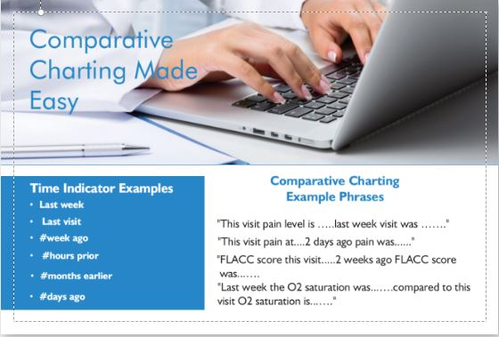
Methods/Design: QI Project

Slide 14
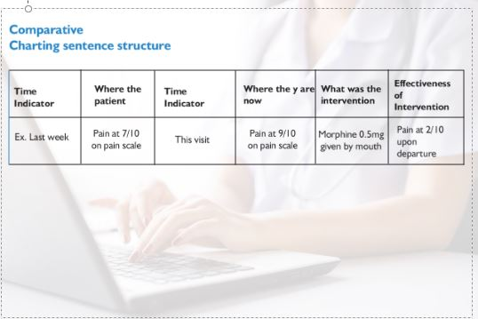

Slide 15
Intervention Implementation
Pre-Chart Audit completed (28)
Pre-survey conducted
Comparative Charting Tool(CCT) cards provided to staff
Hosted in person and video staff education meeting
Intervention conducted 6/3/21-7/3/21
1. Post Chart Audit completed (28)
2. Post-intervention survey conducted

Slide 16
Measures and Analysis
Outcome Measures
Pre and post chart audits
Pre and post nurse surveys

Slide 17
Pre and Post Survey Results

Slide 18
Pre and Post Comparative Chart Audit Question

Slide 19
Pre and Post Comparative Chart Audit

Slide 20

Discussion
Nurses’ perspectives
Standardized charting does meet expectations and requirements for CMS

Slide 21
Implications for Practice
Adopting techniques
Need for EHR to support standardizing charting
Using standardized charting for other documentation area
Comparative charting will become the gold standard

Slide 22
Sustainability
Organization Support
Continued Integration
Prevent Project Fatigue
Identify and Address Barriers
Monitor Performance
Measure Outcomes
Celebrate Successes

Slide 23
Dissemination
Publish the results of the QI project
Submit an abstract to present at state and national hospice conferences.
Share results with other hospice organizations
Explore working groups to share information

Slide 24
Gratitude
Dr. Julia Stocker-Schneider
  Thank you for your mentorship and guidance throughout this process.
Dr. Audris Smith
  Thank you for your attention to detail and professionalism.
University of Detroit Mercy
  Throughout this journey, you have guided and prepared me for success. I am proud to be a Titan.
My organization
  From my first day until now, you continue to maintain a culture of acceptance, integrity and dignity. Thank you.
Family and Friends
  Thank you for being my cheering squad.
Colleagues and classmates
  Let’s continue to be great!

Slide 25
References
Alexander, S., Ladwig, S., Norton, S., Gramling, D., Davis, K., Metzger, M., Deluca, J., & Grambling, R. (2014). Emotional distress and compassionate responses in palliative care decision-making consultations. Journal of Palliative Medicine. 17(5), 578-584.
Bao, A., Amestoy, S., Sonto de Moura, G., & Trindade, L. (2019). Quality Indicators: tool for the management of best practices in health. Revista Brasileria de Enfermagem. 72(2), 378-385.
Barnes, S., Waterman, M., MacIntyre, D., Coughenour, J., and Kessel, J. (2010). Impact of standardized trauma documentation to the hospital's bottom line. Surgery. 148 (4) 793-798
Bergen-Jackson, K., Sanders, S., Herr, K., Fine, P., Titler, M., Forcucci, C., Reyes, J., & McNichol, P. (2009). Determining community provider practices in hospices. The challenges of documentation. 11(6), 334-341
Cagle, J., Rokoske, F., Durham, D., Schenck, P. A., Spence, C., & Henson, L. (2015). Use of electronic documentation for quality improvement in hospice. American Journal Medicine Quality. 27 (4), 282-290
Center for Medicare and Medicaid Services. (2020). CAHPS Hospice Survey. CMS.gov. https://www.cms.gov/Research-Statistics-Data-and-Systems/Research/CAHPS/CAHPS-Hospice-Survey
Center for Medicare and Medicaid Services. (2020). State Surveyors Operations Manual. pdf
Center for Medicare and Medicaid Services. (2017). Medicare Learning Fact Sheet. pdf
Chung, K., Bell, R. & Lee, D. (2006). A point of care clinical documentation system for hospice care providers. Journal of Medical Systems. 30, 33–37. https://doi.org/10.1007/s10916-006-7401-4
Curtis, R., Sathitratanacheewin, S., Starks, H., Lee, R., Kross, E., Downey, L., Sibley, J., Lober, W., Loggers, E., Fausto, L., Lindvall, C., & Engelberg, R. (2018). Using electronic health records for quality measurement and accountability in care of the seriously ill: opportunities and challenges. Journal of Palliative Medicine. 21(S2). https://doi.org/10.1089/jpm.2017.0542
Dudgeon, D. (2017). The impact of measuring patient-reported outcome measures on quality of and access to palliative care. Journal of Palliative Medicine. 21(S2). https://doi.org/10.1089/jpm.2017.0447
Dy, M. S., Herr, K., Bernacki, R., Kamal, A., Walling, A., Ersek, M., & Norton, S. (2016). Methodological research priorities in palliative care and hospice quality measurement. Journal of Pain and Symptom Management. 51(2), 155-162
Dy, M. S., Kiley, K., Ast, K., Lupu, D., Norton, S., McMillian, S., Herr, K., Rotella, J., & Casarett, D. (2015). Measuring what matters: Top-ranked quality indicators for hospice and palliative care from the American academy of hospice and palliative medicine and hospice and palliative nurses association. Journal of Pain and Symptom Management. 49(4), 773-781

Slide 26
Kamal, A., Nicolla, J., & Power, S. (2017). Quality improvement pearls for the palliative care and hospice professional. The Journal of Pain and Symptom Management. 54(5), 758-765. https://doi.org/10.1016/j.jpainsymman.2017.07.040
Kamal, A., Bull, J., Kavalieratos, D., Nicolla, J., Roe, L., Adams, M., & Abernathy, A. (2016). Development of the quality data collection tool for prospective quality assessment and reporting in palliative care. Journal of Palliative Medicine. 19(11). https://doi.org/10.1089/jpm.2016.0036
Kamal, A., Kavalieratos, D., Bull, J., Stinson, C., Nicolla, J., & Abernathy, A. (2015). Usability and acceptability of the QDACT-PC, an electronic point-of-care system for standardized quality monitoring in palliative care. Journal of Pain and Symptom Management. 50 (5), 615-621
Kamal, A., Hanson, L.,Casarett, D., Dy, S., Pantilat, S., Lupu, S., Abernethy, A. (2015). The quality imperative for palliative care. The Journal of Pain and Symptom Management. 49(2), 243-253. https://doi.org/10.1016/j.jpainsymman.2014.06.008
Kamal, A., Bull, J., Ritchie, C., Kutner, J., Hanson, L., Friedman, F., Taylor, D., & The AAHPM Research Committee. (2015). Adherence to measuring what matters measures using point-of-care data collection across diverse clinical settings. Journal of Pain and Symptom Management, 51(3), 499-503
Kamal, A., Nipp, R., Bull, J., Stinson, C., Lowery, A.,Nicolla, J., & Abernathy, A. (2015). Quality of palliative care for patients with advanced cancer in a community consortium. Journal of Pain and Symptom Management. 49(2), 289-292. https://doi.org/10.1016/j.jpainsymman.2014.05.024
Kamal, A., Harrison, K., Bakitas, M., Dionne-Odom, J. N., Zubkoff, L., Akyar, I., Pantilat, S., O'Riordan, D., Bragg, A., Bischoff, & Bull, J. (2015). Improving quality of palliative care through national and regional collaboration efforts. Cancer Control. 22(4), 396-402. https://doi.org/10.1177%2F107327481502200405
Kamal, A., Bull, J., Stinson, C., Blue, D., Smith, R., Hooper, R., Kelly, M., Kinsella, J., Philbrick, M., Gblokpor, A., Wheeler, J., Downey, W., & Abernathy, A. (2011). Collecting data on quality is feasible in community-based palliative care. Journal of Pain and Symptom Management. 42(5), 663-667
Leff, B., Carlson, C., Saliba, D., & Ritchie, C. (2015). The invisible homebound: Setting quality of care standards for home based primary and palliative care. Health Affairs. 34(1). https://doi.org/10.1377/hlthaff.2014.1008

Slide 27
Nation, L. (2019). Using the international classification of functioning, disability and health to document hospice eligibility. Journal of Hospice and Palliative Nursing. 21(3), 237-244
National Hospice and Palliative Care Program. (2021). Hospice Quality Public Reporting. https://www.nhpco.org/regulatory-and-quality/quality/hospice-quality-public-reporting-hospice-compare/
Phoebe, A., & Lilian, I. (2017). Nursing Documentation: A survey of hemodialysis documentation status at Kenyatta National Hospital’s renal unit. American Research Journal of Nursing. 3(1).
Quality by Design : A Clinical Microsystems Approach, edited by Eugene C. Nelson, et al., John Wiley & Sons, Incorporated, 2007. ProQuest Ebook Central, http://ebookcentral.proquest.com/lib/udmercy/detail.action?docID=290310.
Seow, H., Synder, C., Mularski, R., Shugarman, L., Kutner, J., Lorenz, K., Wu, A., & Dy, M. S. (2009). A framework for assessing quality indicators for cancer care at the end of life. Journal of Pain and Symptom Management. 38(6), 903-912. https://doi.org/10.1016/j.jpainsymman.2009.04.024
Sisson, P. (2013, June 13). 112 million claim filed against SD Hospice. The San Diego Union-Tribune. https://www.sandiegouniontribune.com/news/health/sdut-hospice-bankruptcy-san-diego-millions-2013jun18-story.html
Steindal, S., Sorbye, W. L., Bredal, S. I., & Lerdal, A. (2011). Agreement in documentation of symptoms, clinical signs, and treatment at the end of life: a comparison of data retrieved from nurse interviews and electronic patient records using the Resident Assessment Instrument for Palliative Care. Journal of Clinical Nursing. 21, 1416-1424
Wilson, W. (2018). Inadequate nurse’s notes lead to lawsuit. Caring for the Ages. 3, 14-15
Wysham, N., Hochman, M., Wolf, S., Cox, C., & Kamal, A. (2016). Performance of consultative

Slide 28
Questions
Thank you for your attention to this presentation!

