Slide 1
Improving Care:
Clinical Guideline Implementation to
Reduce Urinary Tract Infections Treated by Antibiotics in Hospice Patients
Jamie A. Meyer, MSN, APRN, AGCNS-BC, AGPCNP-BC
Notes:
Good morning, I am Jamie Meyer and I will be presenting my quality improvement project: Improving Care: Clinical guideline implementation to reduce urinary tract infections treated by antibiotics in hospice patients.

Slide 2
Introduction
Urinary tract infections (UTI) is a category of infections
Patients at end of life at increased risk for UTIs
Hospice patients have many factors that put them at an increased risk of UTIs.
The majority of direct patient care provided to hospice patients is predominantly provided by non-licensed health care workers, family members, and friends.
Healthcare providers face challenges when diagnosing, treating, and managing UTIs.
(CDC, 2015)
Notes:
A urinary tract infection (UTI) is an infection of the urinary tract. Hospice patients present with many factors that put them at an increased risk of UTIs. These risks include the co-morbidities of cardiac, pulmonary, neurological combined with age-related urinary tract changes such as weakened pelvic muscles, resulting in incomplete emptying of the bladder, urinary retention, and bacterial colonization of the urinary tract (CDC, 2015).
The majority of direct patient care provided to hospice patients is predominantly provided by non-licensed health care workers, family members, and friends. Since disease manifestations in the hospice population varies due to inability of patients to communicate their symptoms, healthcare providers face challenges when diagnosing, treating, and managing UTIs. Thus, the caretakers need to have the knowledge and awareness of conditions that increase the incidence of UTIs in this very vulnerable population.

Slide 3
Background
Two types of bacteriuria
  Asymptomatic bacterial UTI
    (MedlinePlus, 2016), (Genao & Buhr, 2012)
  Symptomatic bacterial UTI
    (Genao & Buhr, 2012).
Antimicrobial prescribing at end of life (Juthani-Mehta-Mehta, Malani, & Mitchell, 2015)
  40-75% of antibiotic use is inappropriately used in hospice
    (Gradalski & Burczyk-Fitowska, 2017)
Hospice goals of care
Setting: Kindred Hospice, Grand Rapids, MI
Notes:
Urinary tract infections are classified into two types of bacteriuria: asymptomatic and symptomatic bacterial UTI. Asymptomatic bacterial UTI is the occurrence of bacteria in the urine without causing symptoms (MedlinePlus, 2016). It is not recommended to treat patients with asymptomatic bacterial UTI due to putting patients at risk of recurrent infections with multi drug resistant bacteria (Genao & Buhr, 2012). Whereas a diagnosis of symptomatic bacterial UTI is the presence of localizing genitourinary symptoms with a significant colony counts of bacteria in the patient’s urine (Genao & Buhr, 2012, para. 3).
Antimicrobials are commonly prescribed to dying patients in the absence of adequate clinical symptoms to support a bacterial infection (Juthani-Mehta-Mehta, Malani, & Mitchell, 2015). Hospice patients are vulnerable to infections due to the suppressed immune function, multiple comorbid conditions, functional debility and complex diseases that compromise host resistance. Hospice goals of care are to minimize suffering, maximize quality of life, preserve patient dignity, and to neither prolong nor hasten the dying process. As hospice care changes the focus from curative care to symptom management therefore complicating the decision to use antibiotics. Recent studies have demonstrated 40-75% of antibiotic use is inappropriately used in hospice, particularly in the healthcare setting (Gradalski & Burczyk-Fitowska, 2017). The setting for this project was at Kindred Hospice in Grand Rapids, MI.

Slide 4
Significance:
Organization Specific Data
UTI’s are the second most common infection putting geriatric adults lives at risk for morbidity associated with UTI infections
2018, 100 occurrences of UTIs
April 2020 to October 2020, seventy-one occurrences of UTIs
Current practice
Notes:
The organization mission is to honor life and offer compassion to individuals and their families when facing a life-limiting illness. To uphold to the mission and vision of the organization focusing on creating a positive difference in the patient’s lives and memorable moments, this needs to start with the reduction of conditions that inhibit the quality of life in hospice patients. One condition that jeopardizes patient’s quality of life and positive experience is UTIs. At the organization, UTI’s are the second most common infection putting geriatric adults lives at risk for morbidity associated with UTI infections (H. Steuber, personal communication, January 31, 2020). In 2018, one hundred occurrences of UTIs were diagnosed and treated with antibiotics at the organization. For the six months prior to this quality improvement project, seventy-one UTIs were treated with an antibiotic prescription. As the organization focuses on quality measures, the number of diagnosed UTI’s puts the organization at risk of not meeting quality measures focused on zero infections.
The practice previous to this quality improvement project did not include any preventative measures as it relates to reducing the risk of UTIs. Patients were screened for UTIs once they showed signs or symptoms of a UTI. Typically, a urinalysis (UA) was ordered once a patient either had urinary frequency, urinary burning, fevers, or altered mental status. However, many patients were treated with antibiotics without the UA as quality of life and comfort are the focus of the hospice physicians. Implementation of a clinical guideline was needed within the organization to assure continual assessments are completed.

Slide 5
Clinical Question
For adult hospice patients, does the use of a urinary health clinical algorithm and activation of care plan upon admission reduce the future risk of urinary tract infection antibiotic treatment compared with previous practice over a six-month period?

Slide 6
Literature Review
Search Strategy
  Cumulative Index to Nursing and Allied Health Literature and PubMed
  2012 to 2019
  Key search words
    Hospice, Urinary Tract Infections, UTI, Symptomatic UTI, guidelines, care plan, elderly, older adults, clinical practice guideline, and end of life
Three themes identified
Notes:
A comprehensive literature search was conducted with the Cumulative Index to Nursing and Allied Health Literature and PubMed from 2012 to 2019. The key search words included: Hospice, Urinary Tract Infections, UTI, Symptomatic UTI, guidelines, care plan, elderly, older adults, clinical practice guideline, and end of life. Inclusion criteria were any type of study, clinical guideline or scholarly article published in the past 5 to 7 years to ensure a more recent search of studies to address the current research question. Three themes were identified during the literature review. They were: (1) antibiotic use and end of life, (2) negative consequence of antibiotic therapy, (3) importance of clinical practice guidelines.

Slide 7
Literature Review: Theme 1
  Antibiotic Use and End of Life
  Terminally ill patients very susceptible to infections (Esme, Topeli, Yavuz, & Akova, 2019)
  Advance dementia nearing end of life and infections (Mitchell et al., 2014)
  Antimicrobials during the last weeks prior to death
    90% advanced cancer, 42% advance dementia, ¼ hospice patients
    (Juthani-Mehta-Mehta, Malani, & Mitchell, 2015)
Notes:
Antibiotic Use and End of Life
The management of urinary tract infections is critical for survival and the quality of life of patients with terminal illness. . Unfortunately, terminally ill patients are very susceptible to infections, which are the result of disease related processes and/or therapy induced mechanisms (Esme, Topeli, Yavuz, & Akova, 2019). Patients with advanced dementia are usually nearing the end of life and infections typically are seen at the final stages of life (Mitchell et al., 2014). Many studies have shown that terminally ill patients develop infections in final stage of life with many of them being a fatal infection that end up in mortality. One study noted that close to 90% of hospitalized patients with advanced cancer receive antimicrobials during the week prior to death and 42% of nursing home residents with advanced dementia are prescribed antimicrobials during the last two weeks of life. Approximately one-quarter of hospice patients, for whom the intended goal of care is comfort, receive antimicrobials during the final weeks of life (Juthani-Mehta-Mehta, Malani, & Mitchell, 2015).

Slide 8
Literature Review: Theme 2
  Negative Consequences of Antibiotic Therapy
    Negative consequences: drug resistance, unpleasant side effects, high healthcare cost
      (Gradalski & Burczyk-Fitowska, 2017; Juthani-Mehta-Mehta, Malani, & Mitchell, 2015; Rowe & Juthani-Mehta, 2013)
    Patient distress and decrease quality of life
      (Mitchell et al., 2014)
    Underlying illness remains
      (Ford et al., 2019)
Notes:
Negative Consequence of Antibiotic Therapy
A variety of literature has been published that over utilization of antibiotics leads to negative consequences including development of drug resistance, unpleasant side effects, and high healthcare cost. (Gradalski & Burczyk-Fitowska, 2017; Juthani-Mehta-Mehta, Malani, & Mitchell, 2015; Rowe & Juthani-Mehta, 2013). Treating these infections at the end of life can stall the dying process along with contributing to patient distress and decrease quality of life due to work up and treatment (Mitchell et al., 2014). Ultimately, if the infection is cured the underlying illness would remain (Ford et al., 2019).

Slide 9
Literature Review: Theme 3
  Importance of Clinical Practice Guideline
    Treating with noninvasive measures (Cortes-Penfield, Trautner, & Jump, 2017)
    Development of clinical practice guidelines to manage asymptomatic bacteriuria
      (American Medical Directors Association, 2018; Infectious Disease Society of America, 2019)
Notes:
Importance of Clinical Practice Guidelines
Actively treating asymptomatic bacterial urinary tract infections by the use of noninvasive measures including hydration, treating pain, monitoring vital signs, and reviewing medications offers the possibility of avoiding antibiotics (Cortes-Penfield, Trautner, & Jump, 2017). In light of the current trend of growth of the number of geriatric patients being eligible for hospice, there will be the likelihood of an unprecedented increase in the number of patients at increased risk for mortality due to infections. The American Medical Directors Association (2018) and Infectious Disease Society of America (2019) has developed a clinical practice guideline for common infections and the management of asymptomatic bacteriuria. Since there is a potential negative societal consequence of antimicrobial resistance, both guidelines discourage screening and treatment with antibiotics for asymptomatic bacteriuria and encourage use of non-pharmacological and pharmacological interventions to treat symptoms related to these infections (American Medical Directors Association, 2018; Infectious Disease Society of America, 2019).

Slide 10
Purpose Statement
The purpose of this project is to implement a clinical algorithm and care plan to direct care that is respectful and responsive to individual patient’s needs and ensures that patient values guide all decisions within hospice over a 6-month period.
Notes:
This DNP project was a quality improvement project focusing on the implementation of an alogorithm and care plan activation to reduce the incidence of UTIs being treated with antibiotics at the organization in Grand Rapids, Michigan. The goal of this project was to reduce the occurrences of UTIs treated by antibiotics.

Slide 11
Theoretical Framework:
AACN Synergy Model for Patient Care
Synergy
Improved
Quality
Of Care
Nurse Competency
Advocacy
Response to Diversity
Vulnerability
Patient Characteristics
Nurse Characteristics
Clinical Judgment
Complexity
Facilitation of Learning
Resiliency
Predictability
Stability
Collaboration
Caring practices
Participation in decision making
System Thinking
Participation in care
AACN, 2015
Patient Competency
Clinical Inquiry
Resource Availability
System
Notes:
The American Association of Critical-Care Nurses (AACN) Synergy Model for Patient Care provided the structural framework for this quality improvement project Providing the best quality of care to hospice patients results in the reduction of morbidity and mortality related to preventable infections. When nurse competencies stem from patient needs and the characteristics of the nurse and patient synergize, optimal patient outcomes can result (AACN, 2015). This model assumes that the whole patient (mind, body, and spirit) will be considered. A goal of this model is to restore a patient to an optimal level of wellness as defined by the patient, which is reaching towards the patient’s definition of his/her quality of life (AACN, 2015). Geriatric hospice patients are very compromised patients that have very severe or complex needs during their time with hospice. Using this model, the needs of the patient and family will be driving the nurse’s practice. Using the this model as framework will help improve the reduction of UTIs in these patients by providing the appropriate interventions focused on their concerns and needs. The interventions focused on for this project are: (1) use of standard precautions, (2) hydration, (3) prevention of bowel incontinence, (4) proper perineal and catheter care, (5) implementation of care plan and clinical algorithm. All of the eight nursing competencies within this model are essential in providing care to the hospice patient. Three of the competencies were very important to focus on for this project. First Clinical judgment is used in each interaction with the patient by synthesizing, interpreting, and making decisions on the assessment data that potentially is aligned with symptoms of a UTI. Second By using the clinical inquiry of the assessment data, the clinical guideline will direct the nurse on the next steps to better treat the hospice patient. Lastly collaboration results in the use of resources in the organization to meet the needs of the patient. By walking through the clinical algorithm, collaboration is essential for the treatment and prevention of symptomatic UTI. Using this model as the framework helps provide the best care to the patient while facilitating interventions and education to reduce the occurrences of UTIs. This model allows the nurse to recognize how vulnerable the patient is and how to provide the right direction and education to optimize patient outcomes by using the clinical guideline to guide care provided to the patient.

Slide 12
Organizational Assessment
Strength | Weakness
Leadership support Nurse Practitioner coordinating best care for patients | Communication barriers between direct care workers and administrator Staff reluctant to change practice
Opportunities | Threats
Improve communication between staff Create a team-orientated culture Improve patient centered care Increase patient satisfaction and involvement/engagement in care | Decrease quality of care without improvement Overwhelm patients
Quality Measures: zero UTIs
Notes:
Organizaitonal assessment was completed based on a SWOT analysis.
At Kindred Hospice, the leadership team is focused on quality of care along with quality of life aspect for every patient. One of the quality measures based on CMS is no infections and with the change in reimbursement leadership was dedicated to decrease the number of infections. With the positive working relationship that the Nurse Practitioner (DNP student) has with the team, everyone was engaged and supportive of this quality improvement project. As a change was proposed from the current model to the new quality improvement practice direct care workers needed to be the main focus as they will be implementing guidelines out in the field. Communication barriers between direct care workers and leadership proposed a weakness. The communication regarding change and education is not consistent at Kindred Hospice. Majority of the time there is lack of follow through when change does occur in practice. Lastly, many of the direct care workers are reluctant to change due to being set in their ways. This quality improvement project brought great opportunities not just for patients but also the healthcare team. The team-orientated culture was to help patients have a sense of peace that everyone is on the same page along with continuity of the care the patient is to receive. Ultimately the hope was for improvement in patient center care because the patient will be at the forefront of the decision-making process right from the beginning. Next as the care plan facilitated coordination of care and educational needs for patients the patient/family would feel involved and engaged in their care along with satisfied with the care they receive. The communication between the different direct care workers was to improve because the NP is invested in the patient’s care. These opportunities impact the patients’ satisfaction of care provided by each and every healthcare provider. The implementation of this quality improvement project provided a few threats that need to be addressed upfront before the change was put in place. The change needs to be effective for this process to work that all parties involved need to have buy-in. Without improvement to non-pharmacological interventions for patients that propose a risk of UTIs, in the coming months or year reimbursement will be affected due to infection numbers. Hence this will decrease the quality of care as resources will be decreased because of the financial climate. Lastly patients propose a threat as they lack understanding of disease process and focus on ill perceptions of needing an antibiotic to treat all symptoms.

Slide 13
Methods/Design
Quality Improvement Project
  October 27, 2020 to April 27, 2021
Objectives:
  Development and implementation of a clinical algorithm
  Completion of direct health care worker education and evidence based interventions
  Reduction of hospice UTI and antibiotic stewardship. Success to be measured by reduction of UTIs treated with antibiotics by 50% in first 3 months and zero UTIs treated with antibiotics over the final 3 months.
  Maintain quality of care and quality of life for patients at the organization
Notes:
This project was carried out at the organization in Grand Rapids, Michigan. The target population included all patients admitted to hospice. The organization averages a census of 170 patients per month. This quality improvement project included a sample size of all patients who admitted to hospice between the dates of October 27, 2020 to April 27, 2021 that meet specific criteria. Inclusion criteria included: being age 18 years or older, able to fluently speak and understand English. The objectives are

Slide 14
Methods/Design
Outcome measurements
  The Centers of Medicare and Medicaid benchmark of zero infections/quarter
  Operational Perspective: Care plan initiated at admission on all patients
  Learning and Growing Perspective: Every staff member attend educational session
Notes:
Success of this innovation was measured by three different outcomes that include the target metric for each outcome. CMS provides benchmarks for hospices as it relates to UTIs. It is based on the number of events (UTIs) per quarter. As for an operational perspective, there was plan of care that were activated and followed on every patient that was admitted during the project timeframe. Care plans were activated at the time of admission and followed by staff and providers depending on the patient’s risk factors for UTIs. To monitor the activation of the care plans, the project manager monitored monthly through chart audits. Lastly the learning and growing perspective is based on staff education. Every staff member attended an educational session via phone and received written material via email the first of October prior to go-live of October 27, 2020. Additional education and reinforcement was completed via email periodically throughout the 6-month project.

Slide 15
Methods/Design
Data analysis: Quantitative and descriptive statistics
Database created: Intellectus Statistics
IRB approvals: University of Detroit Mercy
Notes:
Data analysis consisted of quantitative and descriptive statistics provided post chart reviews of all new patients admitted during the project timeframe. Data security was ensured by using the medical record number (MRN) to de-identify each patient. A database was created using Intellectus Statistics for ease of data collection over the 6-month period.
This project was submitted for Institutional Review Board (IRB) approval as an expedited project due to minimal risk to the subjects. Approval from the University of Detroit Mercy was obtained prior to the start of this quality improvement project and they determined that no human subjects were involved in the study. There was no anticipated harm to any individual person or the organization as a result of participation in this project. Confidentiality was strictly maintained and no information regarding the patients was divulged.

Slide 16
(Crnich & Drinka, 2014)
Notes:
This is the clinical algorithm created by Crnich and Drinka that was used in this quality improvement project. Other collaborative systems such as the Rochester Nursing home collaborative have used this algorithm to manage and treat UTIs.

Slide 17
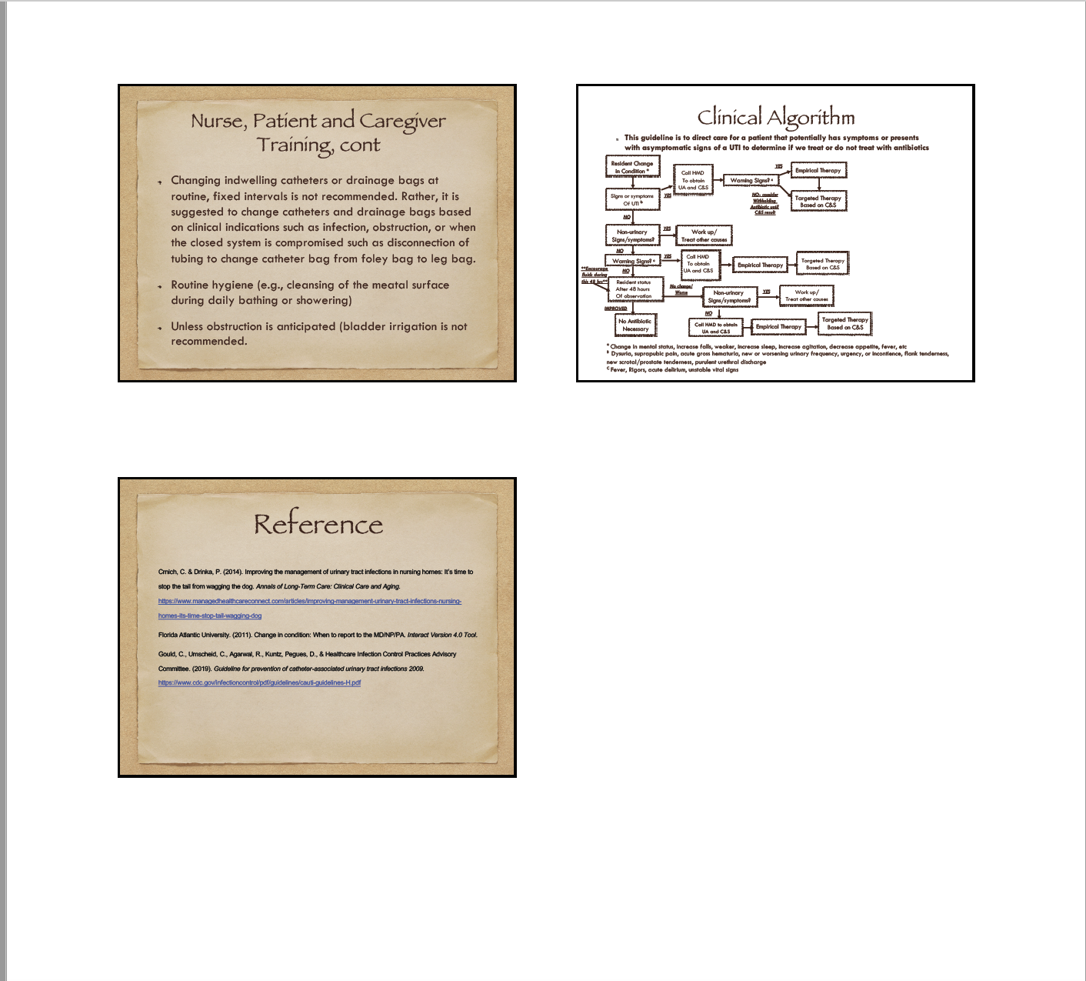
Nurse Educational PowerPoints
(Crinch & Drinka, 2014; Florida Atlantic
University, 2011; Healthcare Infection Control Practices Advisory Committee, 2011)
Notes:
These next two slides are the educational powerpoints created by the DNP student using evidenced based practice information gathered from three different sources (Crinch & Drinka; Florida Atlantic University; and Healthcare Infection Control Practices Advisory Committee. The education was completed via phone during a all staff meeting and email. Two nurses requested a printed copy that was sent via USPS. Education was reinforced at different time periods over the 6 month timeframe.

Slide 18
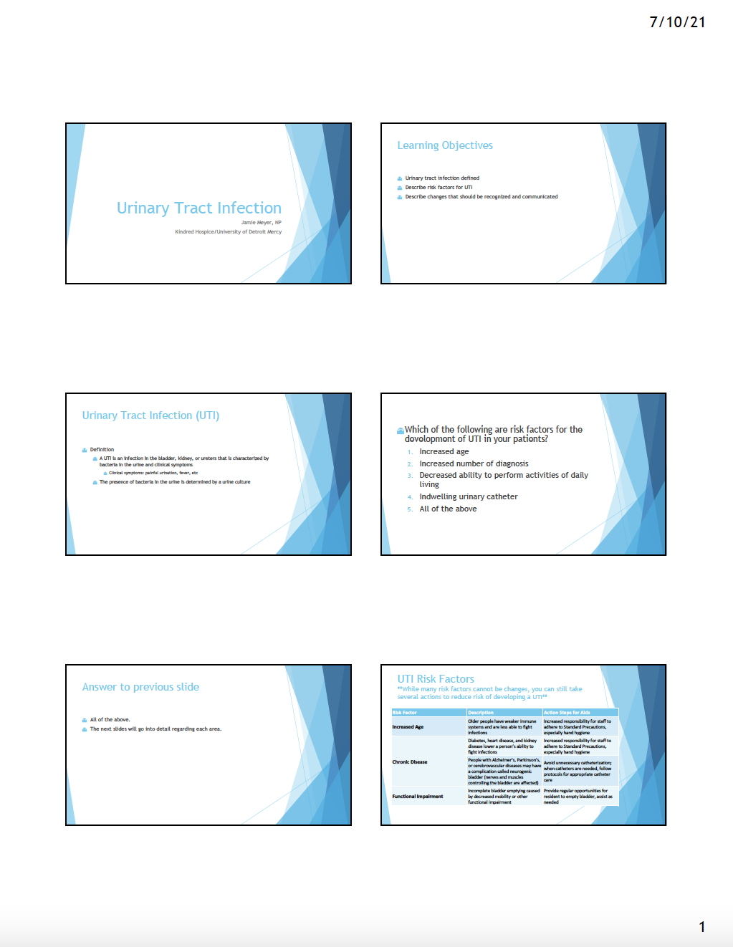
Multi-disciplinary Team Educational PowerPoints
(Crinch & Drinka, 2014; Florida Atlantic University, 2011; Healthcare Infection Control Practices Advisory Committee, 2011)
Notes:
This is the education provided to the multi disciplinary team of hospice aid, social worker, chaplin, bereavement, and volunteer.

Slide 19
Clinical Results

Slide 20
 | All | UTI
Sample Size | 314 | 19
Sex
Male | 134 (42.675%) | 16 (84.21%)
Female | 180 (57.325%) | 3 (15.79%)
UTI
Yes | 19 (6.051%)
NO | 295 (93.949%)
Residence
ALF | 163 (51.911%) | 10 (52.63%)
LTCF | 58 (18.471%) | 2 (10.52%)
Home | 93 (29.618%) | 7 (36.84%)
Catheter
No | 282 (89.809%) | 17 (89.47%)
Yes | 32 (10.1914%) | 2 (10.53%)
Indwelling | 29 (90.625%) | 2
Straight | 2 (6.25%) | 0
Urostomy | 1 (3.125%) | 0
Care Plan
Yes | 226 (71.975%) | 18 (94.73%)
No | 88 (28.025%) | 1 (5.27%)
Overview of Data Analysis
Total antibiotic cost to organization: $173.50
Notes:
The project’s sample size is 314. Nineteen of the patients developed UTIs that were treated with antibiotics. Out of these 19 patients, four of them were treated two separate times and one patient were treated three times for a UTI. This brings the total number of UTIs treated with antibiotics to 25. Out of the project sample size, 71.975% (n=226) had the care plan activated upon admission where as 28.025% (n=88) did not have the care plan activated. For those patients who where treated with antibiotics one did not have a care plan implemented where as 94.73% had care plan implemented at admission. Two patients (10.53%) had an indwelling catheter that was treated with antibiotics. The 25 antibiotics ordered for patient’s during the project timeframe cost the organization a total of $173.50 where as the 71 antibiotics ordered the 6 month period prior to the project start cost the organization a total of $480.48.

Slide 21
Antibiotic Prescribed and
Prescriber
 | UTI
Sample Size | 19
UTI TREATED | 25
BACTRIUM | 7 (28%)
CIPROFLOXACIN | 5 (20%)
KEFLEX | 6 (24%)
Doxycycline | 2 (8%)
PENICILLIN | 1 (4%)
Amoxicillin | 1 (4%)
Nitrofurantoin | 1 (4%)
Augmentin | 1 (4%)
Levofloxacin | 1 (4%)
Physician
A | 2 (8%)
B | 8 (32%)
C | 9 (36%)
D | 6 (24%)
Notes:
This is just an overview of the antibiotics prescribed along with the number of antibiotics prescribed by physician A, B, C, D.

Slide 22
Month
UTI treated
 | UTI Treated
October 2020
November 2020 | 2 (8%)
December 2020 | 4 (16%)
January 2021 | 4 (16%)
February 2021 | 2 (8%)
March 2021 | 5 (20%)
April 2021 | 8 (32%)
Notes:
Since one of the objectives was to reduce the number of UTI treated by 50% in the first three months than have zero UTIs in the last 3 months, this chart represents the amount of UTIs treated by month. Unfortently in the late part of March and early April, changes in the organization created a practice change for care plan activation. Most likely the rise in numbers in March and April is related to care plans being discontinued due to practice change at the organization level. Also In January 2021, a new hospice physician was hired that brought along a different philosophy of care that impacted the number of antibiotics prescribed.

Slide 23
Statistical Results

Slide 24
Fisher's Exact Test
 | Care_Plan
UTI | Y | N | OR | p
N | 208[212.32] | 87[82.68] | 0.13 | .019
Y | 18[13.68] | 1[5.32]
Observed and Expected Frequencies
Note. Values formatted as Observed[Expected].
Notes:
A Fisher's exact test was conducted to examine whether Care Plan and UTI were independent. The results of the Fisher exact test were significant based on an alpha value of 0.05, p = .019, suggesting that Care Plan initiation on admission and UTI are related to one another. Since the Fisher's exact test was conducted for a 2x2 contingency table, the odds ratio was calculated, OR = 0.13. This indicates that the odds of observing Care Plan activated and no UTI is 0.13 times as likely as observing no Care Plan activated and no UTI. This table presents the results of the Fisher's exact test.

Slide 25
Chi-square Test of Independence
 | UTI
Care_Plan | N | Y | χ² | df | p
Y | 208[212.32] | 18[13.68] | 5.19 | 1 | .023
N | 87[82.68] | 1[5.32]
Observed and Expected Frequencies
Note. Values formatted as Observed[Expected]
Notes:
A chi-square test of independence examines the relationship between two nominal variables. It was conducted to examine whether Care Plan activation and UTI were independent. Two conditions need to be met these are adequate cell size having expected values greater than zero and 80% expected values of at least five. Both conditions was met.
The results of the Chi-square test were significant based on an alpha value of 0.05, χ²(1) = 5.19, p = .023, suggesting that Care_Plan and UTI are related to one another.

Slide 26
Discussion: Statistical Significance
Significance between the activation of care plan and no urinary tract infections
  Fisher exact test and Chi-square test
Notes:
As seen in the above slides there was a significance between the activation of care plan and no urinary tract infections based on the Fisher exact test, Chi-square test

Slide 27
Discussion: Clinical Significance
Implications: Clinical Significance
  Patient
  Financial
  Practice Change
  Role of doctoral prepared nurse
Notes:
Consistent utilization of evidenced-based guidelines could decrease the risk of UTIs in the hospice patient at end of life. Those clinicians who referenced the algorithm created for this project to manage their patients were least likely to have an antibiotic prescribed for asymptomatic UTIs which reduces adverse outcomes of antimicrobial administration including drug reactions, drug-drug interactions, and Clostridium difficile infection. Patient, family, and facility satisfaction increases as they become more involved in the plan of care, recognize signs and symptoms of UTI, and proactive interventions to reduce the risk of developing symptomatic UTI. Overall the reduction of UTIs will have a financial impact as seen with the overall reduction in the cost the organization paid for antibiotic prescriptions during the project period vs the 6 month prior.
This project may serve as a practice change in the cooperation for implementation of evidenced-based guidelines to reduce specific infections such as urinary, respiratory, and skin infections. It is imperative to have a multi-disciplinary approach to practice change as each discipline can affect the quality of care that the patient receives during his/her time on hospice. However, to make practice change sustainable collaboration with cooperate stakeholders needs to be incorporated at the start of the project to create an environment of buy in. As different key stakeholders enter into the organization, such as a new hospice physician, direct meetings to discuss the quality improvement project in details will benefit the implementation and success of the quality improvement initiative.
Lastly the quality improvement project provides insights into the effectiveness of using a clinical algorithm to guide care to patients. The advance practice registered nurse and doctoral prepared nurse can influence these approaches to clinical care for hospice patients by focusing on the management of patient’s complex illness and reducing the risk of voidable infections by enhancing quality of life.

Slide 28
Discussion: Sustainability
Sustainability measures
Clinical algorithm to improve
  patient quality of life and increase
  disease management
Notes:
For this project, the long-term plan was focused on dissemination of information. The organization received a clinical algorithm based on the most up to date evidence based practice guidelines to reduce the risk of urinary tract infections among the geriatric population. By using the clinical algorithm, hospice will be able to improve patient quality of life and increase disease management. It is imperative that the clinical algorithm is incorporated into new hire orientation. This clinical algorithm will be updated and offered annually to promote and encourage adherence to new treatment guidelines.

Slide 29
Discussion: Dissemination
Dissemination
  All staff meeting, QAPI, Hospice and Palliative Care poster submission
Notes:
Dissemination of the results will be discussed at the all staff meeting, quarterly quality meeting, and plan to submit abstract to the Hospice and Palliative Care Conference in 2022 for a poster presentation.

Slide 30
Dr. Courtney
Heather Steuber
Dr. Roger Phillips
Staff at Kindred Hospice
Dr. Burson
Joseph Meyer (Husband)
Cindy Scarbrough (Mother)
Terri Gordon (Friend)
Rachel Deridder (Friend)
Notes:
I would like to thank the following individuals for their role in completion of this DNP project. Each of you helped over the course of the last 5 years through job changes that forced my DNP project to be changed multiple times to the completion of this project. Thank you!

Slide 31
References
American Medical Directors Association (2018). Development and evaluation of a clinical practice guideline to improve antibiotic stewardship in a post-acute/long-term care setting. Retrieved from https://jamda.com
AACN. (2015). The AACN Synergy Model of Patient Care. Retrieved from www.aacn.org
Campbell, C. (2016). Outcomes of quality improvement project: Integrating loeb minimum criteria for UTI diagnostic into a focused urinary assessment to reduce antibiotic prescribing in a long term care facility. Park Manor Quail Valley, TX.
Centers for Disease Control and Prevention (CDC) (2012). Urinary tract infection event for long-term care facilities. Retrieved from http://www.cdc.gov/nhsn/PDFs/LTC/LTCFUTI-protoccol_FINAL_8-24-20102.pdf

Slide 32
References
Centers for Disease Control and Prevention (CDC). (2015a). Healthcare-associated infections (HAIs): Catheter- associated urinary tract infections (CAUTI). Retrieved from http://www.cdc.gov/HAI/cauti/uti.html
Crnich, C., Drinka, P. (2014). Improving the management of urinary tract infections in nursing homes: It’s time to stop the tail from wagging the dog. Retrieved from https://www.hmpgloballearningnetwork.com/site/altc/articles/improving- management-urinary-tract-infections-nursing-homes-its-time-stop-tail-wagging-dog
Esme, M., Topeli, A., Yavuz, B., & Akova, M. (2019). Infections in the elderly critically-ill patients. Infectious Diseases – Surveillance, Prevention and Treatment, 6, 1-9.
Florida Atlantic University. (2011). Change in condition: When to report to the
MD/NP/PA. Interact Version 4.0 Tool.

Slide 33
References
Freeman-Jabson, J., Rogers, J., & Ward-Smith, P. (2016). Effect of an education presentation of the knowledge and awareness of urinary tract infection among non-licensed and licensed health care workers in long-term care facilities. Urologic Nursing, 36, 67-71.
Geano, L., & Buhr, G.T. (2012). Urinary tract infections in older adults residing in long- term care facilities. Annals of Longterm Care, 20(4), 33-38.
Givler, D. & Givler, A. (2019). Asymptomatic bacteriuria. StatPearls.
Gould, C., Umscheid, C., Agarwal, R., Kuntz, Pegues, D., & Healthcare Infection
Control Practices Advisory Committee. (2019). Guideline for prevention of catheter- associated urinary tract Infections 2009. https://www.cdc.gov/infectioncontrol/pdf/guidelines/cauti-guidelines-H.pdf
H. Steuber, personal communication, January 31, 2020.

Slide 34
References
Infectious Disease Society of America. (2019). Clinical practice guideline for the management of asymptomatic bacteriuria: 2019 update by the Infectious Diseases Society of America. Clinical Infectious Diseases. Retrieved from idsociety.org.
Juthani-Mehta, M., Malani, P., & Mitchell, S. (2015). Antimicrobials at the end of life: An opportunity to improve palliative care and infection management. Journal American Medical Association, 314(19), 2017-2018.
Keller, S., Feldman, L., Smith, J., Pahwa, A., Cosgrove, S., & Chida, N. (2018). The use of clinical decision support in reducing diagnosis of and treatment of asymptomatic bacteriuria. Journal of Hospital Medicine, 13(6). 392-395.
Kindred Health Care. (2019). Retrieved from https://www.kindredhealthcare.com/locations/hospice/grand-rapids-mi-6554
MedlinePlus. (2016). Asymptomatic bacteriuria. Retrieved from
https://medlineplus.gov/ency/article/000520.htm

Slide 35
References
McHugh, M. (2013). The chi-square test of independence. Biochemial Medical, 23(2), 143-149. https://doi.org/10.11613/BM.2013.018
Mehta, C. & Patel, N. (1983). A network algorithm for performing Fisher's exact test in r×c contingency tables. Journal of the American Statistical Association, 78(382), 427-434.
Menard, S. (2009). Logistic regression: From introductory to advanced concepts and applications. Sage Publications. Thousand Oaks, CA.
Pituch, K. & Stevens, J. (2015). Applied multivariate statistics for the social sciences (6th ed.). Routledge Academic. https://doi.org/10.4324/9781315814919

Slide 36
Questions?

