Slide 1
Redeployment in the Midst of a Pandemic: A Process Improvement Plan
Lubna Haroon MSN, APRN, FNP-BC
University of Detroit Mercy
McAuley School of Nursing

Slide 2
Introduction
Michigan’s first two confirmed COVID-19 presumptive positive patients in Wayne and Oakland County were on March 10, 2020.
Oakland County quickly became one of the hardest hit counties in the state.
St. Joseph Mercy Health System, Oakland campus (SJMO) was one of the first hospitals directly impacted by the coronavirus pandemic.
Leadership looked for ways to manage sudden influx of critically ill patients.
Nurses with prior critical care experience were redeployed to help with management of COVID- specific intensive care units (ICU).

Slide 3
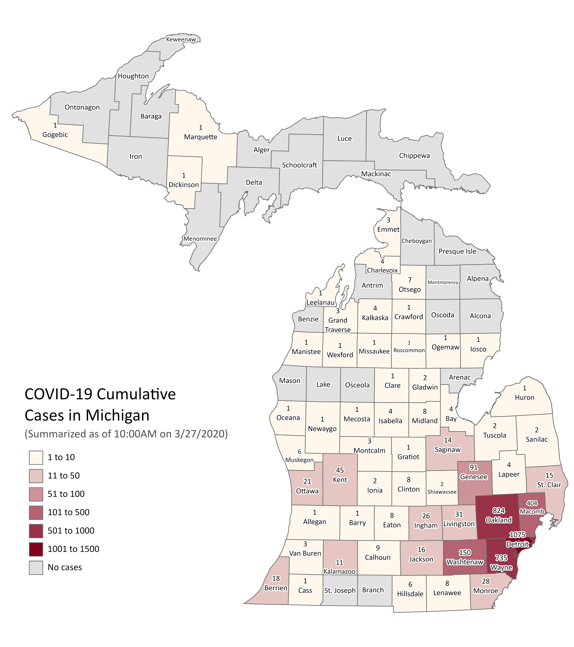
(MDHHS, 2021)

Slide 4
Coronavirus Disease
Coronavirus Disease 2019 (COVID-19) pandemic:
Highly infectious respiratory infection caused by a new strain of virus known as severe acute respiratory syndrome coronavirus 2 (SARS-CoV-2).
Individuals present in a multitude of ways ranging from asymptomatic disease to severe respiratory distress with multiple organ failure on advanced life support, with high likelihood of death.
(Zeng et al., 2020)
(Valk et al., 2020)

Slide 5
Nationwide Pandemic Response
3/11/2020: World Health Organization announced a global pandemic as virus spread to 30 different countries.
5/29/2020: COVID-19 Technology Access Pool is formed as an initiative to make vaccines, tests, and treatments.
1/11/2021: Director-General calls for collective worldwide commitment to ensure vaccination for healthcare workers and those at high-risk in all countries in first 100 days of 2021.
JAN
FEB
MAR
APR
MAY
JUN
JUL
AUG/ SEP/ OCT/ NOV/ DEC
JAN
1/20/2020: First official case of SARS-Cov-2 arrived in the United States.
4/4/2020: Over 1 million cases of COVID-19 confirmed worldwide.
7/15/2020: 75 countries express interest in financing vaccines from their own budgets to support rapid, fair, and equitable access.
(Rollison et al., 2021)
(Lombardi et al., 2020)

Slide 6
Response to Overwhelmed ICUs
New York City, New York:
Hospitals accelerated new graduate orientation and assigned new graduates to intensive care units.
They worked in teams with a more experienced nurse so that 2-3 nurses were caring for 3-4 patients.
Atlanta, Georgia:
ICU surge care delivery model consisted of non-ICU staff partnering with experienced ICU nurse to aid in performing assessments, medication and supply retrieval.

Slide 7
Significance- Impact in Michigan
March 10, 2020
First two coronavirus cases confirmed in Michigan.
March 17, 2020
First coronavirus related death in Michigan.
March 23, 2020
Michigan Governor, Gretchen Whitmer executes statewide stay-at-home order for non-essential workers.
End of April 2020
Death toll >3,000.
Number of coronavirus cases surpasses 1,300.
Death toll 15.
Number of coronavirus cases surpasses 100.
(MDHHS, 2021)
(MHHA 2021)

Slide 8
Impact in Michigan
During the initial surge in April, hospitals cared for 4,700 COVID-19 patients, 1,700 of who were in the ICU.
Everyday hospitals were using about:
36,000 N95 masks
1.53 million gloves
330,000 surgical masks
46,000 surgical gowns
20,000 face shields
With loss of revenue from surgical procedures and nonemergent care and the provision of $188 million of financial assistance to vulnerable population, Michigan hospitals experienced a total loss nearing $3.2 billion by the end of June 2020.
(MHHA, 2021)

Slide 9
Mortality & Morbidity Data
The highest morbidity and mortality rates were reported in Wayne and Oakland Counties.
From the first case in March 2020 until as of July 2, 2021, Oakland County experienced:
102,315 cases
&
2,310 deaths
alone.

Slide 10
Nursing Shortage & Changes in Policy
The sudden surge of critically ill patients caused an increased stress on the current nursing shortage.
Executive Order 2020-30: “Any and all provisions in Article 15 of the Public Health Code, 1978 PA 368, as amended, MCL 333.16101 et seq., relating to scope of practice, supervision, and delegation, are temporarily suspended, in whole or part, to the extent necessary to allow licensed, registered, or certified health care professionals to provide, within a designated health care facility at which the professional is employed or contracted to work, medical services that are necessary to support the facility’s response to the COVID-19 pandemic and are appropriate to the professional’s education, training, and experience, as determined by the facility in consultation with the facility’s medical leadership.”
It goes on to state, “Medical services may be provided under this section without supervision from a licensed physician, without regard to a written practice agreement with a physician, and without criminal, civil, or administrative penalty related to a lack of supervision or to the lack of such agreement.”
(Khan et al., 2018)
(Hick & Biddinger, 2020)
(MDHHS, 2021)
https://www.michigan.gov/whitmer/0,9309,7-387-90499_90705-523481--,00.html

Slide 11
Mental Health & Wellness
American Nurse Foundation Mental Health & Wellness Survey from June 5 - July 6, 2020 (n=10,997).
51% felt overwhelmed
48% felt anxious or unable to relax
40% felt sadness
60% had difficulty sleeping or sleeping too much

Slide 12
St Joseph Mercy Oakland (SJMO)
Staff members were reassigned to various areas of the hospital as screening personnel, COVID med-surge units, or COVID ICUs.
Many individuals hesitant about redeployment to unfamiliar units were inevitably given the choice of redeployment or furlough, where a percentage chose the latter.
Those with prior critical care experience working in other departments were redeployed to COVID ICUs as support staff.
Working outside their specific knowledge base was challenging for both redeployed staff and seasoned ICU staff as both parties had to make adjustments to their nursing routine.

Slide 13
Clinical Question
As part of a health system pandemic response plan, would the use of a SJMO Emergency Pandemic ICU Staffing Protocol and standardization of ICU redeployment education increase nurses’ comfort with redeployment to the ICU?

Slide 14
Literature Review
Impact of travel nurses
Variations in onboarding process.
Orientation specific to the facility and unit they will be working.
Length of orientation variable.
Expectations explained.
Acuity levels and unit patient ratios.
Resources including essential contacts and providers made available.
(Bethel et al., 2019)

Slide 15
Literature Review
Redeployment skills and training
Redeployment of Surgical Trainees to ICU (Payne et al., 2020): | Redeployment of Physicians (Hettle et al. 2020): | Redeployment of CRNAs (Rollison et al. 2021):
78% had prior ICU experience. (n=32) | More than half had not worked clinically in a hospital setting for >10 years. (n=158) | (n=21)
All individuals received training prior to redeployment to ICU: training included patient proning, insertion of invasive lines, and how to have difficult family discussions regarding CPR and EOL. | Cross-skills training program developed: COVID-19 summary, proper PPE use, medical scenarios, medical investigations, COVID-19 local guidance, resuscitation, available resources, COVID-19 well-being and support guidance. | Two orientation days provided in the ICU: nurse hand-off, patient assessments, interdisciplinary team rounds, ICU vent modes, management of non-anesthetized patients, patient care prioritization, unit organization, electronic charging reviewed.
Increased confidence in clinical and technical skills. | Most felt that course provided appropriate level of learning and additional resources. | Felt redeployment was overall rewarding.
97% felt experience was valuable to their careers. | Level of learning too low for their needs. | Increased appreciation between team members.
57% felt redeployment had a negative impact on mental wellbeing. | Lack of social distancing for face-to-face portion. | Issues with fatigue, fear, stress, and burnout.

Slide 16
Literature Review
Challenges in patient care
Surgical Non-Intensivists Redeployed to run and ICU in NYC (DePeralta et al., 2020): | Critical Care and Peri-Operative Resource Management (Lee et al., 2020):
Trained through participation in COVID ICU morning rounds. | ICU nurse to manage ICU specific intervention such as ECMO and renal replacement therapy and supervise patient care on multiple patients cared for by non-ICU nursing staff.
Experienced resources: Unit staffed with knowledgeable surgical resident and APP. | Nurses with CC background but no recent exposure provided with refresher training courses.
Challenges: stretched critical care nursing ratios, medication shortages. | ICU nurses expected to oversee and supervise care for multiple patients.
Experience emotionally draining and satisfying. | -------------------------------------------------------

Slide 17
Purpose Statement
Evaluation of the current program in place for redeploying nursing staff to the ICU during the COVID-19 pandemic response and recommend changes that may improve this program:
Evaluation of the initial redeployment strategies at St. Joseph Mercy Oakland, including but not limited to how staff was chosen to be redeployed.
Evaluation of nurse satisfaction in relation to the redeployment process, specifically those redeployed to the ICU.
Evaluation of the education provided to the nurses prior to redeployment to the ICU and sufficiency of this education from the nursing perspective.
Evaluation of costs of redeployed nursing staff verse nurse agency staffing.

Slide 18
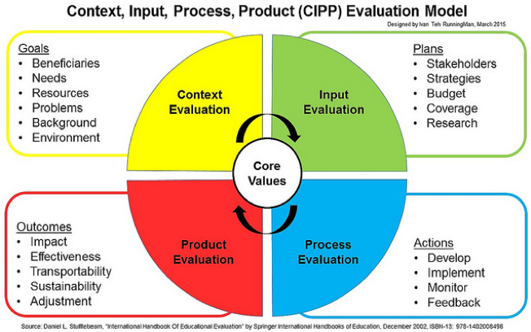
Theoretical Framework

Slide 19
SWOT Analysis
Organization Assessment
STRENGTHS
RN flexibility with unit changes.
Teamwork.
Support from community members.
WEAKNESSES
Staff disagreements.
Protocol changes.
Lack of ICU education.
S
W
Model for other hospital systems.
Improvement in nurse job satisfaction and retention.
OPPORTUNITIES
Decreased nurse retention.
Poor patient outcomes.
THREATS
O
T

Slide 20
Methods
Program Evaluation of current education in place for redeployed nursing staff.
Mixed methods.
Quantitative survey questions– descriptive data, 5-point Likert scale.
Qualitative survey questions– open-ended.
Cost analysis of redeployed nursing staff verses nurse agency staffing.
Focus group of nurse educators
Qualitative questions regarding perceptions of initial redeployment process.
Planning/IRB Approval
Data Collection (Initial Survey)
Data Analysis/ Development of Emergency Staffing Protocol
Data Collection (Post-Survey)
Sustainability Plan
Data Analysis

Slide 21
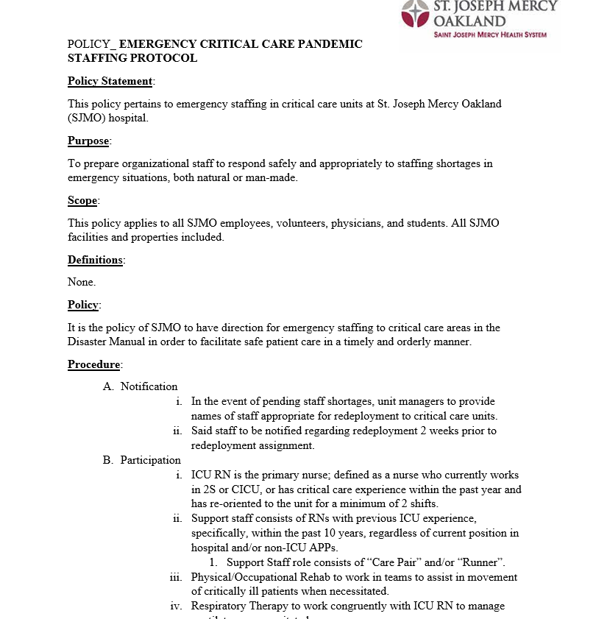
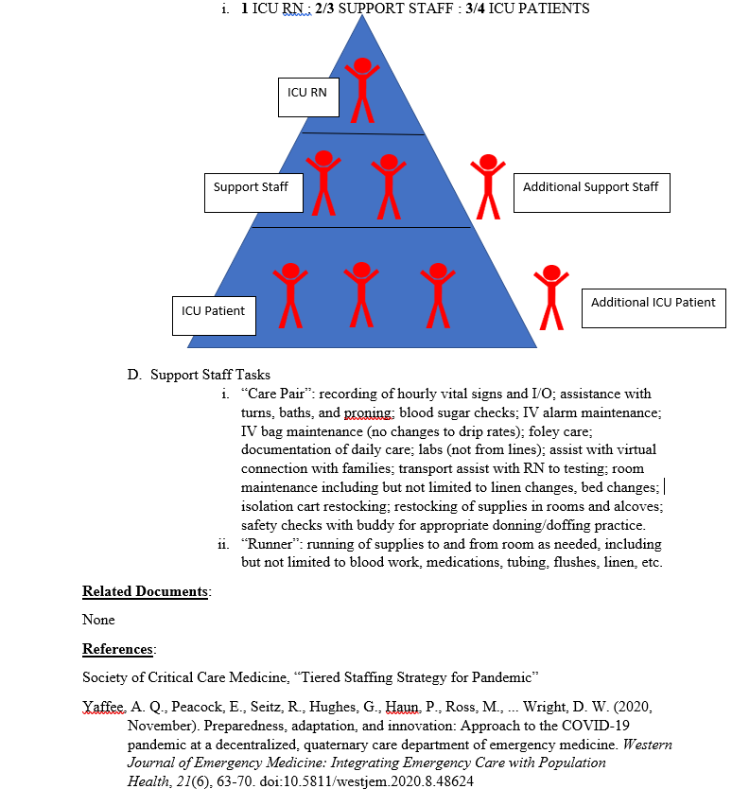
Methods- Outcomes Measured
Was there an increase in nurse comfort levels with redeployment to the ICU post adjustment of redeployment education and addition of ICU Emergency Redeployment Staffing Protocol?

Slide 22
Results & Discussion

Slide 23
Demographic Data
12 nurses participated
4 nurses from PACU
4 nurses from Cath Lab
3 nurses from Cardiac Rehab
1 nurse from IR
Age | n=12
31-35 years old | 2
36-40 years old | 1
41-50 years old | 5
51+ years old | 4
Gender | n=12
Male | 4
Female | 8
Length of RN experience | n=12
6-7 years | 1
8-10 years | 1
10+ years | 10
Critical Care Experience (Years)
Least | 2
Most | 20
Median | 9

Slide 24
Feelings Regarding Redeployment
“anger”
“frustration”
“determined”
“hesitant”
“grateful for opportunity to work”
“guarded”
“hesitant”
“better knowing I’m a support person”

Slide 25
Challenges/Barriers to Redeployment
58% charting
50% decreased familiarity with unit/supplies
33% lack of ICU knowledge
Additional themes provided: family/childcare scheduling, patient monitoring, safety

Slide 26
Greatest Fear Regarding Redeployment
“patient safety”
“death”
“poor patient care related to safety and staffing issues”
“being placed in a situation with poor communication”

Slide 27
Initial survey responses regarding redeployment to a COVID-19 critical care unit (n=12):
Strongly disagree
Disagree
Neutral
Agree
Strongly agree
I had a choice regarding redeployment to the ICU.
During the first wave of the COVID-19 pandemic, adequate education was provided prior to redeployment.
An accessible emergency staffing protocol would make me more comfortable with redeployment, provided that nurse expectations would be specified.
I am interested in annual emergency redeployment training.
Provided there is another wave of COVID-19 that prompts redeployment of staff, I would be willing and comfortable to be redeployed to a COVID-19 ICU.

Slide 28
Post presentation of renewed education and Emergency Staffing Protocol survey responses regarding redeployment to a COVID-19 critical care unit (n=12):
Strongly disagree
Disagree
Neutral
Agree
Strongly agree
I feel comfortable being redeployed to a COVID-19 ICU.
If my unit was closed, I would volunteer to be redeployed to a COVID-19 ICU.
The emergency staffing protocol makes me more comfortable with redeployment to a COVID-19 ICU.
I am interested in annual emergency redeployment training.
If there is another wave of COVID-19 that prompts redeployment of staff, I would be willing and comfortable to be redeployed to a COVID-19 ICU.
I am satisfied with the proposed nurse redeployment education today.

Slide 29
Qualitative Themes
Communication
“Communication- everyone was thrown into a nightmare, uncertain of what is ahead and I didn’t know if I should have been talking to my current manager, the manager of the unit I was going to/educator. I felt very alone and unsupported.”
“Clear, open communication pre/intra/post deployment regarding expectations and options with staff and management is paramount.”
Challenges with Charting
“As EPIC was rolling out and we were just learning to use it in pre-op and recovery, my knowledge of ‘floor charting’ was ZERO, which was a huge source of anxiety.”
“Role identification”
“Communication from management to front-line staff and vice-versa.”
“…was never really instructed on what my job was while I was there.”

Slide 30
Qualitative Themes
Patient Safety
Education
“one shift with another nurse to learn charting in the ICU.”
“followed a CCU RN for 2 shifts.”
“Patient safety issues associated with staffing and bed availability, especially as it pertains to ICU monitoring.”
“time frame of orientation was inadequate.”
“floor orientation with a preceptor.”
Greatest fear “poor patient care related to safety and staffing issues.”
“1 day including some computer use, isolation, doning and doffing, bed and call light workings, 2 days on the floor shadowing.”

Slide 31
Cost Analysis
SJMO nurse average hourly wage -$36
First Choice Agency nurse hourly wage -$45
Redeployment training and education: 4 hours of classroom time, 2 hours Epic/computer training, 1 hour floor training (location of equipment, supply room, etc.), 1-2 day shadowing with nurse totaling 19-31 hours of pay -$684-1,116.
Agency nurses receive similar level of training prior to start at hospital -$855-1,395.
Acute increased cost due to onboarding process/orientation and benefit requirement for staff nurses.
However, advantage to using redeployed nurses verse agency staffing include increased patient safety, existing knowledge of hospital policies and important contacts, and immediate availability.
Long term cost benefit from increased patient safety, nurse satisfaction and retention.

Slide 32
Discussion
Issues consistent among redeployed nurses was fear regarding unknown factors of the coronavirus disease process and worry of transmitting disease to loved ones.
Due to the sudden influx of patients into the hospitals and educators working fervently to provide adequate redeployment education, nurses received varying degrees of education intended.
55 nurses put through some form of training for ICU redeployment.
16 nurses redeployed from this group specifically to the ICU.
3 have since left the system and 1 was on a LOA during data collection period.
Intended education consisted of 4-hour critical care bootcamp in the SIM-lab, 2 hour EPIC training, and 2 hour floor orientation/shadowing.

Slide 33
Discussion
Managers and educators worked to alleviate nurse stress and provide comfort and support, but continued to fall short in these areas for some individuals.
New role out of EPIC at the start of the pandemic contributed to nurse stress.
Issues primarily revolved around unclear expectations and communication, though nurses mentioned appreciation for daily COVID-19 updates from leadership.
The Emergency Critical Care Pandemic Staffing Protocol was effective in improving nurse comfort with redeployment, which could be attributed to role definition.

Slide 34
Limitations
Small sample size.
Inability to formally test emergency protocol as research format was retrospective of the initial spike of the COVID-19 pandemic.
COVID-19 and its continuous effects.
Continued research is recommended to further improve upon pandemic nurse staffing models with specific attention given to nurse and patient safety.

Slide 35
Implications for Practice & Sustainability
Policies to guide critical care nursing practice and promote safe nurse pandemic staffing.
Safe and effective care for critically ill patients, specifically during a pandemic response.
Considerations:
If changes are implemented, a 1-year follow up on the nurses initially redeployed during the first wave would provide additional data in support of the pandemic staffing model.
Nurses displayed an interest in annual redeployment training.

Slide 36
Dissemination
AWARENESS
American Journal of Nursing
COMMUNICATION
International Journal of Nursing
EVALUATION
Journal of Doctoral Nursing Practice
EDUCATION
American Journal of Critical Care
DISCOVERY
Critical Care Nurse
ROLES
Journal of Nursing Research

Slide 37
Acknowledgements
Committee Chair: Jamie Sinutko, PhD, MSN, RN
Organization Member: Angela North, BSN, RN
Committee Reader: Grace Jacek, DNP, APRN, FNP-BC
Dr. Renay Gagleard and Douglas Dascenzo for your support for doctoral research work as well as your assistance in facilitation of this project at SJMO.
Dr. Burson and Dr. Glenn for supporting and inspiring from the beginning. As well as the FNP faculty who have helped me get to where I am today.
SJMO nurses, managers, and educators for being so kind, flexible, and welcoming.
My family, specifically my husband, Imran and my kids, Ayaan and Aliyah as well as my grandfather, Dr. Mohammed Ansari and my mother Dr. Farrah Ansari, my in-laws, siblings, and best friends for their support, guidance, prayers and love.

Slide 38
References

Slide 39
References

Slide 40
Questions?

