Slide 1
Improving Self-Management of Uncontrolled Hypertension
Presented by: Rana Mazraani MSN, APRN, FNP-BC

Slide 2

Introduction
Hypertension (HTN) is one of the most prepotent chronic diseases in the US
  Affects 1/3 of the population over 20 years of age
  One of the most common health condition in older adults
  Defines as SBP ≥ 130 mmHg or a DBP ≥ 80 mmHg or are taking medication(s) for BP
  Only about 1 in 4 adults with HTN have it under control
Self-management of HTN is the process of engaging in TLC’s that positively influence BP control (i.e. diet, exercise, SMBP)
Risk factors for HTN: modifiable and non-modifiable
  Modifiable: cigarette smoking, diabetes, dyslipidemia, obesity, physical inactivity, unhealthy diet
  Non-modifiable: family history, increasing age, male sex, low socioeconomic class
  Potential to reduce prevalence of HTN increases when modifiable risk factors are reduced

Slide 3

Background
The AHA reports that 103 million American adults have high BP and there has been an increase in the death rate by 11% between 2005 and 2015
By 2030, it is estimated that more than 41% of Americans will have HTN
Controlling HTN is a challenge for both health care providers and patients; only 50% of HTN is controlled worldwide
Medications often do not effectively attain BP control
  30% do not refill the prescriptions
  non-adherence
  unpleasant side effects
  cost

Slide 4
Background
Uncontrolled HTN disproportionately effects racial/ethnic minority groups in the US
  Disparities in awareness and complications
    HTN awareness and control rates were inadequate and low when compared with national data for Arab Americans.
  Disparities in health education
    Culture affects the level of education and control of HTN through self-management in African American population
  Lack of resources and support
  Language barriers

Slide 5

Significance of Problem
If left uncontrolled, hypertension can lead to:
  LVH→HF, MI, stroke, CKD, CVD and etc..
  Threatens/reduces quality of life
  Delays in medical procedures/treatments
The leading cause of death in all ages in Michigan, the US, and worldwide is heart disease (MDHHS, 2018; CDC, 2018; WHO, 2018)
Cost burden of HTN is $45.6 million each year
A reduction of 10 mmHg of SBP will reduce the risk of the occurrence of major CVD by 20% and reduce the potential for stroke by 41%

Slide 6

Clinical Question
The project is designed to answer the PICOT question: “(P) In patients aged 18-85 years old with a diagnosis of uncontrolled hypertension, (I) how will implementing a self-management education program (C) compared to current practice (O) affect patient’s self-management knowledge and uncontrolled hypertension (T) within a 4-week period?”

Slide 7

Literature Review
DATABASE: Pubmed, CINAHL, Cochrane
INCLUSION/EXCLUSION: English, full text, dated within 7 years were included in the literature review. Articles that were non-English, not available for full text (without payment or membership) or dated over 7 years were excluded
KEY SEARCH TERMS USED: hypertension, uncontrolled hypertension, hypertension management, hypertension education, self-management, self-efficacy, and team-based approach, alone or in combinations

Slide 8

Literature Review
COMMON THEMES:
  Self-management of chronic disease
  Patient education and HTN
  Team-based HTN follow-ups
  Self-care and HTN
  Technology/SMBP
  Ethnicity and HTN

Slide 9

Purpose Statement
The purpose of this DNP project was to:
  Improve self-management knowledge for patients with uncontrolled HTN
  Propose a sustainable program of ongoing support for this patient population
  Educate and counsel patients on the consequences of uncontrolled HTN
  Incorporating telehealth as a means for follow-up visits to increase access to healthcare

Slide 10
Theoretical Framework
Pender’s Health Promotion Model
Assumptions the Model makes:
  Individuals seek to actively control their own behavior; people inherently want to control their behaviors
  Health professionals (i.e. nurses) constitute a part of the interpersonal environment, which exerts influence on people through their life span.

Slide 11
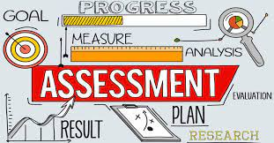
Organizational Assessment
Senior Care Medical Group is a primary care office in Dearborn, MI providing healthcare services to its surrounding community for over 15 years.
Currently, no standard HTN self-management educational program offered to patients with uncontrolled HTN.
Serves a large population of ethnic/racial minorities

Slide 12
SWOT Analysis
Strengths
Weaknesses
Opportunities
Threats
Evidence and literature to support project
Well-established practice
Lack of current scholarly activity
Propose a sustainable HTN educational Program
Competitive Medical Market
Current quality improvement meetings
Staff support
Extended business hours
Current utilization of telehealth
Integrated EHR and charting system
Lack of standardized blood pressure measurement
No formal comprehensive self-management educational program
Standardize BP measurement
Build collaborative environment with emphasis on high-quality care
Utilize telehealth for follow-ups to increase access to care

Slide 13
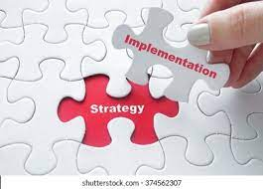
Methods/Design
Project design→ Quality Improvement in healthcare
Setting → Primary Care Practice
Sample → Adults aged 18 to 85 yo with uncontrolled hypertension based on AHA guidelines for hypertension
Pre-intervention → Staff meeting, education, recruiting
Intervention→ Hypertension self-management educational program. Composed of:
  Initial counseling session w/ provider (i.e TLC, DASH, consequences, SMBP)
  Demonstration on how to accurately SMBP and record it
  HTN educational packet to take home
  2-week telehealth follow-up visit
  4-week final in-office BP check

Slide 14
Methods/Design
The cost of the material from current clinic budget
  Approximate cost for colored documents on laser printer is 0.15 cents per page
  Each packet costs approximately $1.00 we utilized about 17 packets totaling about $17.00
Tools and Data collection →
  Quantitative data collected via pre- and post 5-point Likert scale questionnaires
  Demographics collected via EHR
  BP data collected at 2-interval points
  PCMH scores (past scores will be compared to future scores)
Obtained project site IRB approval
Subsequently, obtained expediate review from the UDM IRB committee and received approval

Slide 15
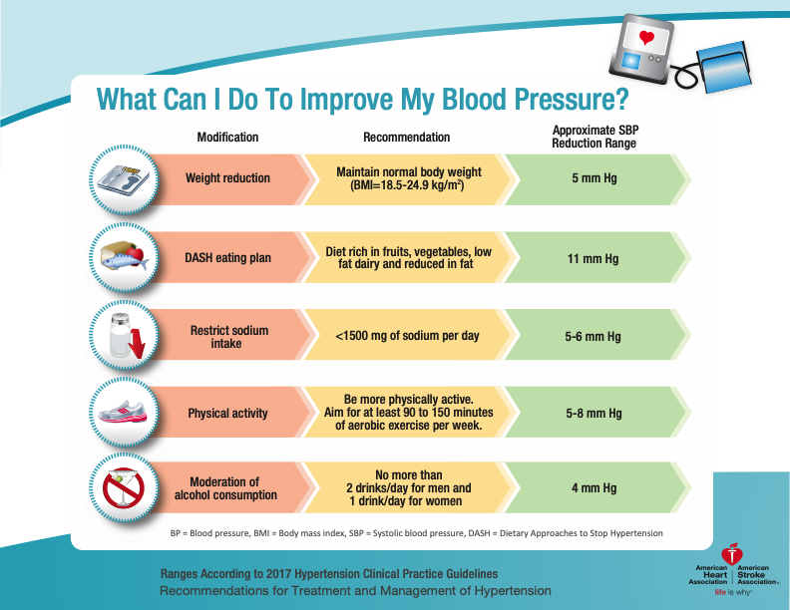
Components of the HTN Educational Packet

Slide 16
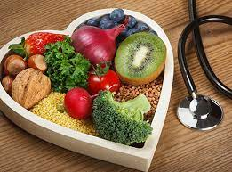
Components of the HTN Educational Packet
Food Group | Serving Sizes | Examples and Notes | Significance of Each Food Group to the DASH Eating Plan
Grains | 1 slice bread 1 oz dry cereal ½ cup cooked rice, pasta, or cereal | Whole-wheat bread and rolls, whole-wheat pasta, English muffin, pita bread, bagel, cereals, grits, oatmeal, brown rice, unsalted pretzels and popcorn | Major sources of energy and fiber
Vegetables | 1 cup raw leafy vegetable ½ cup cut-up raw or cooked vegetable ½ cup vegetable juice | Broccoli, carrots, collards, green beans, green peas, kale, lima beans, potatoes, spinach, squash, sweet potatoes, tomatoes | Rich sources of potassium, magnesium, and fiber
DASH Eating Plan—Serving Sizes, Examples, and Significance
Source: National Heart, Lung, and Blood Institute; National Institutes of Health; U.S. Department of Health and Human Services, 2018.

Slide 17
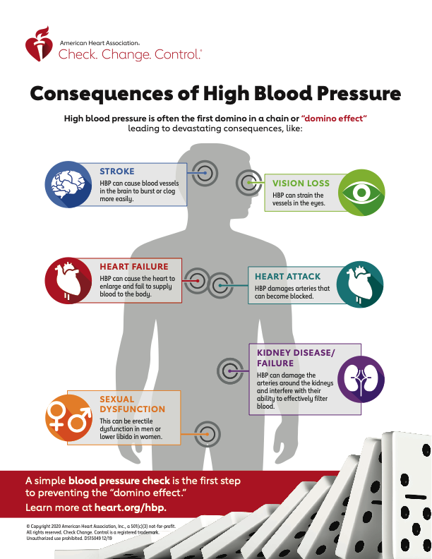
Components of the HTN Educational Packet

Slide 18

Results/Data Analysis

Slide 19
Patient Demographics
Table 1- Age of participants (n= 15)
Age (years) | (18-30) | (31-50) | (51-70) | (70-85)
Number of participants | 0 | 5 | 9 | 1
Percent Total | 0% | 33.33% | 60% | 6.6%
Table 2- Gender of participants (n=15)
Gender | Male | Female
Number of Participants | 8 | 7
Percent Total | 53.33% | 46.66%
Table 3- Ethnicity of participants (n=15)
Ethnicity | Caucasian | African American | Asian American/Pacific Islander | Arab American/Middle Eastern | Hispanic/Latino | Other
Number of participants | 4 | 6 | 0 | 5 | 0 | 0
Percent Total | 26.66% | 40% | 0% | 33.33% | 0% | 0%

Slide 20
Table 4- Descriptive Statistics for the Pre-Implementation Likert Scale Questionnaire (n=15)
Measure | Mode | % of participants
Q 1- I feel confident in knowing what I can do on my own to improve my BP | 3 | 33%
Q 2- I feel confident in selecting healthy foods that can help improve my BP | 3 | 40%
Q 3- I am aware of health problems that can result from having high BP | 4 | 33%
If you check your BP at home, please answer number 4, if not, you may skip this question (n=9)
Q 4- I feel confident in the accuracy of my BP measurement when I check it at home | 3.5 | 38.8%
Results for Pre- and Post Implementation Questionnaire
Table 5- Descriptive Statistics for the Post-Implementation Likert Scale Questionnaire (n=15)
Measure | Mode | % of participants
Q 1- I feel confident in knowing what I can do on my own to improve my BP | 5 | 86.7%
Q 2- I feel confident in selecting healthy foods that can help improve my BP | 5 | 80%
Q 3- I am aware of health problems that can result from having high BP | 5 | 86.7%
If you check your BP at home, please answer number 4, if not, you may skip this question (n=14)
Q 4- I feel confident in the accuracy of my BP measurement when I check it at home | 5 | 86.7%

Slide 21
Results of mean BP pre- and post implementation
Figure 1. Plotted means for systolic and diastolic blood pressure at pre-intervention and 4-weeks after intervention (n=5)

Slide 22

Discussion
17 participants initially, 15 participants attended 2-week telehealth follow-up & post-survey, 5 participants came back for a 4-week BP check
40% of participants were African American, 33% were Arab American, making it 73% of ethnic minority
Improvement in knowledge about self-management of HTN
  Increased confidence in knowing what they can do to improve BP ( Q#1, mode 3 → 5)
  Increased confidence about selecting healthy food that improve BP (Q#2, mode 3→5)
Increase in awareness of health problems that result as a consequence of uncontrolled HTN
Incidentally, saw an increase in SMBP at home
  33% increase in participants who SMBP
100% of participant satisfaction with the HTN self-management education program
Achieved 88.2 % telehealth follow-up

Slide 23

Limitations
Small sample size
Limited to geographic location
Time constraints

Slide 24
Implications & Sustainability
Fully implement the HTN self-management educational program in practice
  Suggestion for future
This innovation will serve as a unique, evidence-based resource for patients with uncontrolled HTN
Since HTN can lead to tremendous health complications → reducing uncontrolled HTN has a great impact on health outcomes and measured quality of care (PCMH scores)
Empower nursing professionals to engage in health policy changes that promote educating and supporting patients
Continue counseling and institute improvements in BP control
Submit an abstract for presentation at a conference pertaining to the DNP project

Slide 25

Acknowledgements
Special Thanks to…
Dr. Arthur Ko PhD, my project chair from University of Detroit Mercy. Thank you so much for your committed guidance and support of my project. I am so appreciative of all the time and effort you put forth to help me move my project forward.
Dr. Grace Jacek DNP, APRN, FNP-BC, my project reader from UDM. Thank you so much for your guidance and commitment to my project. I am very fortunate to have had you as a professor and clinical instructor through my academic career over the last few years.
Thank you to ALL the DNP faculty and staff at UDM. It has been an unfathomable experience and such a privilege to work with you.
Dr. Belal Abdallah MD, my organizational site mentor and practice owner. Thank you for giving me the opportunity to conduct this project and make an impact on the patients at Senior Care Medical Group.
Lastly, I would like to extend my sincere thanks to my loving and supportive husband, Ayman Mazraani, for all his encouragement. Without his tremendous understanding, love, and sacrifice of his own endeavors, it would have been impossible for me to complete this doctoral project.

Slide 26
References
Abd El-Hay, S., & El Mezayen, S. (2015). Knowledge and perceptions related to hypertension, lifestyle behavior modifications and challenges that are facing hypertensive
patients. IOSR Journal of Nursing and Health Science (IOSR-JNHS), 15-26. doi:10.9790/1959-04611526
American Heart Association. (2018). Resistant hypertension - high blood pressure that's hard to treat. Retrieved from https://www.heart.org/en/health-topics/high-blood-pressure/the-
facts-about-high-blood-pressure/resistant-hypertension-high-blood-pressure-thats-hard- to-treat
Armstrong, C. (2018, March 15). High Blood Pressure: ACC/AHA Releases Updated Guideline. Retrieved November 25, 2020, from https://www.aafp.org/afp/2018/0315/p413.html
Beune, E. J. A. J., Van Charante, E. P. M., Beem, L., Mohrs, J., Agyemang, C. O., Ogedegbe, G., & Haafkens, J. A. (2014). Culturally adapted hypertension education (CAHE) to improve
blood pressure control and treatment adherence in patients of African origin with uncontrolled hypertension: a cluster-randomized trial. PloS One, 9(3), e90103.
Bloch, M., & Basile, J. (2019). Cardiovascular risks of hypertension. UpToDate. Retrieved from https://www.uptodate.com/contents/cardiovascular-risks-of-hypertension
Brissette, C. (2014, April 04). The DASH diet is proven to work. Why hasn’t it caught on? Retrieved from https://www.washingtonpost.com/lifestyle/wellness/dash-the-proven-
healthy-diet-that-just-hasnt-caught-on/2017/04/03/5da47e24-1558-11e7-9e4f- 09aa75d3ec57_story.html?noredirect=on&utm_term=.5e12e186732d
CDC. (2020, June 22). Million Hearts® Hypertension Control Change Package. Retrieved August 03, 2020, from https://millionhearts.hhs.gov/tools-protocols/action-guides/htn-
change-package/index.html
Chen, Y., Li, X., Jing, G., Pan, B., Ge, L., Bing, Z., . . . Han, X. (2020). Health education interventions for older adults with hypertension: A systematic review and meta‐analysis.
Public Health Nursing, 37(3), 461-469. doi:10.1111/phn.12698
Chronic Disease Indicators: Explore by Location. (2017). Retrieved August 03, 2020, from https://nccd.cdc.gov/cdi/rdPage.aspx?rdReport=DPH_CDI.ExploreByLocation
Pender's Health Promotion Model. (2020, July 21). Retrieved December 07, 2020, from
https://nursing-theory.org/theories-and-models/pender-health-promotion-model.php
Polit, D. F., Beck, C. T., & Polit, D. F. (2017). Resource manual for Nursing research,
Tailakh, A., Mentes, J., Morisky, D., Pike, N., Phillips, L., & Evangelista, L. (2013). Prevalence, awareness, treatment, and control of hypertension among Arab Americans. Retrieved
November 26, 2020, from https://www.ncbi.nlm.nih.gov/pmc/articles/PMC4445860/
The top 10 causes of death. (2018). Retrieved November 27, 2020, from https://www.who.int/news-room/fact-sheets/detail/the-top-10-causes-of-death
The Impact of Heart Disease and Stroke in Michigan: 2008 ... (2008). Retrieved August 2, 2020,
from https://www.michigan.gov/documents/mdch/Impact_final_268663_7.ppt

Slide 27

Questions?

