Slide 1
An Evaluation of the Joint Commission Certification for the Total Hip and Total Knee Replacement Program
MACHIEL STANDFIELD MSN, RN
UNIVERSITY OF DETROIT MERCY
DETROIT, MICHIGAN
Notes:
Good morning and hello, my name is Machiel Standfield I am presenting An evaluation of the joint commission certification for the total hip/total knee replacement program.

Slide 2
Introduction
Joint replacement surgery is a common procedure among older adults that is an effective treatment for advance arthritic changes.
Arthritic joints have been replaced surgically over 100 years.
The significance of joint replacement for the patient is previous injury, arthritis, smoking, misalignment, and other risk factors.
The number of joint replacements surgeries are expected to grow by 73% approximately 1.9 million by 2026 (CDC, 2021).
Without consistent standards and communication, the quality of care can vary for each patient.
Notes:
A British orthopedic surgeon Sir John Charnley, develop the first successful arthroplasty over 100 years
Today this is a common procedure in the older adult population that suffer from arthritis/injuries/ malalignments
This particular sx will grow 73% by the year 2026.
Every patient is different, but with this type of surgery consistency should be the stand of care.

Slide 3
Background
Patients will gain greater confidence in what to expect from consultation to the first post operative appointment.
With the approval for certification the patient is aware of the review from Joint Commission evaluation of the Joint Care Center.
St Joseph Mercy Oakland (SJMO) orthopedics provides top quality care and is recognized by Blue Cross Blue Shield, Total Joint Replacement also is named Aetna Institutes of Quality.
Highly trained orthopedic surgeons, and a multi-displenary approach for patient centered care.
(St Joseph Mercy Oakland Hospital, 2021)
Notes:
When patients understand the process of having a joint replace during consultation and it gives them more confidence when they are part of the process from the beginning.
Understanding the expectations from having a surgical interventions can ease some anxiety in most patients.
St Joseph mercy Oakland joint care center provides high quality care by staff members and highly trained orthopedic surgeons.

Slide 4
Significance
Populations affected: more than 15 million adults in the United States have Osteo Arthritis , which is the leading cause for joint replacements. Women consist of 29.2% and in men it is 22.7%. (CDC, 2021).
Worldwide/National/Regional Numbers: More than 350 million worldwide have arthritis (Global RA Network, 2021).
Nationally 1 in 4 (23.7%) adults have a diagnosis of arthritis (CDC, 2021).
A third of the adult population in Michigan has arthritis and by 2030 it will be 2.7 million adults (2015 Michigan DHHS, 2021).
Mortality/Morbidity: Mortality with osteoarthritis has not been extensively studies and that mortality is usually related to rheumatoid arthritis. Comorbity in obese patients (31%), diabetics (47%), and heart disease (49%) in the United States. (CDC, 2021).
Other data (organization): SJMO is part of Michigan Arthroplasty Registry that collects data with chart review and extract data for patients that has had a joint replaced.
Notes:
With osteoarthritis being a leading cause for joint replacement here in the US and over 15 million patients are affected.
And according to Global RA more than 350 million patients world wide have arthritis from varying degrees.
Here in MI one third of adults will experience arthritis.
Patients that have surgery at STJMO data is collected by extracting the information from reviewing charts that is compared with the MI arthroplasty Collaborative quality initiative.

Slide 5
Clinical Question
How can the Advance certification for total joint replacement focused on the disease-specific population establish a better pathway from core competency to a uniformed standardized system from consultation to postoperative care?
Can the information from the gap analysis done on the joint care center guide the center through the accreditation process?
Notes:
How will the advance certification establishes a better pathway and form a standardized system for THTK?
And will the GAP Analysis information aid in getting the full accreditation?

Slide 6
Literature Review
Benefits
Importance of clear communications among the continuum of care among the providers and patients (Berg et al., 2019).
Patient centered approach focused on optimizing the care delivery system that will benefit better outcomes (Frost, Stafos, Barbay & Henderson, 2019).
Reduction in the variation of care (Joint Commission, 2020).
Notes:
The benefit from the literature review acknowledges that clear communication among the multidisciplinary of the organization is important from the initial sat at consultation to first post operative appointment on the continuum of care.

Slide 7
Literature Review
Challenges
In the process of obtaining the certification, aligning the stakeholders and organization to achieve the coordination of care (Mori et al., 2012).
Yayac (2020) acknowledges that some patients may need extended care, readmission rates associated with complication that are associated with cost to the patients.
Notes:
The challenges noted from the literature review exposed a much needed alignment of all involved to provide a more consistent care, and there may be outliers to each case with readmission rates, extended care or other complications.

Slide 8
Purpose Statement
The purpose for the program evaluation is to prepare the joint care center at St Joseph Mercy Oakland in Pontiac, MI for the application process, and to submit it for the Advance Certification from Joint Commission, it was submitted December 15, 2021. Following the guidelines and gap analysis by the stakeholders, this will prepare for the accreditation process.
Notes:
READ

Slide 9
Theoretical Framework Donabedian Model (Donabedian, 2005)
Structure | Process | Outcomes
457-bed community teaching hospital. Leader in SE Michigan in Oakland County. Patient's center/personalized care. Advance surgical techniques. Stakeholders: Orthopedic surgeons, administrators, nurses, nurse practitioners, pre/post operation staff, rehabilitation services, case managers, pharmacy, anesthesia services, dietary services. Top quality care from the orthopedic specialist. Preoperative joint classes available. | Patients referred/consulted for joint replacement via their primary care physician, insured or other means of coverage. Communication/preoperative teachings should begin in the orthopedic office and continue through first postoperative appointment. Gap analysis for joint care center. Quality performance measurements monitored for Joint commission, and data review for SJMO and MARCQI. Application for certification December 2021 | Improved performance metrics for total hip/knee replacement: 1-Regional anesthesia, 2- Ambulation on day of surgery, 3- Discharged to home, 4- Functional/health assessment pre/post. Completion of gap analysis on the joint care center. Completing the application for certification. Improved communication with stakeholder from consultation to first postoperative appointment on the continuum of care involving multi-disciplinary stakeholders.
Notes:
This the Donabedian model that was developed to focus on quality improvement theory and practice, that concentrates in the healthcare organization process that looks at structure, process, and outcomes. The hospital is a 457 bed community teaching hospital a leader in SE Michigan that is patient centered that provides top-quality care to its patients. The process was evaluated using the gap analysis approach with the focus on communication and data obtained and reviewed by SJMO and MARCQI. The outcome measurements is dirrected by what Joint commission performance metrics 1. Regional Anesthesia, 2. Ambulation day of surgery, 3. Discharged to home, 4. Pre/Post operative functional health assessment.

Slide 10
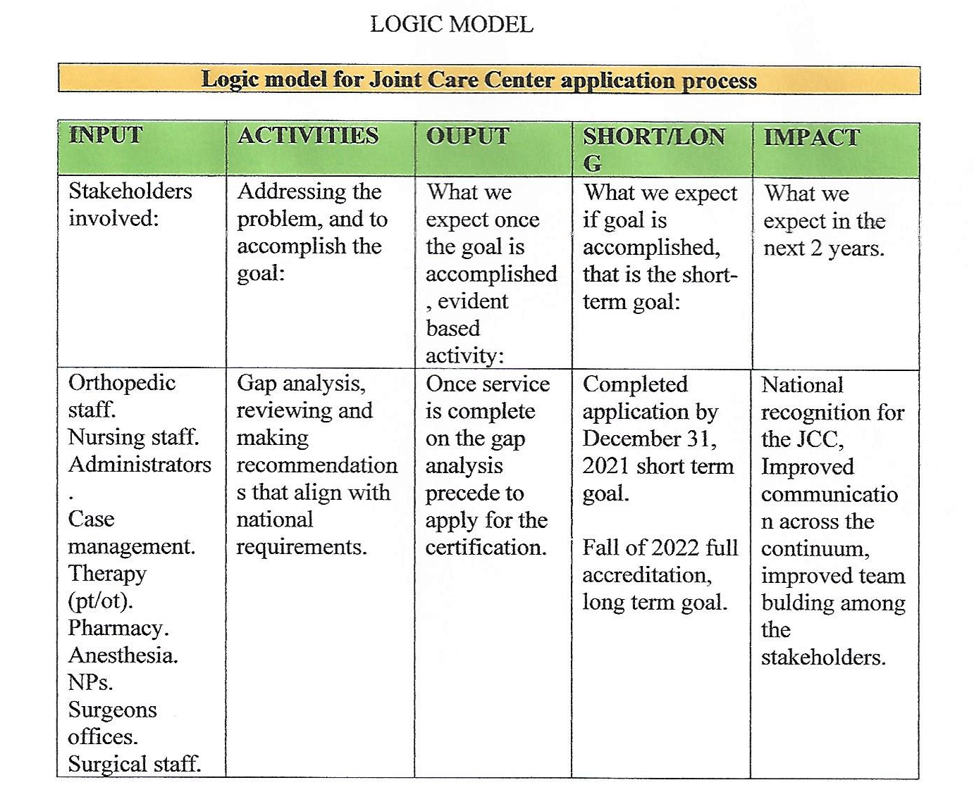
Logic Model
(W.K. Kellogg, 2004)
Notes:
The Logic model was used on the Joint Care Center to involve the stakeholders at SJMO, with using their input during various meetings to build a more cohesive front for the patient population, that will impact the final goal for the service line at SJMO. The one outcome was to complete the application process , improve communication across the continuum.

Slide 11
Organizational Assessment
Notes:
The SWOT analysis also was used to highlight the strength, weakness, opportunity, threats.
STRENTHS: Orthopedic Specials of Oakland count OSOC, support from administration, committed staff and the orthopedic nurse navigator.
OPPORTUNITY: National recognition will increase the appeal to patients seeking joint replacement. Solidify the collaboration among multidisciplinary services. A more competitive edge in SE Michigan.

Slide 12
Methodology
Setting: St Joseph Mercy Oakland Hospital Joint Care Center
Stakeholders:
Champion/Owner-Orthopedic surgeon
Anesthesia
Nursing-pre/post operative, pre-admission testing, 7 south staff
Administration/Quality
Physical therapy
Pharmacy
Case management
Home care
Dietary
Ethical Considerations: No ethical conflicts or issues, data from chart review for MARCQI/SJMO, IRB obtained UDM and SJMO
Notes:
St Joseph Mercy Oakland Hospital Pontiac Mi, that services SE Mi.
The stake holders at SJMO which consists of the champion orthopedic surgeons, anesthesia, nursing staff, PT, pharmacy, case management, home care, dietary services.
No conflict or issue, data retrieved from chart reviews for SJMO and MARQI, IRB obtained from STJMO/UDM.

Slide 13
Design
Form stakeholder collaborative team committee
Set meeting schedule-once a month until December 2021
Review gap analysis-address yellow and red areas
Create communication concept map (assigned)
November 2021, review gap analysis, evaluate readiness for application
Meeting set December with quality manager/nurse navigator/OR nurse manager to go over application. Application completed December 15, 2021.
Notes:
To form a collaborative team among the stakeholders.
Meetings were set to review the GAP to address the red areas.
To design a communication concept map that is still in progress/need the right application to build.
The November meeting was set to evaluate the readiness to apply for the advance certification.
Early December 2021 the Gap analysis was majority done and met the qualification to precede with the application.

Slide 14
Results
Gap Analysis
80% of stakeholders attend meetings
Applying for certification timeline on target for December 15, 2021, this was completed and submitted
Joint Care Center Charter completed
One Clinical Practice Guideline: PLANNING for POST-OPERATIVE DESTINATION (Filson et al., 2018).
Performance Improvement Plan
Notes:
GAP analysis majority done gave us the ability to apply.
60-80% identified stakeholders present at meetings.
Applications completed and submitted December 15, 2021.
Joint Care Center Charter completed.
One Clinical practice identified for the application PLANNING for POST-OPERATIVE destination
Performance Improvement developed and placed in the application.

Slide 15
DISCUSSION
Strengths
Donabedian and the Logic model framework/theory helped guide this program evaluation and the progression to apply for the advance certification
Gap analysis reviewed with stakeholders integrated best practice from differing disciplines
Quality manager set up a meeting to begin application process (December 3, 2021)
It was discussed develop and implement a communication map
Notes:
Using the Donabedian and Logic models to help guide this program evaluation as it progressed to the date of submitting the application.
Reviewing the Gap analysis with the stakeholders.
Meeting with a representative from Joint commission to review the application step by step.
The communication map will be used to a way to provide for the stakeholders to use on surgical patients.

Slide 16
DISCUSSION
Limitations
Late adjustments that pushed meeting times
Reviewing the gap analysis at each meeting caused some delays
Notes:
Meeting times made many adjustments over this period of review.
That delayed gap analysis review.

Slide 17
Impact
Providing safe and high-quality care by the reduction of variance of care.
Emphasis on guidelines in clinical practice in the accreditation process.
Stakeholders providing leadership and frequent communication in the accreditation process.
Providing a competitive edge in SE Michigan, by demonstrating commitment to higher standard.
Gap analysis completion with evidence-based recommendations.
Notes:
High quality care.
Clinical practice guidelines in place to follow.
Communicating frequently among leadership and staff.
Commitment to high standards of are for the patient population here in SE Mi.
Evidence based recommendations for practice.

Slide 18
DISEMINATION
Presentation to the stakeholders at SJMO, invited guest, friends, family, and University of Detroit Mercy, Detroit MI faculty members.
Notes:
Presenting to SJMO/UDM

Slide 19
Thank you !!!!
Committee members
Chair: Dr. Renee Courtney DNP
Organization mentor: Christina Dudek BSN, RN
David Jackson Director of Quality
Tanya West MSN, RN
Stakeholders at SJMO
My family

Slide 20
References
Berg, U., Berg, M., Rolfson, O., & Erichsen-Andersson, A. (2019). Fast-track program of elective joint replacement in hip and knee—patients’ experiences of the clinical pathway and care process. Journal of orthopaedic surgery and research, 14(1), 186
Centers for Disease. (2020, September 14). Arthritis. CDC Retrieved from https://www.cdc.gov/arthritis/pain/index.htm
Donabedian, A. (2005). Evaluating the quality of medical care. The Milbank Quarterly, 83(4), 691.
Filson, R., Mori, C., Ribsam, V., Holtz, L., Bodden, J., ONP-C, R. N. F. A., & Gabbert, T. (2018). Best Practice Guideline Total Knee Replacement (Arthroplasty).
Frost, K., Stafos, A., Barbay, K., & Henderson, K. (2019). Achieving Disease-Specific Care Joint Commission Certification: The Impact of Clinical Nurse Specialist Practice. Clinical Nurse Specialist, 33(6), 273-278.
Global RA Network. (2021). Retrieved October 31,2021 from https://www.globalranetwork.org
2015 Michigan DHHS, 2021. (2021). Retrieved October 31, 2021, from https://www.michigan.gov

Slide 21
References
Mori, Candy, Beun, Stacey & Bailey, Ann. (2012). Bone Up Your Program: Certification Process for the Total Knee Replacement and Total Hip Replacement Center. Orthopaedic Nursing, 31, 287-293. https://doi.org/10.1097/NOR.0b013e31826649ca
St Joseph Mercy Hospital (2021). Retrieved from https://www.stjoeshealth.org
The Joint Commission (2020) Retrieved from: https://store.jcrinc.com/2020-comprehensive-certification-manual-for-disease-specific-care-including-advanced-programs-for-dsccertification/
WK Kellogg Foundation. (2004). WK Kellogg Foundation logic model development guide. WK Kellogg Foundation.
Yayac, M., Pivec, R., Abbas, A., Vannello, C., & Courtney, P. M. (2020). High-Quality Skilled Nursing Facilities Are Associated With Decreased Episode-of-Care Costs Following Total Hip and Knee Arthroplasty. The Journal of Arthroplasty.

