Slide 1
Implementation of a Purposeful Rounding Checklist for Fall Prevention
Zaineb Albachachy MSN, NP-BC
University of Detroit Mercy DNP Student

Slide 2


Introduction
Inpatient fall
  What is an inpatient fall?
    Unintentional descent to the floor
    Adverse event
    “Never event”
Purposeful rounding
  Routine checking on patients
    Regular time intervals
      Assure needs are met
        Comfort, toileting, possessions within reach, pain

Slide 3

Background
Inpatient falls can lead to
  Poor patient outcomes
  Increased healthcare costs
  Negative reputation of organization
  Decrease patient trust in the health care system

Slide 4
Background continued…
Type of Injuries due to inpatient falls
Minor, moderate, and major
Minor = bruises, abrasions, and application of dressing/ice
Moderate= suturing wounds or splinting
Major injuries= internal injury and surgery
Types of inpatient falls
Physiological, anticipated
Gait instability, fall history, and current risk for falls
Physiological, unanticipated
Consists of syncopal episodes and falls caused during seizures
Environmental
Equipment failure and external hazards such as tripping on intravenous (IV) pole wires and IV/oxygen tubing

Slide 5
Significance
Populations affected
  Hospitalized patients
Around one million inpatient falls occur every year in the U.S.
Increased length of stay
  12.3 days
Increased costs
  34 billion dollars a year
  Average cost increased by 61%
    Not reimbursed by CMS

Slide 6
Purpose Statement & Objectives
Purpose
Reduce inpatient falls
Objectives
Educate, Implement
Monitor, Examine
Evaluate, & Assess

Slide 7





Clinical Question

Slide 8
Literature Review
DATABASE
INCLUSION/EXCLUSION
KEY SEARCH TERMS USED

Slide 9

Literature Review
Setting/Outcomes
  Inpatient hospital setting
  Improved patient outcomes and positive reduction of inpatient falls
  Decrease in inpatient falls by 50%
Team Members
  Registered nurses (RN),
  Licensed practical nurses (LPN),
  Nurse assistants (NA).
Patient Viewpoint
  Patient satisfaction
Challenges
  Busy workloads
  Time constraints
  Staff buy-in
  Staff turnover

Slide 10
Organizational Assessment
Beaumont Hospital Wayne
Teaching hospital
99 beds
Third floor medical surgical unit
25 beds
Target population
Fall rate in 2021
Falls with injury
Estimated cost

Slide 11

Organizational Assessment
Strengths
Morse Fall Scale
Current fall prevention measures
Current hourly rounding requirement
Staff and leadership support
Weaknesses
Covid-19
High staff turnover
Staff perception
Travel nurses not familiar with unit routines
Current hourly rounding is generic and lacks direction

Slide 12
Organizational Assessment
Opportunity
Enhancing hospital’s reputation
Reduce hospital’s overall expenditure costs
Improve staff morale
Threats
Staff/patient resistance. Covid-19 pandemic, and other units not having to do the checklist

Slide 13

Theoretical Framework
Kolcaba’s Theory of Comfort
  Comfort as end goal
  Comfort as existing in three forms
    Relief, ease, and transcendence
Lewin's Change Theory
  Unfreezing
  Change
  Refreezing

Slide 14

Ethical and Human Subjects Consideration

Slide 15
Methods/Design
Project design→ Quality Improvement Project
Setting → Inpatient hospital setting
Sample → patients, nursing staff
Pre-intervention → Approval and Education
Intervention→ Implement the purposeful hourly rounding checklist for fall prevention
Audit
Evaluation
Survey
Assess barriers

Slide 16
Method/Design
The cost of the material from current budget
Tools and Data collection →
  Hourly rounding with purpose checklist
  Quantitative data collected post-implementation
    4-point Likert scale questionnaires with 12 questions
  Inpatient fall data and patient census collected
    September 2021 and October 2021
Outcome measurements
  Fall rate, nursing staff using the checklist, nurse’s perception to using the checklist via survey using Likert Scale
    Fall data is assessed for September 2021 and October 2021
    Daily audit for use of checklist
    Survey

Slide 17
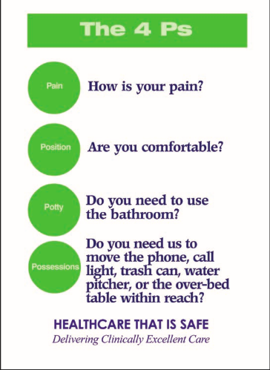
Hourly Rounding With Purpose Using the Four Ps

Slide 18
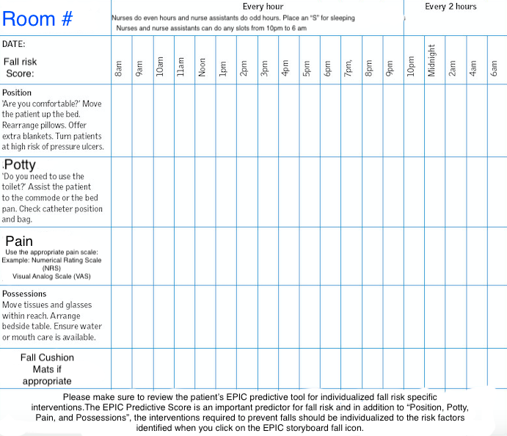
The Checklist
Nurses are responsible for the even hours
Nurse assistants are responsible for the odd hours
24-hour period
  8am to 10pm every hour and 10pm to 6 am every two hours
  Checklist was audited at 6 am daily for completeness

Slide 19

Results of Audited Checklist

Slide 20
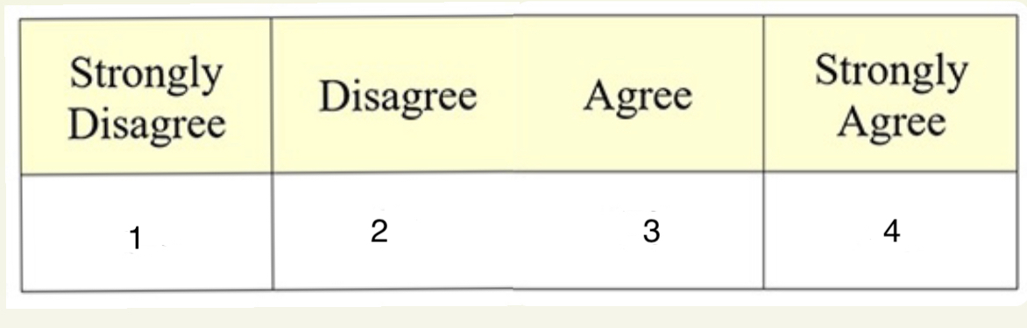
Survey Given to Nursing Staff…
I rounded with purpose on my patients and
utilized the four P’s but did not
document it on the checklist
The checklist was easily accessible
in my patient’s room
The checklist was useful when
completing my hourly rounding
I did not have time to document on the
checklist every time I rounded on my patients

Slide 21
Survey Given to Nursing Staff…
I want to continue using the rounding
with purpose checklist
I did not round hourly on my patients
Purposeful rounding decreased the
number of patient’s interruptions during my shift
Purposeful rounding increased my workload

Slide 22
Survey Given to Nursing Staff…
When I purposefully rounded, I always addressed the
4P’s (pain, potty, position and possession).
I purposefully rounded every hour
during the day and every 2 hours at night
Purposeful rounding decreased
my patients call light use
Purposeful rounding makes my care more obvious
to the patient/families and makes them feel safer

Slide 23

Results/Data Analysis

Slide 24
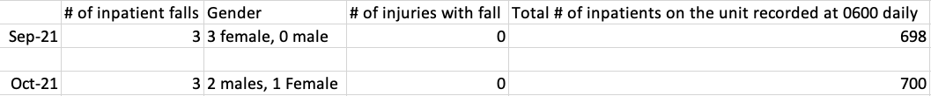
Data Analysis
Table 1
Descriptive Statistics for September 2021 and October 2021 patient census on third floor at BHW
Table 2
September 2021 and October 2021 patient falls and gender of patients who sustained a fall on third floor at BHW
None of the patient falls resulted in any type of injury for September 2021 and October 2021

Slide 25
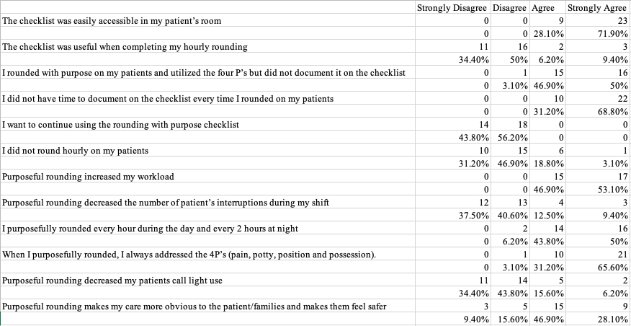
Results for Post Implementation Questionnaire
Table 3
Number and percentage for each question for the Post-Implementation Likert Scale Questionnaire (n=32)

Slide 26
Discussion
Not effective in preventing falls
Three falls in September 2021 and three inpatient falls in October 2021
Cost saved
No expectations in lower costs
Thirty-two anonymous post project implementation surveys were filled out by nursing staff
Nursing staff used the checklist
Did not document on it
Nursing staff used the four P’s
Nursing staff had tome constraints
Nursing staff did not want to continue using the checklist
Staffing shortage & lack of time
Covid-19 pandemic

Slide 27
Discussion
The project never left Lewin’s unfreezing stage due to:
Nursing staff resistance to change
Covid-19 pandemic
Verbal reminders
Ineffective
More creative ways to encourage utilization of checklist
Sticky notes on work computers
Passing out small candy bars with reminder to use checklist
Asking the unit manager to encourage nursing staff to use the checklist
Staffing shortage and lack of time

Slide 28
Implications & Sustainability
Implications
  Covid-19 pandemic, staffing shortages and high nursing turnover into consideration when implementing this checklist on another unit.
Sustainability
  Collaborating with the unit educator
  Stabilize nursing ratios
  Covid-19

Slide 29

Limitations
High staff turnover
  Covid-19 pandemic
Nursing staff shortage
Lack of time and the need to prioritize charting
Implementing project during the Covid-19 pandemic
  Short staffing
  Burn out

Slide 30

Dissemination plan
Plan
  Submitted a final paper to the University of Detroit Mercy’s Doctor of Nurse Practice project database.
  Presented to nursing faculty at University of Detroit Mercy.
  Third floor unit council meeting
    Monthly meeting
      Nursing staff, leadership

Slide 31

A special thank you to my family, friends, Dr. Wodwaski, Dr. Burson, Dr. Glenn, Dr. Wyatt, Amber Leech RN, and Beamont Wayne’s third floor nursing staff.

Slide 32
References
Agency for Healthcare Research and Quality. (2021). Fall prevention.
https://www.ahrq.gov/topics/falls-prevention.html
Agency for Healthcare Research and Quality. (2021). Preventing falls in hospitals. https://www.ahrq.gov/professionals/systems/hospital/fallpxtoolkit/fallpxtk3.html
Altobaiti, S.W. (2019). Impact of the use of the 4Ps in hourly rounds on reductions in patient falls in wards. Journal of Contemporary Scientific Research, 3(7), 1-7.
http://www.jcsronline.com/wp-content/uploads/2019/09/Volume3Issue7Paper1.pdf
Ampe, J., Balcaen, K., Goffin, J., Gu, Y., Ni, Y. (2016). Review on prevention of falls in hospital settings. Chinese Nursing Research, 3(1), 7-10. https://doi.org/10.1016/j.cnre.2015.11.002
Beaumont Health. (2021). About us. Retrieved from https://www.beaumont.org/about-us/mission-vision-and-values

Slide 33
References
Bott, M., Dunton, N., He, J., Kim, H., Park, S.H., Zhao, Y. (2019). Evidence on fall and injurious fall prevention interventions in acute care hospitals. The Journal of Nursing Administration, 49(2), 86-92.
Chandler, A.M., Fehlberg, E.A., Lucero, R.J., McDaniel, A.M., Mion, L.C., Richey, P.A., Shorr, R.I., Weaver, M.T. (2018). Impact of the CMS no-pay policy on hospital-acquired fall prevention related practice patterns. The Gerontological Society of America, 1(3), 1-7. doi:10.1093/geroni/igx036
Chae, J.S., Cho, I., Jung, M., Kim, Y.H. (2019). Development of ICNP-based inpatient falls prevention catalogue. International Nursing Review 67, 239-248. https://doi.org/10.1111/inr.12566
Christiansen, A., Coventry, L., Graham, R., Jacob, E., Twigg, D., & Whitehead, L. (2018 Intentional rounding in acute adult healthcare settings: A systematic mixed‐method review. Journal of Clinical Nursing, 27(9-10), 1759-1792.
Daniels, J.F. (2016). Purposeful and timely nursing rounds: A best practice implementation project. JBI database of systematic reviews and implementation reports, 14(1), 248–267. https://doi.org/10.11124/jbisrir-2016-2537

Slide 34
References
Grillo, D., Firth, K., & Hatchel, K. (2019). Implementation of purposeful hourly rounds in addition to a fall bundle to prevent inpatient falls on a medical-surgical acute hospital unit. Medsurg Nursing, 28(4), 243.
Hall, N., Meluskey, T., Toole, N. (2016). A systematic review: Barriers to hourly rounding. Journal of Nursing Management, 24, 283-290. DOI: 10.1111/jonm.12332
Johns Hopkins Medicine. (2021). Falls cost U.S. hospitals $34 billion in direct medical costs. https://www.johnshopkinssolutions.com/newsletters/falls-cost-u-s-hospitals-30-billion-in- direct-medical-costs/
King, B., Krupp, A., Liebzeit, D., Mahoney, J., Pecanac, K. (2016). The Gerontological Society of America, 58(2), 331-340. doi:10.1093/geront/gnw156

Slide 35
References
Morgan, L., Flynn, L., Robertson, E., New, S., Forde‐Johnston, C., & McCulloch, P. (2017). Intentional rounding: A staff‐led quality improvement intervention in the prevention of patient falls. Journal of Clinical Nursing, 26(1-2), 115-124.
Petiprin, A. (2020). Kolcaba's theory of comfort. http;//www.nursing-theory.org/theories-and-models/theories-and-models/kolcaba-theory-of-comfort.php
Petriprin, A. (2020). Lewin's change theory. https://nursing-theory.org/theories-and-models/lewin-change-theory.php
Petiprin, A. (2020). Watson’s philosophy and science of caring. https://nursing-theory.org/theories-and-models/watson-philosophy-and-science-of-caring.php

Slide 36
References
Radecki, B., Reynolds, S., & Kara, A. (2018). Inpatient fall prevention from the patient's perspective: A qualitative study. Applied Nursing Research, 43, 114-119.
Sims, S., Leamy, M., Davies, N., Schnitzler, K., Levenson, R., Mayer, F., . . . Harris, R. (2018). Realist synthesis of intentional rounding in hospital wards: Exploring the evidence of what works, for whom, in what circumstances and why. BMJ Quality & Safety, 27(9), 743-757.
Titler, M., Conlon, P., Reynolds, M., Ripley, R., Tsodikov, A., Wilson, D., & Montie, M. (2016). The effect of a translating research into practice intervention to promote use of evidence- based fall prevention interventions in hospitalized adults: A prospective pre–post implementation study in the U.S. Applied Nursing Research, 31, 52-59.
The Joint Commission. (2021). Preventing Falls. https://www.centerfortransforminghealthcare.org/improvement-topics/preventing-falls/
Vo, T. (2020). A practical guide for frontline workers during COVID-19: Kolcaba’s comfort theory. Journal of Patient Experience, 7(5), 635-639.

