Slide 1
Reducing Emergency Department Length of Stay by Implementing a MidTrack Treatment Area: A Program Evaluation
Kirsten Scott MSN, AGCNS-BC
University of Detroit Mercy

Slide 2
Introduction
Topic of interest:
Improving Emergency Department (ED) throughput
Utilizing an expedited process to move patients through the ED
Program Objective:
Lead a multidisciplinary team through a quality improvement project
Evaluate the project for improvements

Slide 3
Background
Adverse patient outcomes
Volume and capacity
Implications of not acting

Slide 4
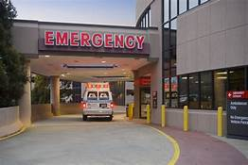
Significance
National Benchmarks:
LWBS: <1%
LOS: <3 hours
Munson Benchmarks:
LWBS: <2%
LOS: <3 hours

Slide 5
Clinical Question
Does the implementation of a Midtrack Treatment Area:
Reduce length of stay for low variability patients with an ESI score of 3?
Reduce Left Without Being Seen Rates?
(ESI, 2011)

Slide 6
Literature Review
Throughput
Crowding
Boarding
Major Concerns
FastTrack
MidTrack
Split Flow
Studies
Reduced LOS and LWBS rates
Outcome

Slide 7
Purpose Statement
The purpose of this program evaluation is to evaluate the implementation of a care delivery model that incorporates a Midtrack Treatment Area (MTA) into ED nursing standards of practice for patients and determine if it can reduce ED LOS & LWBS rates.

Slide 8
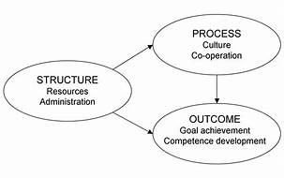
Theoretical Framework
Donabedian Model
(NCBI, 2005)

Slide 9
Methods & Design
IRB approval was obtained from the study institution and the host facility
Gathering of data:
Quantitative
Munson Analytics
Manual Abstraction
Analysis of data:
Pre and post intervention

Slide 10
Data: Left Without Being Seen Rates

Slide 11
Data: Left Without Being Seen Rates

Slide 12
Data: Length of Stay

Slide 13
Data Analysis

Slide 14
Data Analysis

Slide 15
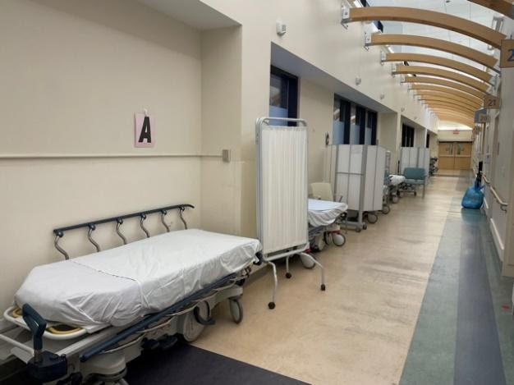
Evaluation and Recommendation
Strengths
Staff/leadership participation
Location
Improved metrics
Recommendation
Continue collecting data
Research potential for applying the MTA model in other areas

Slide 16
Sustainability
Consider broader implementation across the system
Investigate if a similar model can be applied to other ESI levels
Continue collecting feedback and data
Make changes as needed
(Phillips, n.d.)

Slide 17
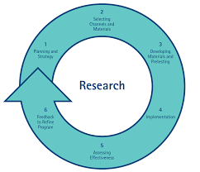
Dissemination
Share the data and analysis with stakeholders
Share with the organization via poster presentation
Future NACNS and ENA conferences
Consider future publishing
(NHMRC, 2020)

Slide 18
Nursing and Healthcare Implications

Slide 19
Family
Coworkers: Marc DuVall & all of the ED PCC’s
Mentor: Dr. Kevin Omilusik
Stakeholders: Jennifer Lechota, Brendan Franklin, Holly Rose, Dr. Archer
Chair: Dr. Arthur Ko
Professor: Dr. Karen Mihelich
IRB: Dr. Elizabeth Hill & Judith Murray

Slide 20
References
About Munson healthcare I Munson healthcare I northern Michigan. (n.d.). Munson
Healthcare. https://www.munsonhealthcare.org/about-the-system/about-munson- healthcare
Amarasingham R, Swanson TS, Treichler DB, et al. A rapid admission protocol to reduce
emergency department boarding timesBMJ Quality & Safety 2010;19:200-204.
American College of Emergency Physicians. Policy statement: crowding [Internet] Irving, TX:
American College of Emergency Physicians; 2013. Available from:https://www.acep.org/
patient-care/policy statements/crowding/#sm.000uy2fqlzc4ed610br2m5bif3m23.
American College of Emergency Physicians, Emergency Practice Committee. (2016).
Emergency department crowding: High impact solutions. American College of
Emergency Physicians. https://www.acep.org/legislation-and-advocacy/practice-management- issues/boarding/crowding/emergency-department-crowding---high-impact-solutions
American Hospital Association. Chartbook: Trends Affecting Hospitals and Health Systems.
Table 3.3 and Chart 3.7. Available at http://www.aha.org/research/reports/tw/chartbook/ch3.shtml.
Christopher Cairns, M.P.H., Jill J. Ashman, Ph.D., and Kai Kang, M.P.H. (2021). Emergency
Department Visit Rates by Selected Characteristics: United States, 2018 (NCHS Data
Brief No. 401). Centers for Disease Control andPrevention. https://www.cdc.gov/nchs/products/databriefs/db401.htm#:~:text=In%202018%2C%20there%20were%20an%20estimated%20130%20million,the%20ED%20in%20the%20past%2012%20months%20%282%29
Emergency Nurses Association. (2018). Staffing and productivity in the emergency department
[Position statement]. https://www.ena.org/docs/default-source/resource-library/practice- resources/positionstatements/staffingandproductivityemergencydepartment.pdf?sfvrsn=c5
7dcf13_6
Gaieski, D. F., Agarwal, A. K., Mikkelsen, M. E., Drumheller, B., Cham Sante, S., Shofer, F. S.,
Goyal, M., Pines, J. M. (2017). The impact of emergency department crowding on early
interventions and mortality in patients with severe sepsis. American Journal ofEmergency Medicine, 35(7), 953–960. https://doi.org/10.1016/j.ajem.2017.01.061
McCarthy ML, Zeger SL, Ding R, et al. Crowding delays treatment and lengthens emergency
department length of stay, even among high-acuity patients. Ann Emerg Med
2009;54:492-503.
Putney, T.,MSN, Chief Nursing Officer. 2021.
Resnik, D., 2011. What is Ethics in Research & Why is it Important? National Institute of
Environmental health sciences.
Wuerz RC, Milne LW, Eitel DR, and Travers D, Gilboy N. Reliability and validity of a new five-
level triage instrument. AcdEmerg Med. 2000; 7:236-42.

