Slide 1
Internationally Educated Nurse Transition to Practice Program Development
Christen Kemp, RN, MSN, FNP-BC
University of Detroit Mercy, 2024
Notes:
Welcome again, my name is Christen. Let’s go ahead and get started. My DNP project is the Internationally Educated Nurse Transition to practice program development

Slide 2
Introduction
Looming nursing/staffing crisis
Multifaceted
Nurses retiring from bedside and educational roles
Reduced levels of new graduate nurses
Role transition/exit
Supply < Demand
Patients are at risk for compromised quality of care
(University of St. Augustine for Health Sciences, 2021); (ANCC, 2020)
Notes:
Unfortunately the phenomenon of the nursing staffing crisis is not new
it is multifaceted
Read slide
supply does not outpace demand and because of that our patients are at risk for compromised quality of care

Slide 3
Background and Significance
Need for permanent diversified hiring practices
Lack of local applicants
Unsustainable pay trends
Moving toward the Internationally Educated Nurse (IEN)
Approximately 1,000 IENs arrive in the U.S. monthly to fill open positions
IENs present with various competence and practice readiness levels
Long term staffing goals depend upon successful adjustment of the IEN at the bedside
Currently, there is not a practice to assist in adjustment
(Bruise, 2022)
Notes:
The field of nursing cannot continue on this path
There is a lack of local applications, and high, unsustainable pay trends
therefore there is a need for permanent diversified hiring practices.
One way to diversify hiring trends is the shift toward utilizing the IEN
Read slide
In order for this to result in a long term staffing solution, there needs to be successful adjustment of the IEN to bedside practice

Slide 4
Clinical Question
At the host facility, will development of a new IEN Transition to Practice Program result in the host health system’s adaptation and use of the proposed program?
Notes:
Formally, our clinical question is:

Slide 5
Support from Literature
Discussion
Transitional facilitators < barriers and challenges faced by the IEN
Need to strike a balance between adopting U.S. normative practices and maintaining their own identity tied to homeland and culture (Rovito et al., 2022)
Recommendations
Overcome obstacles via well planned and thorough experienced nurse transitional program, developed for the IEN
Transition to practice programs for experienced nurses are meant to apply and build on the prior experience of the RN and help them to apply it in new situations (Longo et al., 2014)
Use of the IEN
Benefits of IENs
Experiences of the IENs
Need for IEN Transition Program
Program Recommendations
Notes:
To begin addressing the clinical question, we need to look to the literature
Through a ROL five major themes were reviled, Shifting toward Utilizing…
It was demonstrated that transitional facilitators…
that it is crucial to find the balance …
These obstacles can be navigated with a well-planned transitional program
Research type: Primarily Qualitative, published in 2009-2022
Seven articles across two data bases

Slide 6
Project Purpose
The IEN Transition to Practice Program is a two-phase project
Phase one: Program development
Phase two: Program implementation and evaluation
DNP Project Focus: Development of an IEN Transition to Practice Program for the host facility (Phase one)
Notes:
The IEN transition to practice program as a whole is broken down into two phases
Read slide

Slide 7
SWOT Analysis
Notes:
Moving into the SWOT analysis are the organizational specific strengths, weaknesses, opportunities and threats in relation to the program as a whole
Read slide

Slide 8
Theoretical Framework
Two guiding models
Duchscher’s Transition Shock
Promoting Action on Research Implementation in Health Services (PARiHS); Framework for implementing research into practice
Notes:
This project was guided by theoretical models
Read slide

Slide 9
Transition Shock
(Wakefield, 2018)
Notes:
Here we see the 4 phases of transition shock, honeymoon, shock, recovery and resolution. On the left is what the IENs may experience, and on the right is the counter effort of the transitional program
Discuss figure

Slide 10
PARiHS
(National Collaborating Centre for Methods and Tools [NCCMT], 2022)
Notes:
The PARiHS framework is what guides evidence into practice
In this framework, successful implementation and sustainability of that practice change is dependent upon the combination of evidence, context and facilitation and how they work together
In this case, evidence is…
Graphic representation of the PARiHS framework as related to the project and program. The PARiHS framework can be expressed as the following: SI = f (E, C, F); SI - successful implementation, E - evidence, C - context, F - facilitation and f - function of (NCCMT, 2022).

Slide 11
Project Design
Design: Program Development
Evidence-based approach toward assessment and development of program components to address a professional nursing need
Program development phases: Assessment, planning, development, and evaluation
Project Target Population: Nurses
Recommended in-house Filipino/internationally educated nurses
Host facility nursing development and educational staff/leadership
Notes:
The project design focuses on program development, utilizing an evidenced based approach of assessment and development of program components to address a professional nursing need
Read slide

Slide 12
Ethical Considerations
Phase One
Phase Two
Institutional Review Board:
Approval received from University of Detroit Mercy
Project collaboration approval received from the System Director for Nursing Education, Research, and Innovation, at host facility
Participants: Newly hired IENs ages 18+; Participation is required
Institutional Review Board:
Prior to implementing, it is expected that the host facility will complete formal IRB review
Notes:
Ethical considerations for both the project and program as a whole. My specific project was phase one which received…
Read slide
Phase 1
Peer feedback participation is voluntary, all responders are 18+
Data was de-identified and anonymous
Phase 2
Risk of harm: Physical-minimal to none; Other-potential risk from labeling, relationship dynamics and minor emotional distress
IENs fully assume the label of International, placing them at risk for being perceived as “other”, increasing risk of isolation
IEN will forge multiple new relationships, which may be emotionally and mentally taxing to maintain.
Emotional distress may incur from the transitional process and be exacerbated through the peer debriefing and data collection instruments.

Slide 13
Assessment
Curriculum Plan
Supportive Professional Structure
Two articles with direct curriculum recommendations
Four different outlines from existing host facility programs
Five articles with support recommendations
Host facility mentoring program plan, and Filipino based employee and community taskforce feedback
Created preliminary Curriculum Plan and Supportive Professional Structure to undergo key informant review via feedback group
Integrating current literature recommendations with existing host facility resources
Notes:
Now we are moving into some of the nitty gritty
Assessment is the first program development stage
Assessment is identifying all of the different recourses, similar to dumping out a pieces of a puzzle
Read slide
These resources were used to create… which then later underwent
This was done to integrate…

Slide 14
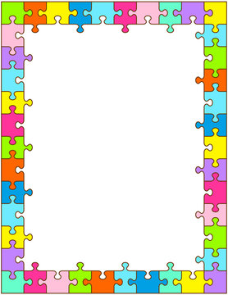
Planning
Curriculum Plan
Topical outline indicating the sequence of content areas to be addressed during the ongoing education sessions
Multiple, four hour in-person sessions occurring over the course of one year
Sessions consist of didactic material, skills lab, and peer debriefing
Desired Outcomes:
Phase one: Finalized curriculum that is ready to implement
Phase two: Increased practice confidence of the IENs after program completion
Notes:
In the planning phase, the end product structure begins to take shape
Read slide
Curriculum plan purpose: Augments formal program consisting of educational opportunities and professional support to enhance bedside transition
Organized by session number, timeframe, topic, data collection tool, data collection frequency
Outcomes…

Slide 15
Planning Continued
Supportive Professional Structure
Multi-member support system to guide and differentiate between networking needs
Paced introduction of support members over one year
On-unit preceptors, clinical mentors, and experienced transition peers
Desired Outcomes:
Phase one: Finalized supportive structure that is ready to implement
Phase Two: Increased perceived support of the IENs after program completion
Notes:
The teammate to the curriculum plan is the supportive professional structure
Organized by timeframe, role, purpose, data collection recommendations

Slide 16
Development
Feedback Preparation and Collection
Developed participant engagement material and data collection
Buy-in and Recruitment
Content dissemination and reminders
Notes:
The development portion of the project had a lot of moving pieces in order to prepare for the feedback collection
Participant engagement materials were created, more detail next slide
Buy in and recruitment focused on gathering in system support for the project and identifying individuals to provide feedback
Once feedback group members were identified content dissem began
Participant materials
Slide set presentation
Accompanying Microsoft stream
Content dissemination packet--Hard word doc with instructions and preliminary versions
Anonymous Microsoft Form, open ended, but prompted feedback
Buy-in and Recruitment
Met with the Educational Board of Directors (6)
Met with Nurse Residency Program Coordinators (6)
Outreach to Nurse Educators and other Nurse Leaders (36) to participate
Outreach to Nurse Managers to recommend in-system international staff (28)
Outreach to recommended international staff (18) to participate
An invitation to participate was extended via email to the recommended staff members
Total time for feedback, 2 weeks
Reminder email-1 week prior and 2 days prior to closing

Slide 17
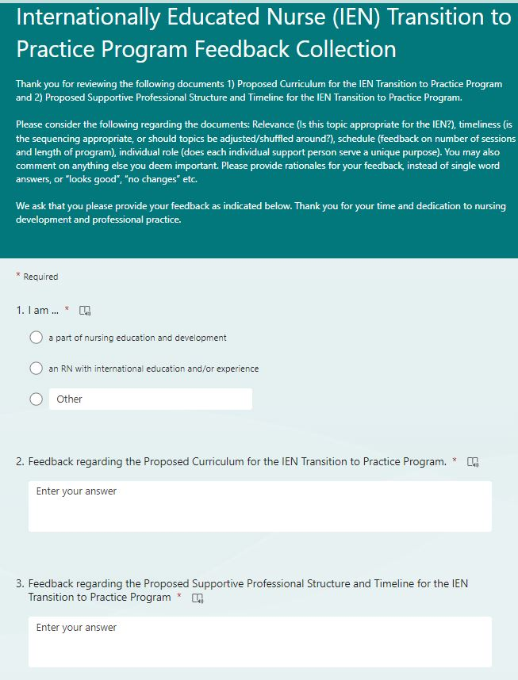
Feedback Materials
PowerPoint
Microsoft Form
Content dissemination packet with feedback instructions
Microsoft Stream

Slide 18
Feedback Outcomes
All peer feedback was reviewed for recommendations
Curriculum plan: Topics rearranged and added
Supportive professional structure: Timeframe adjustment and role clarification
Additional considerations
Notes:
Feedback outcomes is where the project started to get fun. The puzzle is almost finished, as it starts to all come together
Things that were added: Guest speaker, IV/central line types, autism care, discharge planning and case management, quality metrics
Rearranged: Sociocultural skills (nonverbal com, slang, local colloquialisms) [week 2 vs week 4], delegation and RN support roles
Support network changes: on-unit clinical mentor adjusted by 2 weeks, “ends” at 36 weeks, but goal to transition to casual support, not full stop
Additional Considerations: IENs encouraged to not be timid, same nationality for transitional peer, paced placement with peer

Slide 19
Evaluation
Approval of finalized curriculum plan and supportive professional structure received from the System Director for Nursing Education, Research, and Innovation
Formal handoff with nursing education staff
Reviewed program need and purpose
Discussed content and structure
Outcomes
Questions answered and clarification provided
Host facility is ready to begin program implementation, educational staff is looking forward to program roll out
Notes:
Evaluation is the final step of the project design
First approval was…
Then a formal, in person hand off was completed
Read slide

Slide 20
Project Deliverables
Finalized Curriculum Plan
Finalized Professional Supportive Structure
Data collection tools
Notes:
At this point the nursing educators were engaged, asked good questions and are looking forward to implementing the program. They were already discussing and planning what topical speakers they should arrange.

Slide 21
Sustainability
Data collection tools
Measure participant/IEN outcomes and achievements
Reflective of overall program goals and objectives
Program evaluation
Dynamic program, adjust as needed
Guided by IEN feedback plus results of data collection
Continuous buy-in
Ongoing key informant feedback
Financial benefit
Cost savings related to retention
Long term → Formal oversight committee
Notes:
Successful projects and programs depend upon sustainability
The deliverables remind me of a brand new car that is ready to roll off of the lot, it is ready, but to keep it operational, preventative measures and maintenance is needed.
Read slide
Program adjustments, driven by evaluation of IEN feedback and data collection
Buy in- stimulating nursing managers, preceptors, peers for their insight
Improved transition to practice leads to increased practice confidence, and is associated with lower turnover rates. The cost of onboarding a nurse to fill the vacancy left by the previous nurse is exponential
Successful program leads to decrease staff turnover within the IEN cohorts, and decrease the need for replacement onboarding

Slide 22
Implications for Nursing Practice
Local / Host Facility
Initial discordance in practice environment
Anxiety and role confusion from involved staff
Decreased productivity, efficiency, and quality metrics while staff adjust
Controlled destabilization that fosters new ideas and innovation (ANCC, n.d.)
Foster a new integrated normal
Beyond
Change in workplace homogeneity
Restructure diversity training to shift focus from patients differing from the nurses, to the inclusion of IENs
Staffing Crisis and Patient Outcomes
There are 440,000 avoidable deaths occur in American hospitals yearly related to adverse events that proper nursing care can often prevent (MNA, 2021)
Matching RN expertise with the needs patient, while providing evidenced based care
Notes:
Looking at impact, this project does create change at the local and expanded level
I am hoping that even though my project is a small drop in the bucket, that it will make lasting change

Slide 23
Featured References
American Nurse Credentialing Center. (2022). Find a Magnet organization. Retrieved from https://www.nursingworld.org/organizational-programs/magnet/find-a-magnet- organization/
Brusie, C. (2022). Hospitals are turning to foreign-educated nurses fix the U.S. staffing crisis. Retrieved from https://nurse.org/articles/foreign-educated-nurses-united-states/
Michigan Nurses Association. (2021). Campaign for safer hospitals. Retrieved from https://www.misaferhospitals.org/uploads/7/7/1/1/7711851/2021_short_studiesfactsheet-one_page.pdf
Longo, M. A., Young, D., Jones, C., Shaw, C. A., Werner, R., Minor, D., & Hoying, C. (2014). TERN residency program. Journal for Nurses in Professional Development, 30(4), 181-185. Doi: 10.1097/NND.0000000000000063
National Collaborating Centre for Methods and Tools. (2022). PARiHS framework for implementing research into practice. Retrieved from https://www.nccmt.ca/knowledge-repositories/search/85
Rovito, K., Kless, A., & Costantini, S. D. (2022). Enhancing work for diversity by supporting the transition of internationally educated nurses. Nursing Management, 53(2), 20-27. Doi: 10.1097/01.NUMA.0000816252.78777.8f

Slide 24
Featured References
University of St. Augustine for Health Sciences. (2021). The 2021 American nursing shortage: A data study. Retrieved from https://www.usa.edu/blog/nursing-shortage/
Wakefield, E. (2018). Is your graduate nurse suffering from transition shock? Journal of Perioperative Nursing, 30(1). 47-50.
Full reference list available Here

Slide 25
Acknowledgements
DNP Project Co-Chairs: Arthur Ko, PhD, RN, and Theresa R. Wyatt, PhD, RN, CCM, CCRE
DNP Project Reader: Christine M. Pacini, PhD, RN
Organizational Expert: Mary Kravutske, PhD, RN
Host facility and all the engaged nursing staff
DNP peers
My biggest fans

Slide 26
Questions and Feedback

