Slide 1
Implementation of a Dementia-Specific Advance Care Planning Tool at a Program for All-Inclusive Care for the Elderly (PACE)
Stephanie N. Johnson, MSN, APRN, AGCNS-BC
Notes:
My name is Stephanie Johnson. Today I will be discussing my DNP project about the implementation of a dementia-specific advance care planning tool.

Slide 2
Introduction
Multiple Type of Dementia
Umbrella Term
Many Causes
Alzheimer's Disease is the most common
No Cure
Notes:
-Dementia is an umbrella term for a group of symptoms including deterioration in memory, cognitive function, speech, processing abilities, and problem solving.
-There are many causes of dementia including diseases like Parkinson's, medical incidents like a stroke, and idiopathic.
-Alzheimer's disease is the most common form of dementia and typically the one that is most recognized from by the public.
-There is no cure for dementia and the treatments currently available do nothing to reverse the disease only to slow the progression.

Slide 3
Background
Why Does it Matter?
Chronic & Progressive Disease
Vulnerable Population
Inconsistent ACP Process
Care Resources PACE (Program of All-Inclusive Care for the Elderly)
Collaboration between APRNs & Social Workers
Provision of ACP to Participants
(Alzheimer's Association, 2022; Care Resources, 2021a).
Notes:
Why does it matter?
- Dementia is a chronic and progressive disease. Treatments provide assistance with symptoms. Individuals with dementia will have this disease until the day that they die.
-Due to the cognitive decline in individuals with dementia this is a very vulnerable population. Most individuals with dementia are 65 years or older making them older adults. Both of these factors create a population that is at a high risk for abuse and being taken advantage of.
-Advance care planning is an important tool for all populations as it allows for individuals to record their wishes for care, treatment, and end of life decisions in the event that they lose the ability to make their own decisions or to communicate effectively. This is especially important for individuals with dementia since they often lose decision-making capacity and sometimes even the ability to communicate long before end-of-life. Although ACP exists for individuals with dementia, the ACP intervention process is inconsistent and lacking. Many individuals with dementia are introduced to the concept of ACP at their PCP appointments though some may only have interaction with ACP during an inpatient stay. There is an immense need for improved ACP implementation process for this population.
-Care Resources PACE or Program of All-Inclusive Care for the Elderly is a program funded by medicare and medicaid that serves the older adult population. This program provides services to individuals that qualify for some level of higher care such as a assisted living, long term care, etc but are able to stay in their homes because of the program's services. The program is exactly as it describes all-inclusive. Participants receive their PCP visits, prescriptions, PT, OT, SLP, durable medical equipment, meals, home care, social work, transportation, and a day center all with this program.
-APRNs are ideal individuals to improve the ACP implementation process in collaboration with a multidisciplinary team with key players such as social workers.

Slide 4
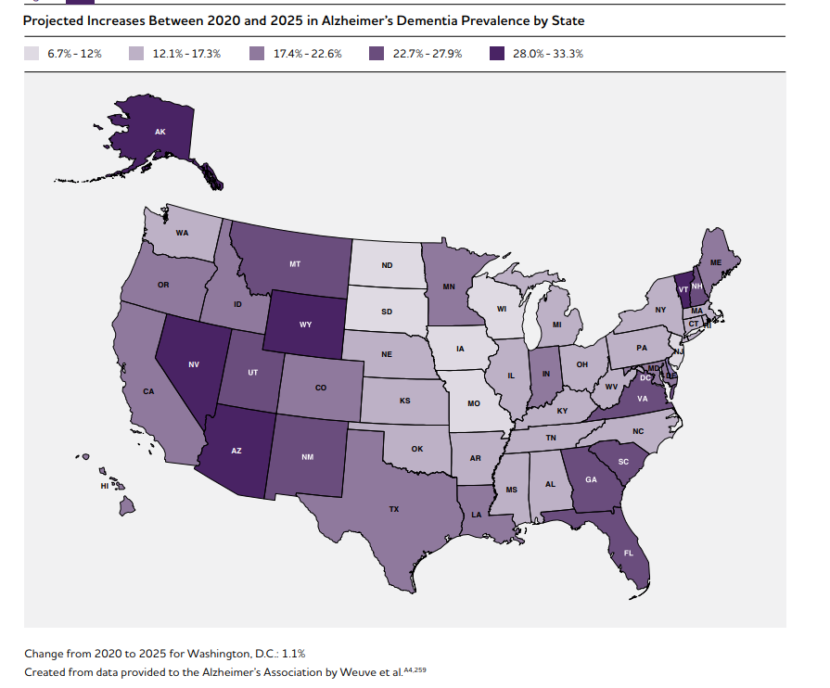
Significance
Mostly Older Adults 65+
Worldwide Prevalence:
2020: 55 Million Cases
2030: >78 Million Cases Expected
Michigan Prevalence:
2019: 190,000 Michigander Cases
2025: 220,000 Expected Michigander Cases
Astronomical Cost of Care
2030: $2 trillion
2050: $9 trillion
5th leading cause of death
PACE: Majority of participants have dementia diagnosis
(Alzheimer’s Association, 2022).
(Alzheimer's Association, 2022; Michigan Dementia Coalition, 2019)
Notes:
-As discussed earlier dementia mostly effects older adults age 65 or older. The population of individuals diagnosed with dementia is expected to rise astronomically in the next decade. In Michigan there are currently more than 190,000 cases this is expected to rise to over 220,000 by 2025.
-Worldwide there are more than 55 million documented cases of dementia by 2030, just 7 years from now, we are expecting to see that number rise to over 78 million cases. This is obviously a huge number and therefore a significant problem for the healthcare community. The huge increase in cases of dementia can be attributed to in aging baby boomer population, increased life expectancy, and overall increase in the world’s population.
-The cost of caring for individuals with dementia is astronomical and could reach $2 trillion by 2030 and $9 trillion by 2050.
-Dementias are the 5th leading cause of death in the world though this does not take into account the years of decline and morbidity leading up to death.
-The majority of the participants at Care Resources PACE have a dementia diagnosis or a MOCA scale score that places them in this category.

Slide 5
Care Resources PACE
Located in Grand Rapids, Michigan
Serves Residents of Kent County and select zip codes in Allegan, Barry, Ionia and Ottawa Counties
Has approximately 320 current program participants
Current ACP Process: Inconsistent & Not Meeting Specific Population Needs
Adults 55+ who meet State of Michigan nursing facility level of care
Notes:
The site chosen for my project was Care Resources PACE.
Located in Grand Rapids, MI
-Serves Residents of Kent County and select zip codes in Allegan, Barry, Ionia and Ottawa Counties
-Adults 55+ who meet State of Michigan nursing facility level of care
-Plans to expand program into the Lowell region with plans for a new facility underway
2. Has approximately 320 current program participants & can enroll a net of 10 new participants each month
4. Care Resources identified the need to improve upon their current ACP process secondary to their current process being inconsistent and standardized. Due to the fact that the majority of their participants have a dementia or cognitive impairment diagnosis the standard ACP process was not meeting specific needs of this population.

Slide 6
Clinical Question
Does the implementation of a dementia-specific advance care planning tool help increase knowledge and decision-maker confidence, as well as decrease inappropriate healthcare utilization rates?
Notes:
For this project I explored this question: Does the implementation of a dementia-specific advance care planning tool help increase knowledge and decision-maker confidence, as well as decrease inappropriate healthcare utilization rates?

Slide 7
Literature Review
10 Articles were Included
5 Major Themes:
Barriers to Advance Care Planning
Lack of Support & Education for Surrogate Decision-Makers
Advance Care Planning Promotes Quality of Life
Healthcare Professionals' Roles & Needs
Lack of Dementia-Specific Advance Care Planning
Notes:
-Ten articles were included in the literature review. Half of the articles were systematic reviews.
-Five Major themes were identified
1.Barriers to Advance Care Planning
Many individuals with dementia do not understand the terminality of dementia and therefore do not understand the importance of ACP, individuals with dementia find it difficult to discuss end-of-life care choices with their families or do not wish to dwell on the inevitable, and the belief that the individual with dementia’s loved ones would make the decisions they would want on their behalf without any paperwork or preparation.
2.Lack of Support & Education for Surrogate Decision-Makers
Surrogate decision-makers often feel underprepared for the significant responsibility of being their loved one's decision maker, this is accompanied by burden and guilt of not knowing if they made the decisions that their loved one would have wanted.
3. Advance Care Planning Promotes Quality of Life
Individuals with dementia who have ACP had lower levels of healthcare utilization including hospitalization rates and emergency department visits, lower rates of life-prolonging interventions such as enteral feeding tubes, Improved relational quality with loved ones with a lower rate of decisional conflict.
4. Healthcare Professionals' Roles & Needs
PCPs have unique relationship that supports ACP implementation, healthcare providers often feel underprepared to provide ACP education and support for their patients with dementia
5. Lack of Dementia-Specific Advance Care Planning
Participants in the relevant studies were frustrated that the ACP tools offered did not address dementia-specific topics important to discuss with their loved ones

Slide 8
Barriers to Advance Care Planning
Misunderstanding about terminality of dementia
Difficulty discussing the future
Belief that loved ones will take care of everything
Notes:
Many individuals with dementia do not understand the terminality of dementia and therefore do not understand the importance of ACP
individuals with dementia find it difficult to discuss end-of-life care choices with their families or do not wish to dwell on the inevitable
the belief that the individual with dementia’s loved ones would make the decisions they would want on their behalf without any paperwork or preparation

Slide 9
Lack of Support & Education for Surrogate Decision-Makers
Surrogate Decision-makers are underprepared
Immense burden & guilt
Notes:
Surrogate decision-makers often feel underprepared for the significant responsibility of being their loved one's decision maker
this is accompanied by burden and guilt of not knowing if they made the decisions that their loved one would have wanted.

Slide 10
Advance Care Planning Promotes Quality of Life
Lower rates of healthcare utilization
Lower rates of life-prolonging treatments
Improved relational quality with loved ones
Notes:
Individuals with dementia who have ACP had lower levels of healthcare utilization including hospitalization rates and emergency department visits
lower rates of life-prolonging interventions such as enteral feeding tubes
Improved relational quality with loved ones with a lower rate of decisional conflict.

Slide 11
Healthcare Professionals' Roles & Needs
Primary Care Providers have unique relationship
Providers feel underprepared to provide ACP
Notes:
PCPs, including advanced practice nurses such as nurse practitioners and clinical nurse specialists, have unique relationship that supports ACP implementation
healthcare providers often feel underprepared to provide ACP education and support for their patients with dementia

Slide 12
Lack of Dementia-Specific Advance Care Planning
Current ACP is not specific to dementia
Lack of dementia-specific ACP tools
Notes:
Participants in the relevant studies were frustrated that the ACP tools offered did not address dementia-specific topics important to discuss with their loved ones

Slide 13
Purpose Statement
Increasing Dementia Population -> Increasing Need to Act
Millions without a Voice
Financial and Emotional Burden
Dementia-Specific ACP Tool
Notes:
-The increasing dementia population creates an increasing demand for action by the healthcare community.
-Without advance care planning intervention there will be millions of individuals affected by dementia who will not be able to participate in their own decision-making process.
-The financial and emotional burden associated with the growth of this population is large and continues to grow.
- A dementia-specific ACP tool can help to decrease unnecessary suffering of individuals with dementia, provide support to their surrogate decision-makers, and decrease unnecessary healthcare utilization costs.

Slide 14
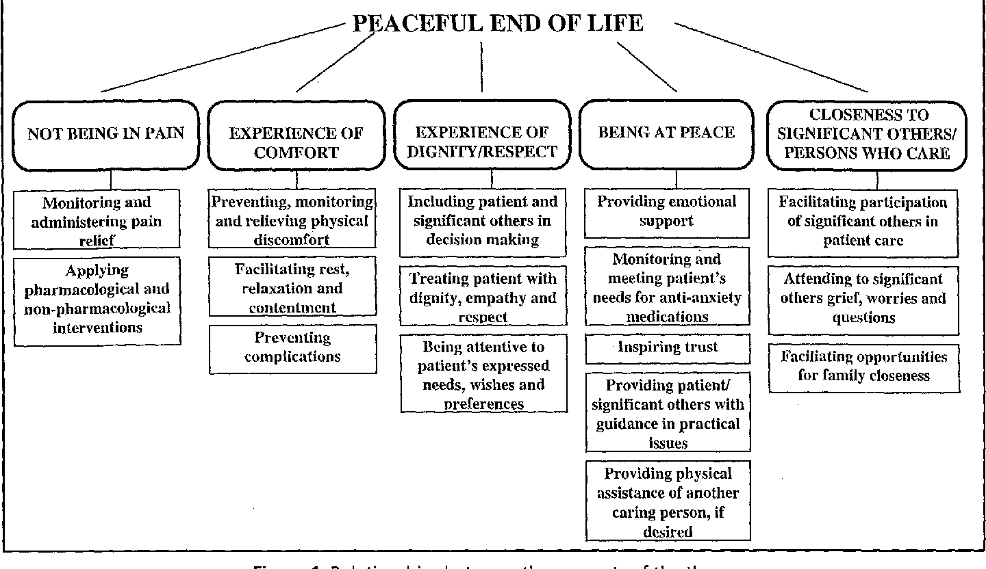
Theoretical Framework
Developed for use with End-of-Life Patients
5 Categories for Peaceful EOL
Provides Framework for ACP intervention & discussion
(McEwen & Wills, 2014).
Notes:
Theoretical framework:
-I used the Peaceful End-of-Life theory. This framework identifies five categories that provide for a peaceful end-of-life. These categories and the interventions helped to frame the ACP session content. The tool facilitated discussion between the individual with dementia and their surrogate decision-maker regarding acceptable versus unacceptable care, interventions, etc. We sought to ensure that the individual with dementia achieves their desired form of peace at end-of-life.

Slide 15
Donabedian Model
Structure Measures
Social work team works 1:1 with program participants and their surrogate decision-makers
Interdisciplinary structure of PACE allows for collaboration
Process Measures
Goal is 100% of participants with dementia diagnosis receive Dementia-Specific ACP
Participants with dementia diagnosis will all receive education regarding their diagnosis and EOL care options
Outcome Measures
Decrease in ED visits and Inpatient Stays among project participants
Increased Surrogate Decision-maker confidence in role responsibilities
Increased understanding of dementia & EOL care options for both participating parties
(NHS, 2021).
Notes:
Donabedian Model assesses quality in three categories structure, process, and outcome (NHS, 2021). Analyzing this project using the Donabedian model established agreement between myself and the interdisciplinary team about what important outcome measures should be evaluated during the study. These will be discussed on a later slide.
Structure Measures- Structure measures are attributes of the program or providers to provide services to program participants.
1. Including the ability of the social work team to work 1:1 with the participants and their surrogate decision-maker.
2. The interdisciplinary structure of the PACE team allows for collaboration between the PCPs, social work team, and their participants.
Process Measures- The eventual goal is for 100% of the PACE participants with a dementia diagnosis or qualifying MOCA score to receive dementia-specific ACP intervention.

Slide 16
Organizational Assessment
Strengths
Weaknesses
PACE Program is All-Inclusive
No Increased Cost to PACE or Program Participants
Surrogate Decision-Makers are not Present at Day Center
Scheduling and Contact is Difficult
Opportunities
Threats
Quality Improvement Team on Site
Work to Decrease Healthcare Utilization Rates is Ongoing
Medicare & Medicaid Funded Program
Specific Documentation Requirements
Notes:
I performed a SWOT Analysis for Care Resources where I would perform my study. I will briefly review some key findings:
Strenghts: PACE programs are all-inclusive so there would be no increase in costs for participants to be part of this project.
Weaknesses included the surrogate decision makers are not present at the day center making scheduling difficult.
Opportunities on-going quality improvement opportunities including the goal of reducing unnecessary healthcare utilization rates.
Threats included PACE is medicare and Medicaid funded there are specific documentation requirements which would have to be met with each participant interaction or financial consequences can occur.

Slide 17
Methods/Design
Process Quality Improvement Project
Dementia-Specific ACP Tool
Introduced at Enrollment
Educate both Members of Dyad
Evaluate Understanding
Assess Decision-Maker Confidence
Notes:
Methods and Design:
This project is a process quality improvement project since I will be working to improve upon Care Resource's current ACP process for their participants with dementia.
An advisory team was formed with myself as the leader, a DNP prepared nurse practitioner mentor, and the social work manager. This team was responsible for discussing, finalizing, and planning the ACP tool intervention.
2. The ACP tool was introduced at enrollment to new participants who have dementia or cognitive impairment diagnosis or a MOCA scale score (19 points of less) that put them in the dementia category who agreed to participate in the project.
-The session educated both the participant with dementia and their surrogate decision-maker about dementia and facilitated the ACP conversation including end-of-life care options
- The assessment tools are discussed on the next slide along with when these tools were administered.

Slide 18
Method/Design
Outcome measurements:
Knowledge Assessment
Surrogate Decision-Maker Confidence
Healthcare Utilization Rates
Statistical methods
Pre-Intervention Assessment
Immediate Post-Intervention Assessment
3 Month Post-Intervention Assessment
IRB plan:
Approval by Program Manager & QI Team
Qualitative Feedback Survey
Approval by UD Mercy IRB
Notes:
Three outcome measures were assessed throughout this project.
First, a knowledge assessment was performed before the ACP implementation was presented to the participant with dementia and their surrogate decision-maker. The knowledge assessment was then administered immediately after the ACP implementation and then again 2-3 months after implementation.
2. Second, a surrogate decision-maker confidence assessment was administered at the same three times as the knowledge assessment. This assessment assessed how confident the surrogate-decision maker is on their ability to be their loved one's advocate and decision maker
3. The dyad completed a qualitative feedback survey after the ACP session to assess what they liked about the process, how they felt after the session, and their thoughts on the future for decision-making.
3. Finally, healthcare utilization rates for 4 months before implementation and 4 months after implementation were obtained for the project participants.
The outcomes were compared to one another from pre implementation, immediate post-implementation, and 2-3 month post-implementation to see how the rates change and to determine if there was a statistical significance between the data collection points.
I received approval by the COO and Center Manager to implement the project. The project proposal was submitted to University of Detroit Mercy’s Institutional Review Board. The review board approved the project before any implementation began. Implementation began March 21st.

Slide 19
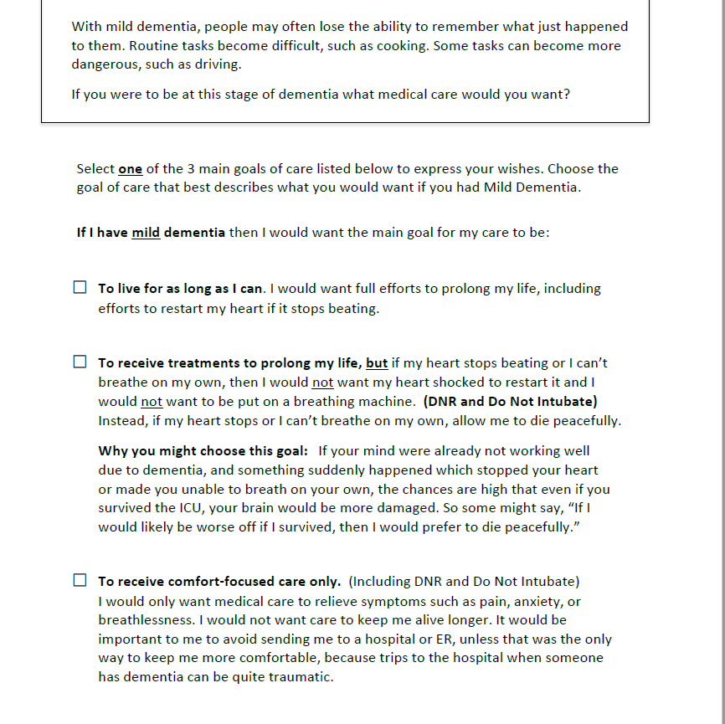
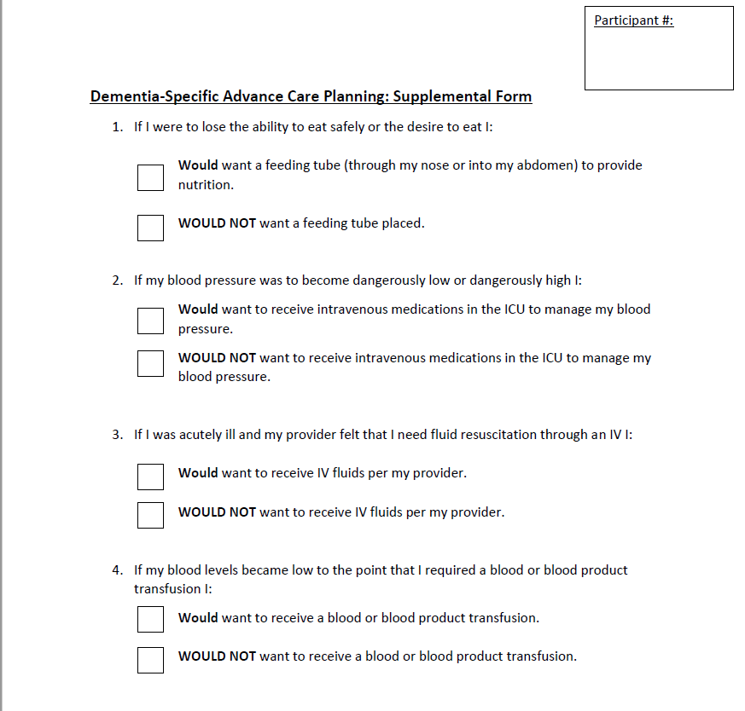
The Dementia-Specific ACP Tool
Notes:
This image on the left is a sample from the dementia-directive which was the dementia-specific ACP tool that was utilized for this project. This tool walks through the project participants through three stages of dementia, with descriptions of common symptoms, and asks what kind of care the participant with dementia would want in that situation. Options for care at each stage included a “do everything” or full code approach, DNR with aggressive treatment up until cardiac or respiratory arrest, and comfort care. Each participant chose their preferred type of care based on their personal beliefs and values of what is or is not acceptable care for them personally.
The image on the right is the dementia-specific ACP supplement form that I created in addition to the dementia directive. The supplement form sought to identify specific questions that were not directly addressed in the dementia-directive such as blood transfusions, feeding tubes, vasopressors, and IV fluid resuscitation.

Slide 20
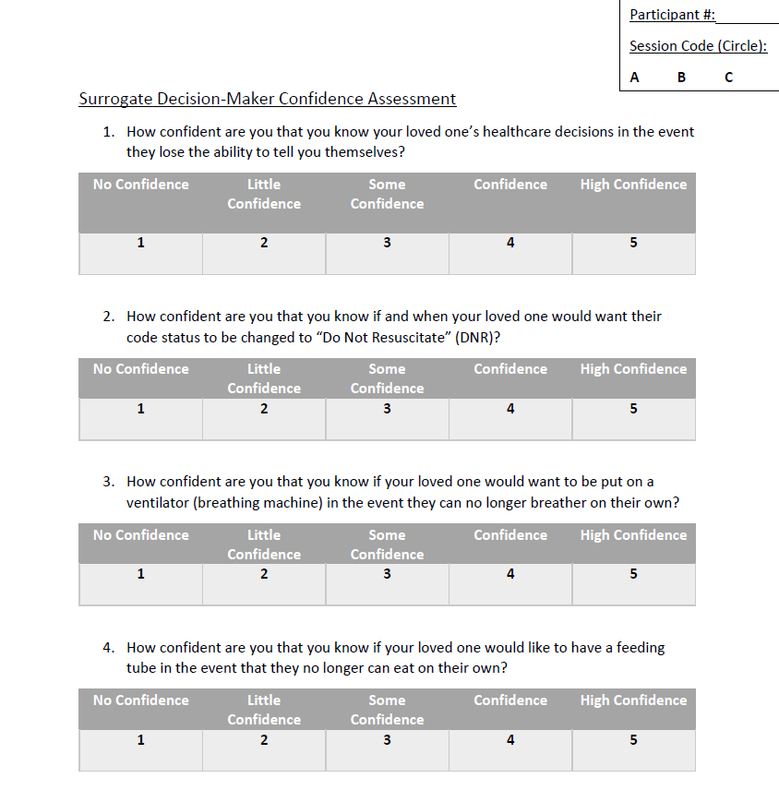
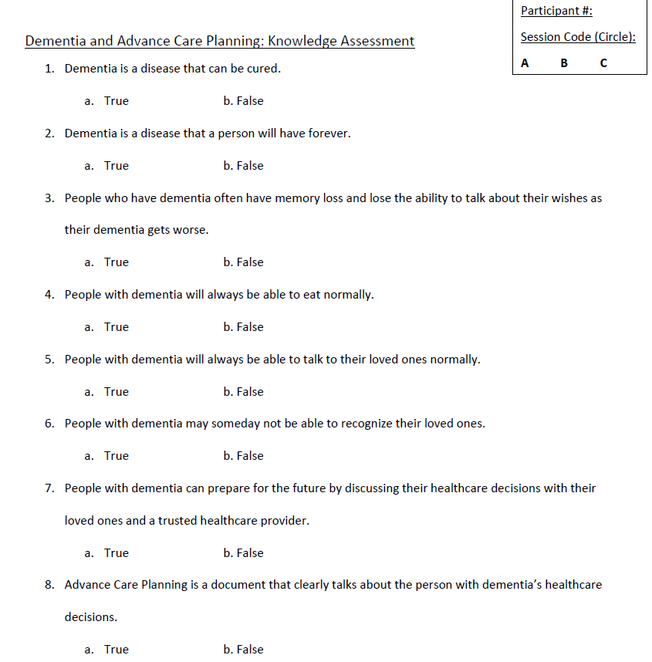
Data Collection Surveys
Notes:
Here are the data collection surveys that were used.
On the left is the surrogate decision-maker confidence survey. This is a Likert based scale that asked decision-makers how confident they were in five different areas of decision-making.
On the right is the knowledge assessment that was administered to both the individual with dementia and the surrogate decision-maker. The knowledge assessment asked questions about dementia disease progression, care options, and the purpose of ACP.

Slide 21
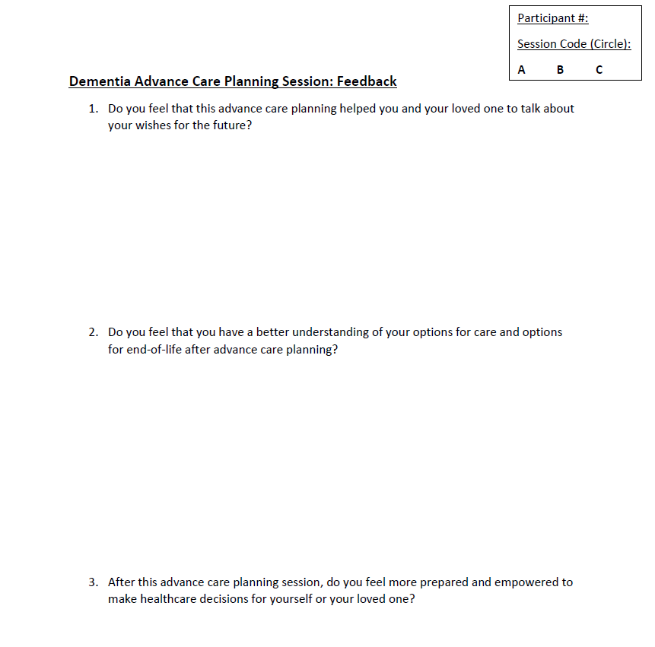
Data Collection Surveys
Notes:
And finally here is the dementia specific ACP qualitative feedback survey. The survey asked three feedback questions about the ACP process and the tool itself.

Slide 22
Results
11 Dyads
Pre-Implementation survey
Dementia-Specific ACP Session
Immediate Post-Implementation Survey
10 Participants w/ Cognitive Deficits & 9 Surrogate Decision-Makers
Three-month Post-Implementation Survey
Notes:
11 Dyads completed the
Pre-Implementation survey
Dementia-Specific ACP Session
Immediate Post-Implementation Survey
After several months of recruitment we were able to recruit 11 dyads. These dyads were composed of first a newly enrolled Care Resources participant who has been diagnosed with dementia or a cognitive impairment or an enrollment MOCA score of 19 or less. The other member of the dyad was a chosen surrogate decision-maker who either was already named or who the participant with cognitive deficit would choose to be their decision-maker in the future.
10 Dyads completed
Three-month Post-Implementation Survey due to a participant death.
10 participants with cognitive deficits completed the 2-3 month follow up since one participant passed away between implementation and follow up. 9 surrogate decision-makers completed 2-3 month follow up. One follow up was lost from the participant who passed away and the second one was unable to be contacted for follow up.

Slide 23
Results: Demographic Data
80-89
70-79
Notes:
Just briefly I will discuss the Demographic data of the participants included in the study sample:
On the left you can see the ethnic make up of our participants with the cognitive deficits. About half of the participants with dementia or a cognitive impairment were Caucasian and approximately the other half were African American with one participant being Hispanic/latino.
On the right are the ages of the participants with cognitive deficit. Just under half of the participants with dementia were 70-79 years old, about one third were 60-69 years old, two 80-89 year olds and one participant from 90-99 years old.

Slide 24
Results: Demographic Data
Spouse
Child
Notes:
The surrogate decision-makers included in the project were a majority children of the participant with dementia. One surrogate decision-maker was a spouse, another a grandchild, and the final surrogate decision-maker was a friend of the participant.

Slide 25
Results: Participant Knowledge Assessment
Z Score | Two-Tailed P Value
-0.241 | 0.809
Not statistically significant
Notes:
Nonparametric analytics were used to analyze the data due to small sample size. Participants with dementia/cognitive impairment knowledge assessment scores before implementation of the ACP tool and scores right after completing the ACP discussion were analyzed. Using the non-parametric Wilcoxon test I looked at this paired data. Thr two tailed p value was 0.809. Because the p value was greater than 0.05 this in not a statistically significant result. Increased knowledge occurred for some participants though the results were not statistically significant.

Slide 26
Results: Surrogate Decision-Maker Knowledge & Confidence Assessment
Decision-Maker Knowledge Scores:
Decision-Maker Confidence Scores:
Z Score | Two Tailed P Value
-2.226 | 0.026
Z Score | Two Tailed P Value
-2.384 | 0.017
Statistically significant improvement
Evidence of improved learning and increased confidence post-ACP session
Notes:
For the surrogate decision-maker confidence and knowledge assessment I again utilized the Wilcoxon test to analyze the relationship of the pre-implementation score and the immediate post-implementation score. For the knowledge assessment variable the two sided p value was 0.026. Decision-makers showed statistically significant improvement in knowledge score.
For the confidence assessment pre-implementation and immediate post-implementation analysis the two sided p value was 0.017. Decision-makers showed a statistically significant increase in confidence assessment scores after the ACP session.
We can conclude that the immediately after the session surrogate decision makers felt increased confidence in knowing the decisions their loved on would want made on their behalf and an improved knowledge about the progression of dementia, the purpose of ACP, and end-of-life care decisions.

Slide 27
Results: Participants with Cognitive Deficits Three-Month Post Knowledge Assessment
No statistically significant differences between the three data collection points
No Change in Learning
Friedman’s Test: alpha value of .05, χ²(2) = 0.24, p = 0.886
Notes:
Non-parametric analytics were used to knowledge assessment scores for the individual with dementia and decision-maker knowledge assessment scores and confidence scores from all three data collection points of pre-implementation, immediately after the ACP session, and two to three months post-implementation for follow up. Intellectus statistics was used to perform Friedman rank sign test..
Analysis showed that there were no significant differences in the participants with cognitive deficits’ score between any of the three data collection points. The resulting p value was 0.886. Therefore we can conclude no statistically significant improvement for the participants with cognitive deficits.
There is no change in increased knowledge across the three data points. This could indicate that there is learning retention although there was no statistically significant improvement.

Slide 28
Results: Surrogate Decision-Maker Three-Month Post Knowledge Assessment
Statistically significant difference among the three data collection points.
Surrogate decision-makers showed increase in knowledge scores and retained their knowledge at the follow up.
Friedman’s test: alpha value of .05, χ²(2) = 8.00,
p = 0.018
Notes:
For the surrogate decision-maker knowledge assessment we again utilized Friedman’s test. The resulting p value was 0.018.
Therefore we can conclude that the results showed that the surrogate decision-makers had a statistically significant improvement in knowledge assessment scores across the three points of data collection. The surrogate decision-makers had an improvement in knowledge and retained their knowledge over time.

Slide 29
Results: Surrogate Decision-Maker Three-Month Post Confidence Assessment
Statistically significant difference among the three data collection points.
Surrogate decision-makers showed increase in confidence scores and retained their confidence at the follow up.
Friedman’s Test: alpha value of .05, χ2(2) = 10.58, p = 0.005
Notes:
Friedman’s test was used again for the confidence assessement. The p value resulted as 0.005. This was statistically significant and therefore we can conclude that the surrogate decision-makers had improvement in confidence assessment scores across the three points of data collection. The surrogate decision-makers had an improvement in their confidence to perform the role of decision-maker and advocate and retained their confidence over time.

Slide 30
Healthcare Utilization Rates
Combined ED and Inpatient Admissions for project participants
Avoiding 2 Potential ED Visits/Inpatient Admissions= Cost Savings of $4,064-11,996
Pre-Implementation Combined Visits:
Total: 11
Post-Implementation Combined Visits:
Total: 9
(Duncan et al.,2019; Parker, 2019)
Notes:
I performed chart reviews on the project sample participants. For the my project sample, a combined ED and Inpatient admission rate was obtained. The pre-implementation total was 11. Post-implementation the total combine ED and inpatient healthcare utilization rate was 9. It should be noted that the participant who passed away during the project accounted for 4 of the post-implementation visits. Her visits to the ED resulted in her signing up with hospice according to her documented wishes.
PACE program participants are encouraged to call the triage nurse before going to the ED, with the exception of life-threatening incidents such as a fall/chest pain/possible stroke/etc., the triage nurse then recommends either to go to the ED or sets up follow up for the program participant with the appropriate interdisciplinary healthcare team member. Some of the reasons the project visited the ED either before of after implementation included acute/chronic pain, constipation, fatigue, bowel ischemia, falls, cognitive impairment, and acute confusion. Care Resources tracks and monitors all ED visits and inpatient admissions. Their goal is to decrease their total healthcare utilization rates including ED visits and inpatient stays by using their multidisciplinary team and chain of care as much as possible to control costs.
According to Duncan et al., the average inpatient medicare cost per day within 1-3 days of a patient’s death is $5983. And an average ED visit is $2032 according to a study by United Healthcare. By preventing two inpatient stays or ED visits PACE saved an estimated $4064-11,966 in medicare costs.

Slide 31
Results: Qualitative Feedback Questionnaire
Three qualitative questions
Facilitating Conversation
Improved Understanding
Empowered Decision-Making
90.9% of Dyads answered positively to the questions
Notes:
After the ACP sessions a qualitative questionnaire was completed by the dyads. The three questions included on the questionnaire are seen here.
90.9 % of the dyads answered positively to all three of the questions. Additional response themes included:
“conversation” The session helped facilitate conversation.
“understanding” The tool helped provide understanding.
“Resources and care options” The tool and session helped educate about available resources and options for care.

Slide 32
Sustainability Plan
Feedback from Social Work team
Post-Implementation Review
Buy-In from:
Social Work Team
Primary Care Provider Team
Notes:
The Sustainability plan:
Feedback from the social work team
-post-implementation survey was administered to the social work team to gain feedback on what worked well for the PACE population and what things should be adjusted for continued use.
2. Post-Implementation Review
-I analyzed the project process, outcomes, feedback, and personal experience from facilitating the project. This analysis informed suggested changes to the ACP process for continued improvements.
3. Buy-In from
Obtaining feedback from the PCP and social work team allowed for continued work.

Slide 33
Social Work Feedback Survey: Results
Four Respondents to Survey
All respondents felt that ACP tool fit their PACE population
Provided good education about dementia progression & care options
Length was biggest concern
For Future Use:
Add more empathetic language
More questions about mental health
Include in enrollment process
Add information about completing DPOA-HC
Notes:
Four Respondents to Survey
All respondents felt that ACP tool fit their PACE population. On a scale of 1-5 (one being does not fit at all and 5 fits the population very well) all respondents rated the tool as 4-5.
Provided good education about dementia progression & care options.
Length was biggest concern. With the necessary data collection surveys the required length of time needed to complete the ACP sessions, 1 to 1.5 hours, was noted to be too long. However, without the data collection tools completing the ACP tool itself took on average 30-45 minutes. This time requirement is much more in line with what the social work team is able to accomplish and fit into their current workflow.
For Future Use:
Add more empathetic language
More questions about mental health
Include in enrollment process
Add information about completing DPOA-HC

Slide 34
Limitations
Small sample size
Minimal qualitative feedback
Varying stages of cognitive decline
Notes:
Limitations:
Small sample size
-Only 11 dyads total included with one dyad excluded from the three month follow up secondary to the participant with dementia passing away during the course of the project
Minimal qualitative feedback
-Qualitative questions should have offered more open-ended questions to elicit more in-depth responses
3. Varying Stages of cognitive decline
- Some participants had more progressed cognitive decline making it more difficult for them to participate in the ACP discussion and the data collection.

Slide 35
Hopes for the Future: Implications for Practice
Consistent ACP Process for New Enrollees
1
ACP Process that Informs Individualized Plan of Care
2
Facilitate Conversation b/w Participant w/ Dementia and their Loved Ones
3
Consistently improve healthcare utilization rates at Care Resources
4
Notes:
Establish a consistent ACP process for new Care Resources enrollees
Create an ACP process that informs future plan of care for participants with cognitive decline
Facilitate ACP conversations between the participant with dementia and their surrogate decision maker
Consistently improve healthcare utilization rates at Care resources

Slide 36
Plan for Dissemination
Present at PACE
Abstract submitted to Sigma Theta Tau local research event
Submit to Journals
Notes:
I already was privileged to present my findings and the outcome of my work at Care resources to both the social work and the PCP team.
I also have submitted my abstract to the local Sigma fall research event.
I am planning to submit my project to journals. Some potential journal candidates include the NACNS journal, journal of applied gerontology, and Dementia journal

Slide 37
Acknowledgments
Drs. Mihelich & Wyatt- DNP Advisory Team
Dr. Laura Hall- PACE Organizational Mentor
Ryanne Mondry and PACE SW Team
My family & friends
Notes:
I would like to thank my DNP advisory team of Dr. Mihelich and Dr. Wyatt.
I would also like to thank Dr. Laura Hall, Ryanne Mondry, and the whole Care Resources social work team for their months of collaboration.
Finally I would like to thank my family and friends who spent many hours supporting and encouraging me. And my maternal grandmother who’s own journey with dementia inspired my work today and my paternal grandfather who always believed I could do anything I set my mind to.

Slide 38
Questions?

Slide 39
References
Alzheimer’s Association. (2022). 2022 Alzheimer’s Disease Facts and Figures. https://www.alz.org/media/Documents/alzheimers-facts-and-figures.pdf
Bosisio, F., Sterie, A. C., Rubli Truchard, E., & Jox, R. J. (2021). Implementing advance care planning in early dementia care: results and insights from a pilot interventional trial. BMC Geriatrics, 21(1). https://doi.org/10.1186/s12877-021-02529-8
Care Resources. (2021a, October 29). What is PACE? Retrieved June 14, 2022, from https://careresources.org/what-is-pace/
Dixon, J., Karagiannidou, M., & Knapp, M. (2018). The Effectiveness of Advance Care Planning in Improving End-of-Life Outcomes for People With Dementia and Their Carers: A Systematic Review and Critical Discussion. Journal of Pain and Symptom Management, 55(1), 132–150.e1. https://doi.org/10.1016/j.jpainsymman.2017.04.009
Duncan, I., Ahmed, T., Dove, H. G., & Maxwell, T. L. (2019). Medicare cost at end of life. American Journal of Hospice and Palliative Medicine, 36(8), 705–710. https://doi.org/10.1177/1049909119836204
Fried, T. R., Cohen, A. B., Harris, J. E., & Moreines, L. (2021). Cognitively Impaired Older Persons’ and Caregivers’ Perspectives on Dementia‐Specific Advance Care Planning. Journal of the American Geriatrics Society, 69(4), 932–937. https://doi.org/10.1111/jgs.16953
Geddis‐Regan, A., Errington, L., Abley, C., Wassall, R., Exley, C., & Thomson, R. (2020). Enhancing shared and surrogate decision making for people living with dementia: A systematic review of the effectiveness of interventions. Health Expectations, 24(1), 19–32. https://doi.org/10.1111/hex.13167
Gotanda, H., Walling, A. M., Reuben, D. B., Lauzon, M., & Tsugawa, Y. (2022). Trends in advance care planning and end‐of‐life care among persons living with dementia requiring surrogate decision‐making. Journal of the American Geriatrics Society, 70(5), 1394–1404. https://doi.org/10.1111/jgs.17680
Huang, H. L., Lu, W. R., Liu, C. L., & Chang, H. J. (2020). Advance care planning information intervention for persons with mild dementia and their family caregivers: Impact on end-of-life care decision conflicts. PLOS ONE, 15(10), e0240684. https://doi.org/10.1371/journal.pone.0240684
Kim, H., Cho, J., Park, W. S., & Kim, S. S. (2021). Characteristics of Advance Care Planning Interventions Across Dementia Stages: A Systematic Review. Journal of Nursing Scholarship, 53(2), 180–188. https://doi.org/10.1111/jnu.12624
Ma, H., Kiekhofer, R. E., Hooper, S. M., Dulaney, S., Possin, K. L., & Chiong, W. (2021). Goals of Care Conversations and Subsequent Advance Care Planning Outcomes for People with Dementia. Journal of Alzheimer’s Disease, 83(4), 1767–1773. https://doi.org/10.3233/jad-210720
McEwen, M., & Wills, E. M. (2014). Theoretical Basis for Nursing (4th ed.). Lippincott Williams & Wilkins.
Michigan Dementia Coalition. (2019). 2019-2022 ROADMAP FOR CREATING A DEMENTIA CAPABLE MICHIGAN. In Dementia Coalition. https://www.midementiacoalition.org/roadmap
National Health Service. (2021). A Model for Measuring Quality Care. In Online Library of Quality, Service Improvement, and Redesign Tools. National Health Service Improvement. https://www.med.unc.edu/ihqi/wp-content/uploads/sites/463/2021/01/A-Model-for-Measuring-Quality-Care-NHS-Improvement-brief.pdf
Parker, J. (2019). $32 billion price tag for avoidable emergency room visits. Hospice News. https://hospicenews.com/2019/07/30/32-billion-price-tag-for-avoidable-emergency-room-visits/
Sellars, M., Chung, O., Nolte, L., Tong, A., Pond, D., Fetherstonhaugh, D., McInerney, F., Sinclair, C., & Detering, K. M. (2018). Perspectives of people with dementia and carers on advance care planning and end-of-life care: A systematic review and thematic synthesis of qualitative studies. Palliative Medicine, 33(3), 274–290. https://doi.org/10.1177/0269216318809571
Wendrich-van Dael, A., Bunn, F., Lynch, J., Pivodic, L., van den Block, L., & Goodman, C. (2020). Advance care planning for people living with dementia: An umbrella review of effectiveness and experiences. International Journal of Nursing Studies, 107, 103576. https://doi.org/10.1016/j.ijnurstu.2020.103576

