Slide 1
Assessing the Impact:
A Program Evaluation of a Nursing Leadership-Led Clinical Debrief
Brandon Tatar MSN, APRN, ACCNS-AG
Chair: Karen Mihelich DNP, ACCNS-AC

Slide 2
Introduction
The demands of the healthcare environment provides repeated exposure to death, trauma, violence, and other unexpected outcomes to healthcare professionals.
These clinical events in tandem with other work-related stressors increases the risk of burnout.
  Patient acuity
  Lack of resources
  Staffing constraints
  Early recognition, intervention, and awareness of high-stressed clinical events is crucial.
  Clinical debriefing allows for an organization to recognize traumatic events and provided support while promoting quality improvement

Slide 3
Background & Significance of Clinical Debriefing
Clinical debriefing: clinical reflection that allows for improving performance and process while promoting a supportive work culture.
  Reflective discussion of actions and processes
  Opportunity for learning through interpersonal feedback
  Identify larger system-level issues in patient care
Personal & Organizational Benefits
  Increase clinical performance of healthcare professionals
  Inform improvement to clinical processes
  Improve communication and teamwork
  Support for emotional needs
The use of a formalized clinical debriefing process remains underutilized within clinical practice.

Slide 4
Local Problem
Level III Trauma Center in Southeast Michigan
The critical care Clinical Nurse Specialist identified the need to implement a formalized clinical debriefing process.
An interdisciplinary team established a formalized clinical debrief process
Clinical debrief process identified nursing leadership as the optimal debrief facilitator.

Slide 5

Problem Statement/Clinical Question
The organization recently implemented a new clinical debrief process and organizational leadership lack a clear understanding of impact of this new debrief process.
Clinical Questions:
Is the clinical debrief process being utilized?
Are nursing leaders actively participating in the debrief of clinical events and can they be considered an experienced facilitator?
What is nursing staff’s perception of clinical debriefing?
The organization must evaluate the clinical debriefing structure to optimize the process and maximize the potential benefits for the individual staff, teams, systems, and patients.

Slide 6
Literature Review
Debrief framework and tools
24 different frameworks and tools identified.
Frameworks identified the five E’s model as effective attribute to include in the debrief process.
  Experience Facilitator
  Environment
  Education
  Evaluation
  Emotions
Framework needs to meet the unique needs of the organization.
Debriefing inclusion criteria
“Major clinical events” was the primary indication for conducting a debrief.
  Cardiac arrest, intubation, or adverse outcomes.
“Staff request”
  A staff member asking for a debrief was an acceptable criterion for the initiation of a debriefing.

Slide 7
Literature Review
Barriers to clinical debriefing
Absence of a clear protocol and structure
Lack of a trained facilitator
Lack of Time
Emotions and Well-being
Well-being of staff is not always considered with debriefing.
Neglecting to address emotions may lead to higher incidences of work-related stress, leading to occupation burnout and affecting patient care

Slide 8

Gaps in Literature
Limited validation and comparison between frameworks
  Little validation or generalization within these frameworks to suggest sustainability outside of the organization of which it was created.
  Data cannot be generalizable to other populations
No gold standard of debrief facilitation education or experience
  Frameworks failed to depict the required education to become a facilitator
  Inconsistency within the chosen experience facilitator

Slide 9
Project Purpose and Objectives
Considering the importance of continuously monitoring the debrief process, this program evaluation seeks to appraise the utilization and feasibility of the newly implemented framework for facilitating a clinical debrief.
The purpose is to evaluate:
Feasibility of conducting a clinical debrief after a high-stressed clinical event through peer surveys.
Utilization of the clinical debrief tool by examining the number of documented debrief sessions with the total number of clinical events such as cardiopulmonary arrest, rapid response, or code stroke.
Ability of the clinical debrief session and tool to address the associate's well-being and the use of emotional support resources.
Ability of the clinical debrief session and tool to identify opportunities for practice changes through the reported strengths and weaknesses within the completed documents.
Organizational barriers to conducting a clinical debrief.
Nursing Leadership is the most appropriate to facilitate clinical debriefing.
Clinical debriefing process meets the five E’s model’s key attributes of clinical debriefing.

Slide 11
Theoretical and Conceptual Framework
The 5 E's of Debriefing
Describe the critical characteristics of clinical debriefing and are stressed as necessary component for the productivity of the debrief.
  Educated/Experience facilitator
  Environment
  Education
  Evaluation
  Emotions
Theory of Reflective Practice in Nursing
Highlights the potential of reflection to optimize nursing practice.
Assumes a person consist of multiple dimensions and event or clinical situations affect the person and the processes and results.
Promotes that reflection brings about personal and professional development, resulting in improved care outcomes.

Slide 12
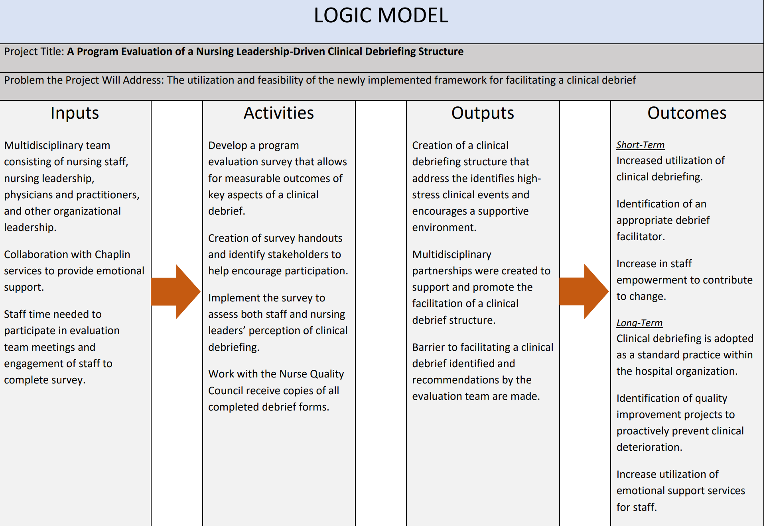

Slide 13
Organization Assessment
Strengths
Support from organizational leadership and its origins rooted in the nursing staff’s request to debrief.
Weakness
Lack of awareness from nursing staff and other providers regarding the debriefing process.
Opportunity
Increase utilization in support services for staff.
Decrease in staffs reported negative emotional from stressful clinical events.
Threats
Other organizations have well-adopted support services for hospital employees

Slide 14

Methodology

Slide 15
Method & Design
Project Design
Program evaluation with a mixed-methods design.
Setting and Sample
Evaluation will be conducted on the inpatient units.
Excludes the emergency department, clinical decision unit, and outpatient procedural areas
Survey participants include nursing and nursing support staff.
Nursing leadership will conduct a separate survey evaluation.
Evaluation will be conducted based on the first four months of its implementation.

Slide 16
Method & Design
Data Collection
Quantitative and Qualitative data was collected from completed debrief form with the six-month evaluation period.
  A generated report of all cardiac arrest events will be obtained to evaluate the utilization of the debrief session.
  Evaluation surveys will be sent to both nursing staff and nursing leaders regarding their experience with participating in a clinical debrief session.
The Five E’s Model of debriefing will guide as an approach to empirically measure the successfulness of a nurse leaders as a debrief facilitator.
  Survey questions will be categorized by they perspective key attribute of the Five E’s model.

Slide 17
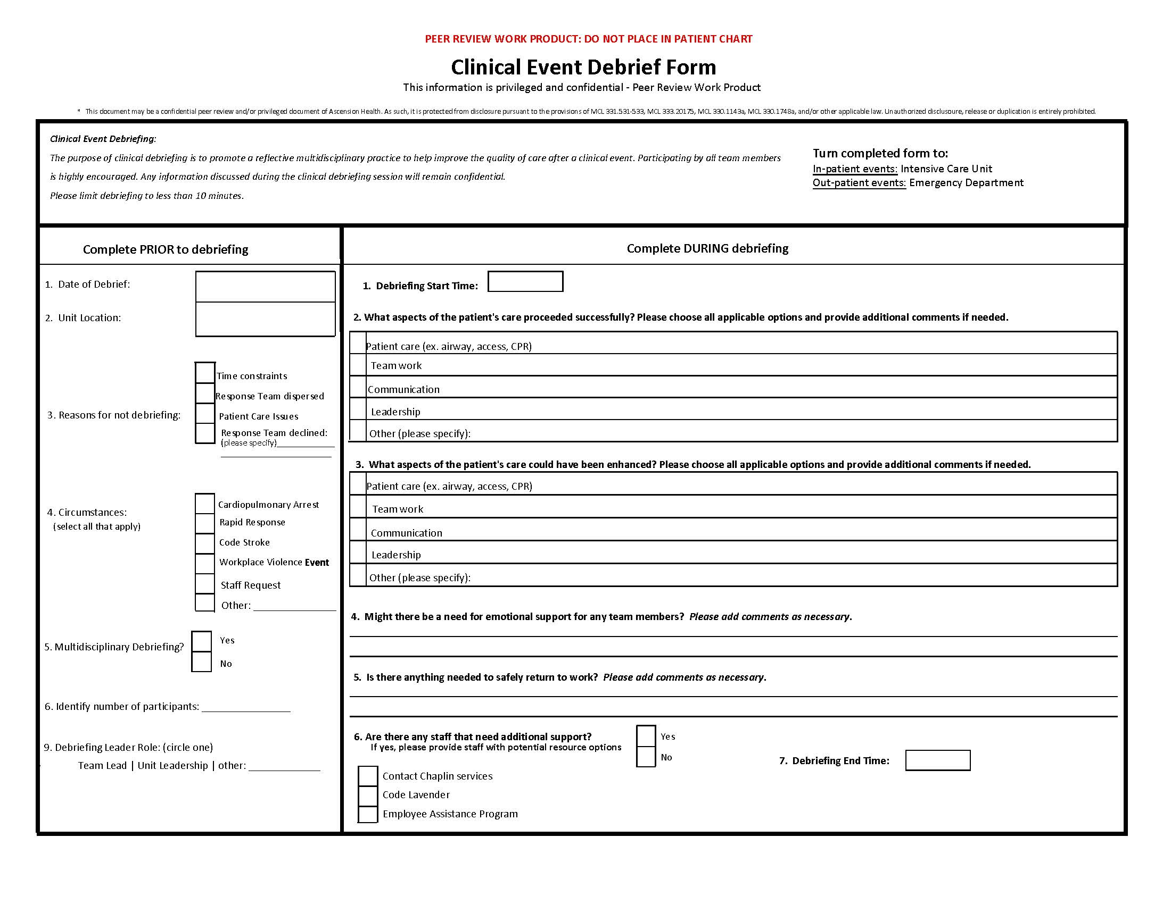

Slide 18
Outcome Measures
/
The total number of completed clinical debrief sessions.
The number of debriefing session completed with an identified debrief leader as nursing leadership.
The ability of the facilitator to meet all key elements of debriefing.
Satisfaction of the session by the facilitators and participants.
Utilization of support resources from staff.

Slide 19
Method & Design
Statistical Methods
Descriptive statistics and the Likert scale will measure the frequency with which each key attribute affected the clinical debrief process.
Kruskal Wallis test was used to assess differences in satisfaction by unit population and years of experience.
Thematic analysis will be conducted to identify themes regarding the participants’ perceptions of the debriefing process.
Ethical considerations
Project granted IRB exception for not human subject research.
Participation in survey evaluations was voluntary.

Slide 20
Results

Slide 21
Clinical Debrief Sessions
Strength
  Teamwork (n=13, 76.5%)
    “appropriate number of compressors”
    “smooth transition between compressors”
Opportunity for Improvement
  Communication (n=8, 47.1%)
    Crowd control and poor closed-loop communcation
    “too many people in room causing loud noise levels”
Emotional Support
  35.3% (n=6) support needs were identified
  Chaplin services was most utilized (n=3)
47% (n=17) clinical debrief session were conducted
76.5% (n=13) of clinical debrief session were led by a nursing leaders
  Clinical Nurse Managers: 12
  Team Lead/House Supervisor: 1
Average debrief session: 4.8 minutes
Average number of participants: 6

Slide 22

Nursing and Nursing Support Evaluations
Participation
  70 staff members participated in the survey
  45.7% (n=32) of associates stated participating in a clinical debrief session
    10 from critical care.
    13 from medical/surgical.
    9 from cardiac telemetry
  Lack of awareness was the most identified barrier to participation (n=14, 20.0%)
  Time constraints was reported by 13 associates (18.6%).
  Medical/surgical population has the most associates decline to participate (n=4).
  6 associates identified an absence of a facilitator as a barrier.

Slide 23
Crosstabulation of unit populations with position and barriers to participation (Table A)
 | Unit Population
Variables | Critical Care (n= 18) | Medical/Surgical (n= 27) | Cardiac Telemetry (n= 25) | Total (n= 70)
No. of participants in Clinical Debriefing | 10 (55.6) | 13 (48.1) | 9 (36.0) | 32 (45.7)
Position
Registered Nurse | 14 (77.8) | 18 (66.7) | 23 (92.0) | 55 (78.6)
Unlicensed Assistive Personal | 4 (23.2) | 9 (33.3) | 2 (8.0) | 15 (21.4)
Barriers to Clinical Debriefing
Choice not to participate | 0 (0.0) | 4 (14.8) | 0 (0.0) | 4 (5.7)
Team unaware of the Clinical Debrief process | 3 (16.7) | 7 (25.9) | 4 (16.0) | 14 (20.0)
Absence of an experience facilitator | 3 (16.7) | 0 (0.0) | 3 (12.0) | 6 (8.6)
Time Constraints | 1 (5.6) | 5 (18.5) | 7 (28.0) | 13 (18.6)
Patient Care Needs | 2 (11.1) | 2 (7.4) | 2 (8.0) | 6 (8.6)
Team Dispersion | 1 (5.6) | 1 (3.7) | 2 (8.0) | 4 (5.7)
Team Declined | 0 (0.0) | 0 (0.0) | 1 (4.0) | 1 (1.4)

Slide 24

Nursing and Nursing Support Evaluations
Facilitator’s Performance (based on the 5’E Model)
  Emotions was the best performed attribute of the facilitators
    Addressing well-being and offering emotional support resources ( 4.62).
  Environment was the lowest performing attribute of the facilitators
    Ability to encourage participation from all associates (4.34)
  Cardiac Telemetry associates ranked facilitators performance the highest in each attribute compared to critical care and medical/surgical associates.
  Each key attribute had a satisfactory score

Slide 25
Crosstabulation of unit populations with satisfaction and facilitator performance (Table B)
 | Unit Population
Variables | Critical Care (n= 10) | Medical/Surgical (n= 13) | Cardiac Telemetry (n= 9) | Total (n= 32)
Position
Registered Nurse | 9 (90.0) | 10 (76.9) | 8 (88.9) | 27 (84.3)
Unlicensed Assistive Personal | 1 (10.0) | 3 (23.1) | 1 (11.1) | 5 (15.6)
5 E's of Clinical Debriefing
Experience Facilitator
Session was organized with clear purpose and expectations | 4.50 | 4.23 | 4.67 | 4.44
Environment
Facilitator provided a psychologically safe space | 4.50 | 4.54 | 4.78 | 4.59
Facilitator encouraged participation for everyone | 4.60 | 4.00 | 4.56 | 4.34
Education
Facilitator provided opportunity for personal and professional growth | 4.40 | 4.38 | 4.78 | 4.50
Evaluation
Facilitator encouraged exchange of ideas to improve care | 4.60 | 4.38 | 4.67 | 4.53
Emotion
Facilitator addressed wellbeing and provided support | 4.60 | 4.54 | 4.78 | 4.62
Facilitator provided clarity regarding outcomes of the event | 4.30 | 4.54 | 4.67 | 4.50
Satisfaction
Overall Experience | 4.20 | 4.15 | 4.44 | 4.25
Likelihood to adopt in practice | 4.20 | 4.62 | 4.78 | 4.53

Slide 26
Survey Questions and the 5 E’s key attributes (Figure A)
Experienced Facilitator | Q1. The debrief leader explained the purpose of the debrief session and clarified expectation and objectives from the start
Environment | Q2. The debrief leader used a nonthreatening but honest approach, creating a psychologically safe environment
 | Q3. The debrief leader encouraged participation of all associates; invites participants to actively contribute to the discussion
Education | Q4. The debrief leader gives feedback on performance and provides an opportunity for personal and professional growth
Evaluation | Q5. The debrief leader allowed me to voice my ideas to improve patient care and/or hospital workflow
Emotion | Q6. The debrief leader asked about my feelings and well-being, and provided additional support resources if needed
 | Q7. The debrief leader provided a sense of clarity regarding the outcomes of the clinical event

Slide 27
Satisfaction
Cardiac Telemetry associates were the most satisfied population
  Overall experience: 4.44
  Likelihood to adopt into practice: 4.78
Kruskal-Wallis Test was not statistically significant for both overall experience and adoption into practice
  Overall experience: x2 (0.5), df (2), p= 0.781
  Adoption into practice: x2 (0.68), df (2), p= 0.711
Associates with 10 or more years of experience were the most satisfied population
  Overall experience: 4.45
  Likelihood to adopt into practice: 4.82
Kruskal-Wallis Test was not statistically significant for both overall experience and adoption into practice
  Overall experience: x2 (0.67), df (2), p= 0.714
  Adoption into practice: x2 (1.62), df (2), p= 0.445
Satisfaction & Unit Population
Satisfaction & Years of Experience

Slide 28
Frequency table for years of experience and satisfaction (Table 3)
 | Years of Experience
Variables | 1-4 years (n= 8) | 5-9 years (n= 13) | 10 years or more (n= 11) | Total (n= 32)
Satisfaction
Overall Experience | 4.00 | 4.23 | 4.45 | 4.25
Likelihood to adopt in practice | 4.50 | 4.31 | 4.82 | 4.53

Slide 29

Nursing Leadership Evaluations
6 Clinical Nurse Manager completed an evaluation
  No evaluations were completed by the Team Leads/House Supervisors
The most identified barrier to conducting a clinical debrief was team dispersion (n=3, 50.0%)
The critical care clinical nurse managers (n=2) chose not to participate in facilitating a clinical debrief session and stated a low interest in adopting clinical debriefing into their practice.
Very Satisfied overall experience from those that participated (n=3, 5).

Slide 30
Discussion

Slide 31
Associate’s Experience
Kruskal-Wallis Test determined no statistical significance in satisfaction of clinical debriefing between unit populations and years of experience.
Clinical Significance in the satisfaction of clinical debriefing among adult in-patient populations
  Most studies focus on “more stressful” clinical environment such as emergency and critical care medicine.
  Satisfaction score were higher in the cardiac telemetry population than the critical care population
Clinical Significance in the satisfaction of clinical debriefing regardless of years of experience
  Associates with 10 years or more of experience had higher satisfaction rates
Likelihood to adopt score are higher than the overall experience score
  Staff understand importance and relevance of clinical debriefing even if experience was subpar
  Concept consistent and proven in literature

Slide 32

Associate’s Experience
Clinical Debriefing can be an effective stress-reducing intervention in all healthcare population
  Preconceived biases may explain the lack of diversity in current clinical debriefing literature
  More studies should focus on phenomenon outside of the traditional “high-stress” clinical environments.

Slide 33

Emotional Needs
Sharing of emotional needs by staff was only occurred in 6 clinical debrief events (35.6%).
The ability of the facilitator to address emotional well-being and support was ranked highest of all key attributes.
“I have not had someone asks me that questions before…I almost didn’t know what it meant”
Only 3 events occurred in which an emotional support resources was utilized.

Slide 35
Nursing Leadership & Facilitation
Nursing leadership was able to meet all five key attribute of clinical debriefing, indicating that they may be considered an experienced facilitator.
The experienced facilitator plays a vital role in the satisfaction of clinical debriefing
Cardiac telemetry associate's leadership evaluations ranked highest as well as staff’s overall experience
Dissatisfaction is associated with poor organization and is a result of the debrief facilitator
Medical/surgical associates had the lowest organizational score and the lowest satisfaction scores
Nursing leaders' attitude towards debriefing may impact staff satisfaction and participation
Critical Care low adoption into practice score compared with Critical Care leadership’s willingness to facilitate

Slide 36
Clinical Questions
Are nursing leaders actively participating in the debrief of clinical events and can they be considered an experienced facilitator?
76% clinical debrief session led by nursing leaders
Nursing leaders can incorporate all key aspects of clinical debriefing making them an experienced facilitator
What is nursing staff’s perception of clinical debriefing?
Overall satisfactions rates were satisfactory across all unit populations
Is the clinical debrief process being utilized?
Nursing leaders as an experienced facilitator does not inherently increase utilization
Only a 47% utilization rate

Slide 37
Program Modifications
Ensure Debrief Form availability.
Incorporate debrief form into the daily code cart checklist.
Allows debrief form to be an “orderable” form by unit.
Nursing leadership remains primary facilitator but encourage further education for executive leaders and others
Healthcare professionals who received clinical debriefing education are more willing to participate and initiate clinical debriefing practices (Toews et al., 2021).
Incorporating non-nursing leaders may increase utilization in times when leadership coverage may be limited

Slide 38
Sustainability
Clinical Debrief forms should continue to be monitored by the organization to ensure staff well-being and accessibility to engage in debriefing.
Quality Improvement project derived from the clinical debriefing should be disseminated to organizational leaders
Cost-benefit analysis can occur between the outcomes associated with clinical debriefing and the time spend participating in debrief sessions
Clinical Debrief education incorporated into Mock Codes, ALCS/BLS Skills Classes, and orientation

Slide 39
Implications to Practice
Enhance and complement existing literature and knowledge of promoting and implementing a clinical debrief process.
  No know study to examine nursing leadership as an experience facilitator.
Nursing leaders can be considered as an experienced facilitator but do not inherently increase utilization
Selection of a specific facilitator may limit utilization

Slide 40

Thank You!
Faculty Chair:
  Dr. Karen Mihelich DNP, ACCNS-AG
Organizational Chair:
  Laurie O’Dell MSN, RN
Multidisciplinary Committee:
  Anna Reseigh BSN, RN
  Garrett Hartinger DNP, APRN, AGCNS-AG
  Kathy Scarpa BSN, RN
  Paige Harris BSN, RN
  Ronny Hadid M.D
  Amar Charugundla D.O
  Meaghan Shaum RRT

Slide 41
References
Al-Majid, S., Carlson, N., Kiyohara, M., Faith, M., & Rakovski, C. (2018). Assessing the degree of Compassion Satisfaction and compassion fatigue among critical care, oncology, and Charge Nurses. Journal of Nursing Administration, 48(6), 310–315. https://doi.org/10.1097/nna.0000000000000620
Coggins, A., Santos, A. D., Zaklama, R., & Murphy, M. (2020). Interdisciplinary clinical debriefing in the emergency department: An observational study of learning topics and outcomes. BMC Emergency Medicine, 20(1). https://doi.org/10.1186/s12873-020-00370-7
Conoscenti, E., Martucci, G., Piazza, M., Tuzzolino, F., Ragonese, B., Burgio, G., Arena, G., Blot, S., Luca, A., Arcadipane, A., & Chiaramonte, G. (2021). Post-crisis debriefing: A tool for improving quality in the Medical Emergency Team System. Intensive and Critical Care Nursing, 63. https://doi.org/10.1016/j.iccn.2020.102977
Galutira, G. D. (2018). Theory of Reflective Practice in Nursing Gemma. International Journal of Nursing Science, 8(3), 51–56. https://doi.org/10.5923/j.nursing.20180803.02
Hale, S. J., Parker, M. J., Cupido, C., & Kam, A. J. (2020). Applications of postresuscitation debriefing frameworks in emergency settings: A systematic review. AEM Education and Training, 4(3), 223–230. https://doi.org/10.1002/aet2.10444
Jiffry, A. J., Cho, C. S., Schmidt, A. R., Pham, P. K., & Nager, A. L. (2023). A mixed methods needs assessment for a debriefing intervention following critical cases. Academic Pediatrics, 23(1), 85–92. https://doi.org/10.1016/j.acap.2022.05.015

Slide 42
References
Intellectus Statistics [Online computer software]. (2024). Intellectus Statistics. https://statistics.intellectus360.com/
Nerovich, C., Derrington, S. F., Sorce, L. R., Manzardo, J., & Manworren, R. C. (2023). Debriefing after critical events is feasible and associated with increased compassion satisfaction in the Pediatric Intensive Care Unit. Critical Care Nurse, 43(3), 19–27. https://doi.org/10.4037/ccn2023842
Phillips, E. C., Smith, S. E., Tallentire, V., & Blair, S. (2023). Systematic Review of Clinical Debriefing Tools: Attributes and evidence for use. BMJ Quality & Safety. https://doi.org/10.1136/bmjqs-2022-015464
Polit, D., & Beck, C. (2020). Nursing research. Wolters Kluwer Health.
Rose, S., & Cheng, A. (2018). Charge nurse facilitated clinical debriefing in the emergency department. Canadian Journal of Emergency Medicine, 20(5), 781–785. https://doi.org/10.1017/cem.2018.369
Sandhu, N., Eppich, W., Mikrogianakis, A., Grant, V., Robinson, T., Cheng, A., & Canadian Pediatric Simulation Network (CPSN) Debriefing Consensus Group (2014). Postresuscitation debriefing in the pediatric emergency department: a national needs assessment. CJEM, 16(5), 383–392.

Slide 43
References
Schmutz, J. B., & Eppich, W. J. (2017). Promoting learning and patient care through shared reflection. Academic Medicine, 92(11), 1555–1563. https://doi.org/10.1097/acm.0000000000001688
Scott, Z., O’ Curry, S., & Mastroyannopoulous, K. (2022). The impact and experience of debriefing for clinical staff following traumatic events in clinical setting: A systematic review. Journal of Traumatic Stress, 35, 278-287. https://doi.org/10.1002/jts.22736
Sugarman, M., Graham, B., Langston, S., Nelmes, P., & Matthews, J. (2021). Implementation of the ‘take stock’ hot debrief tool in the ED: A quality improvement project. Emergency Medicine Journal, 38(8), 579–584. https://doi.org/10.1136/emermed-2019-208830
Toews, A. J., Martin, D. E., & Chernomas, W. M. (2021). Clinical debriefing: A concept analysis. Journal of Clinical Nursing, 30(11–12), 1491–1501. https://doi.org/10.1111/jocn.15636
Welch-Horan, T. B., Mullan, P. C., Momin, Z., Eggers, J., Lawrence, J. B., Lichliter, R. L., & Doughty, C. B. (2022). Team debriefing in the covid-19 pandemic: A qualitative study of a hospital-wide clinical event debriefing program and a novel qualitative model to analyze debriefing content. Advances in Simulation, 7(1). https://doi.org/10.1186/s41077-022-00226-z
Zinns, L. E., Mullan, P. C., OʼConnell, K. J., Ryan, L. M., & Wratney, A. T. (2020). An Evaluation of a New Debriefing Framework: REFLECT. Pediatric emergency care, 36(3), 147–152. https://doi.org/10.1097/PEC.000000000000111

